Slide 1
Test Configuration & Result

Slide 2
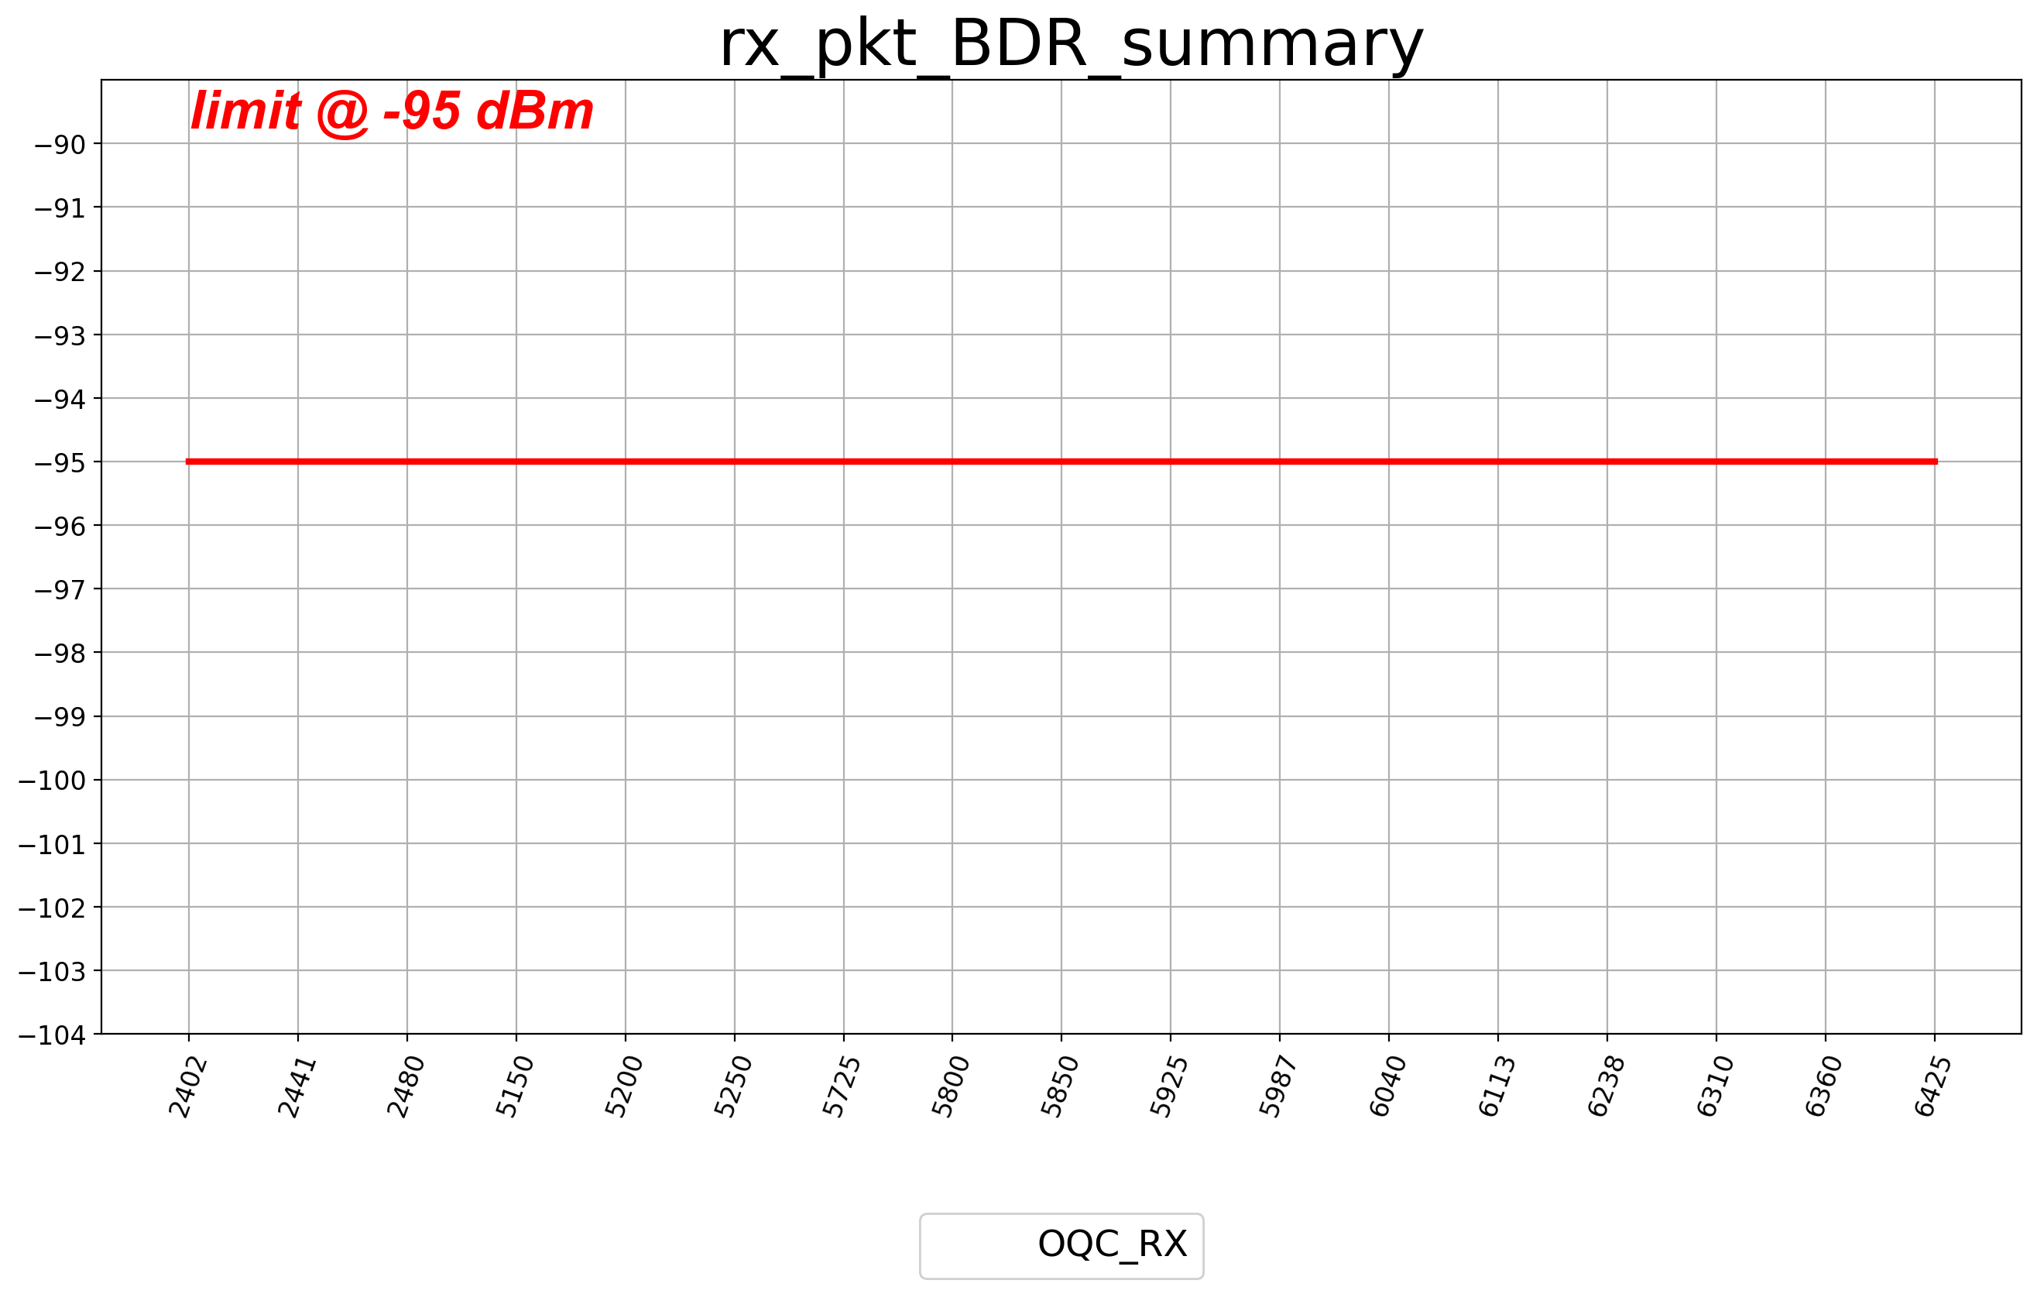
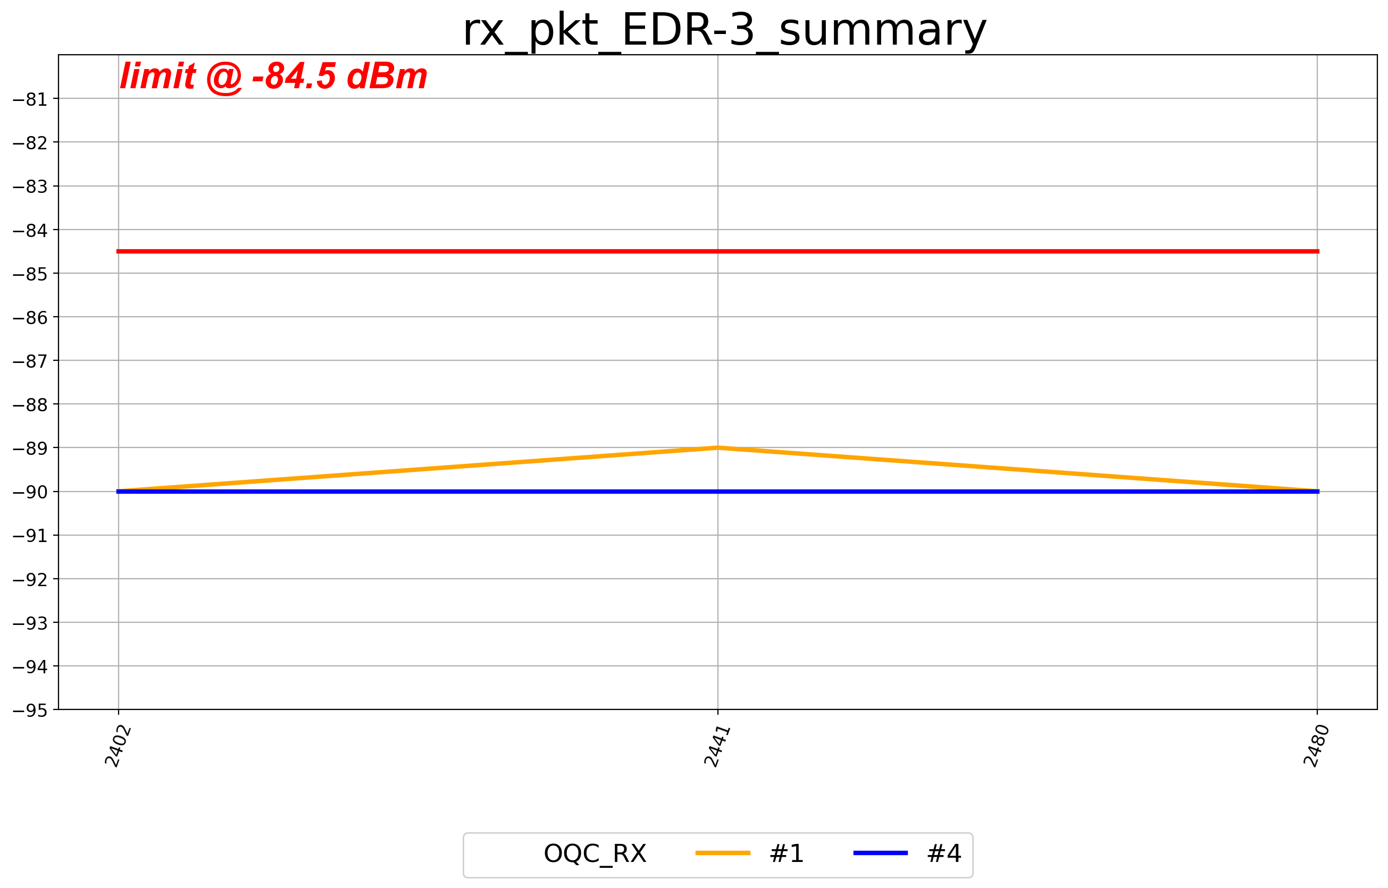
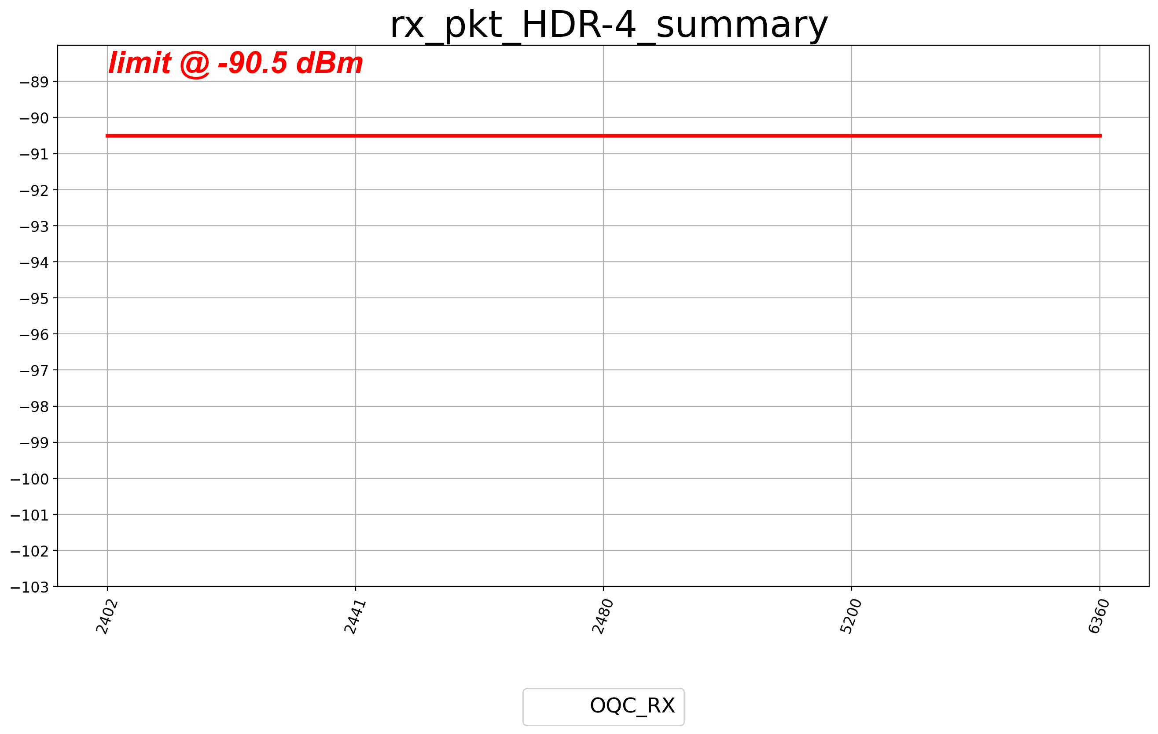
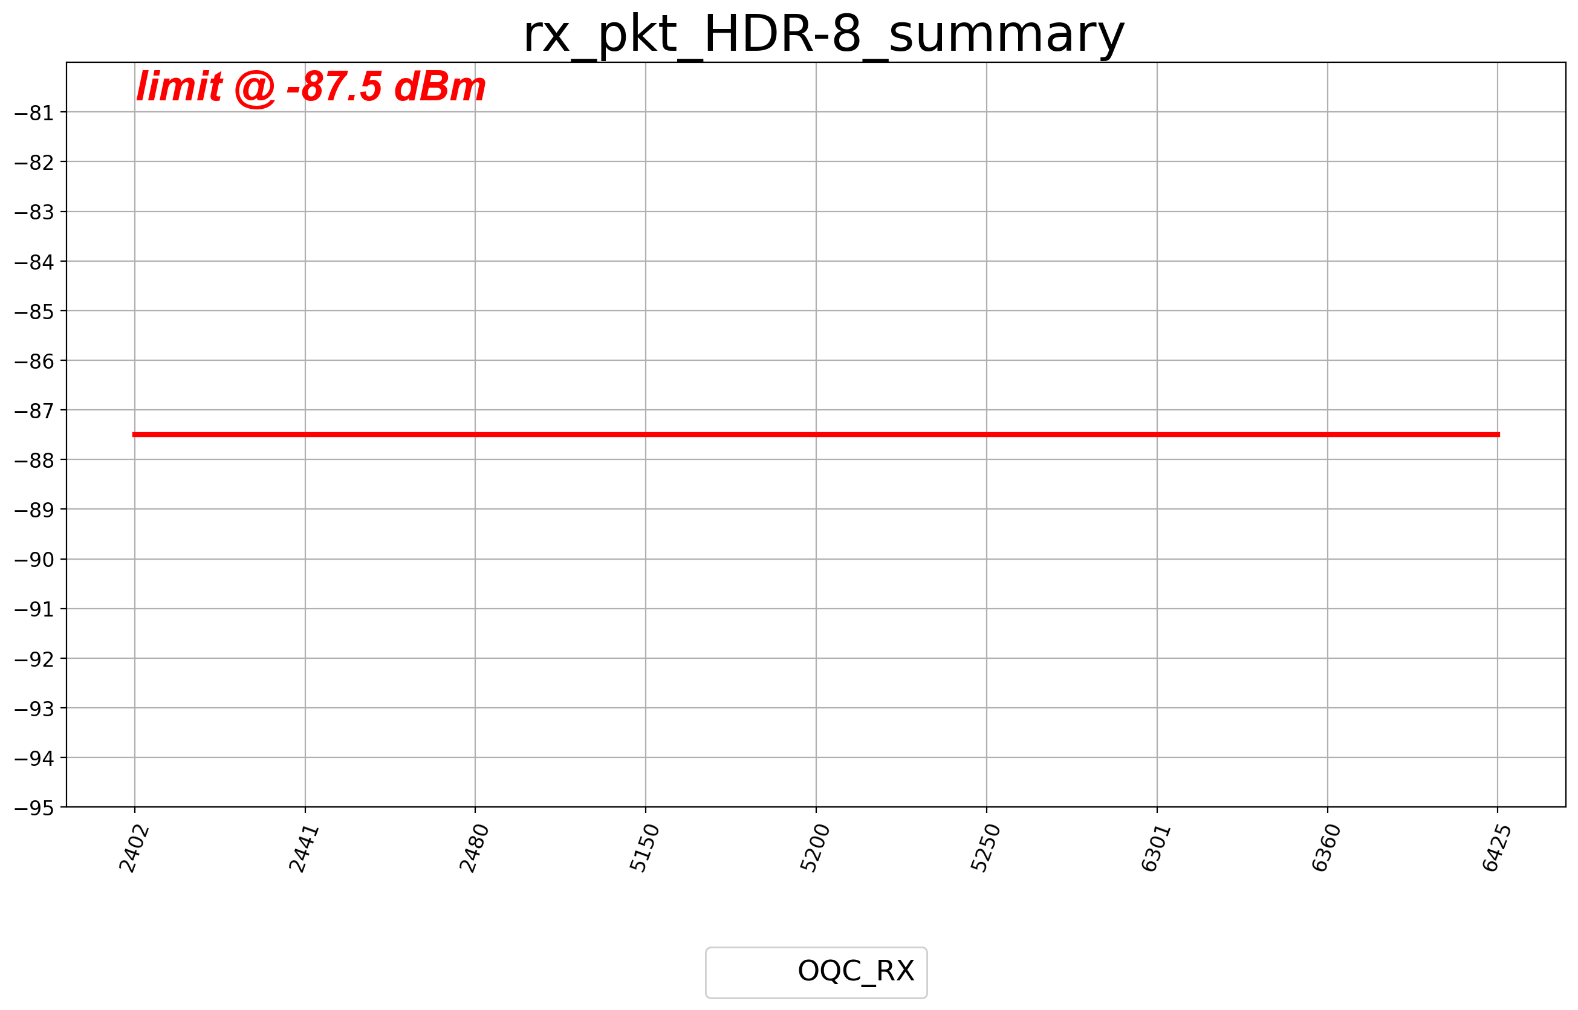
Sensitivity summary

Slide 3
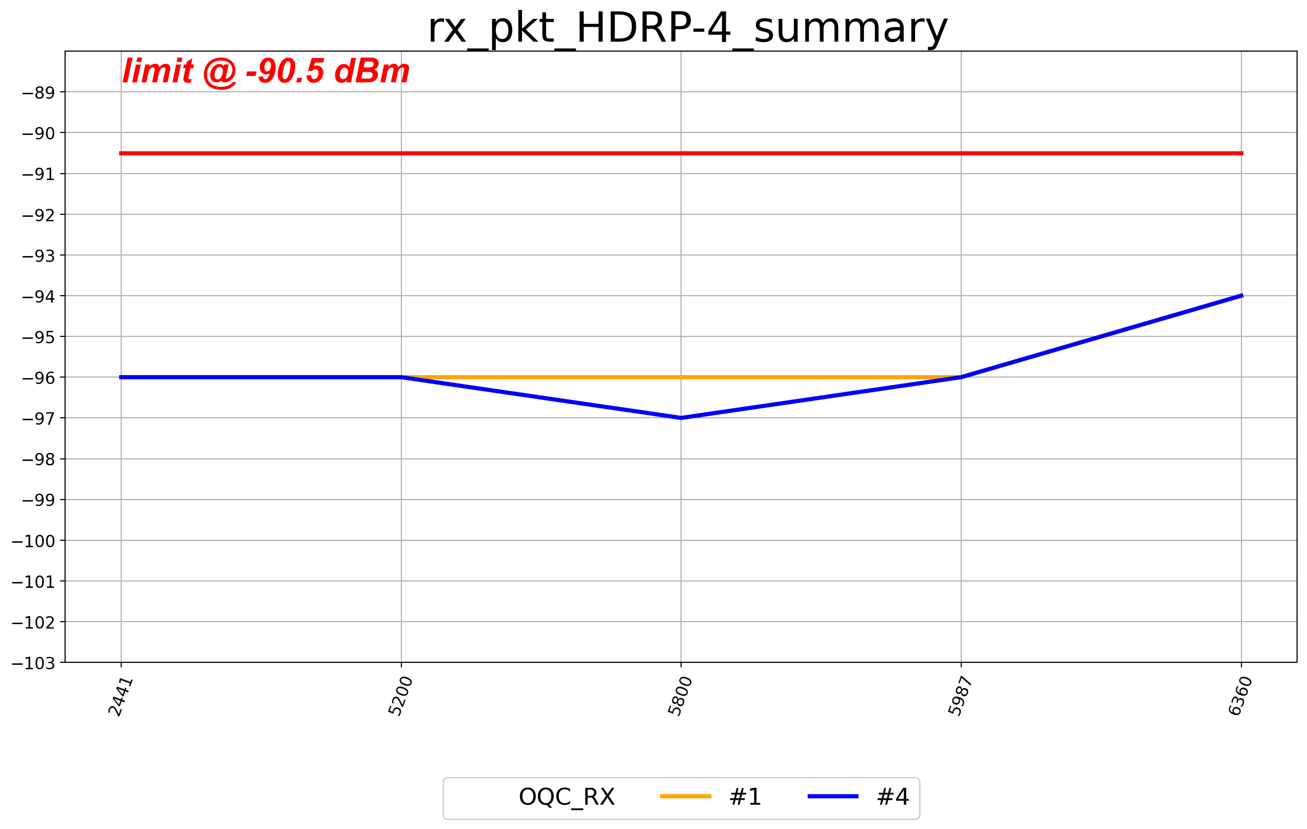
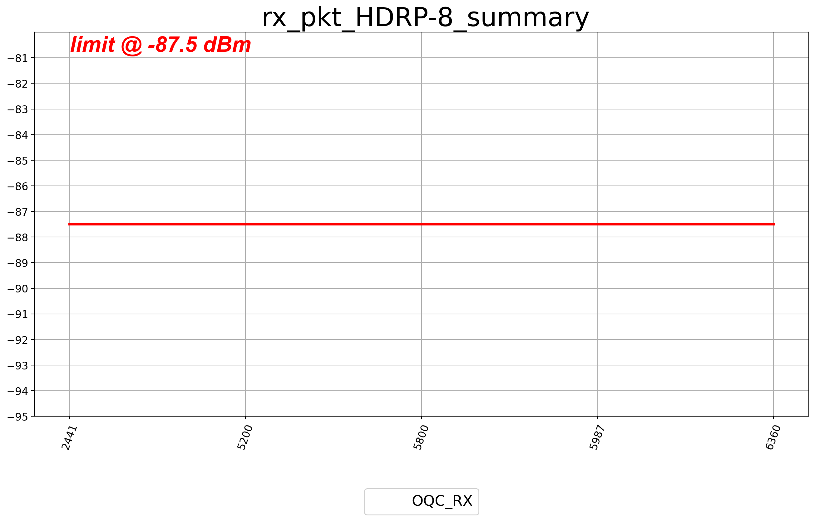
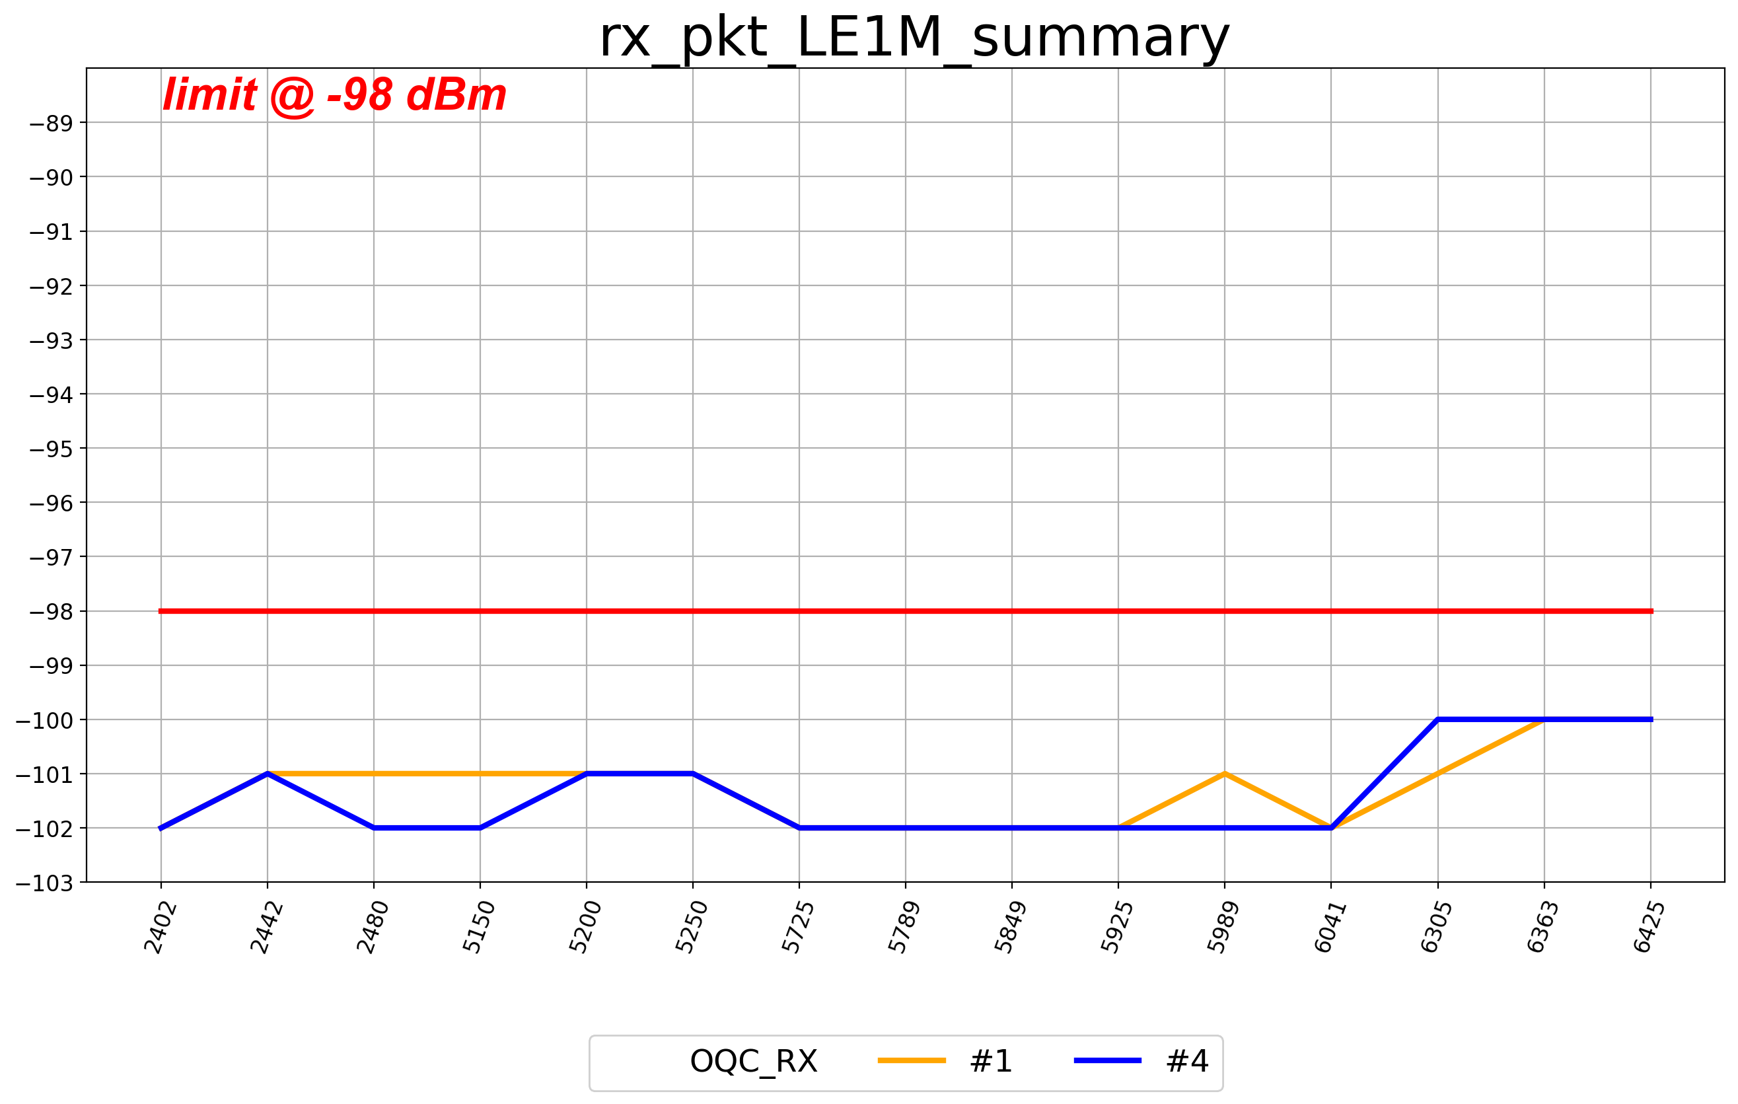
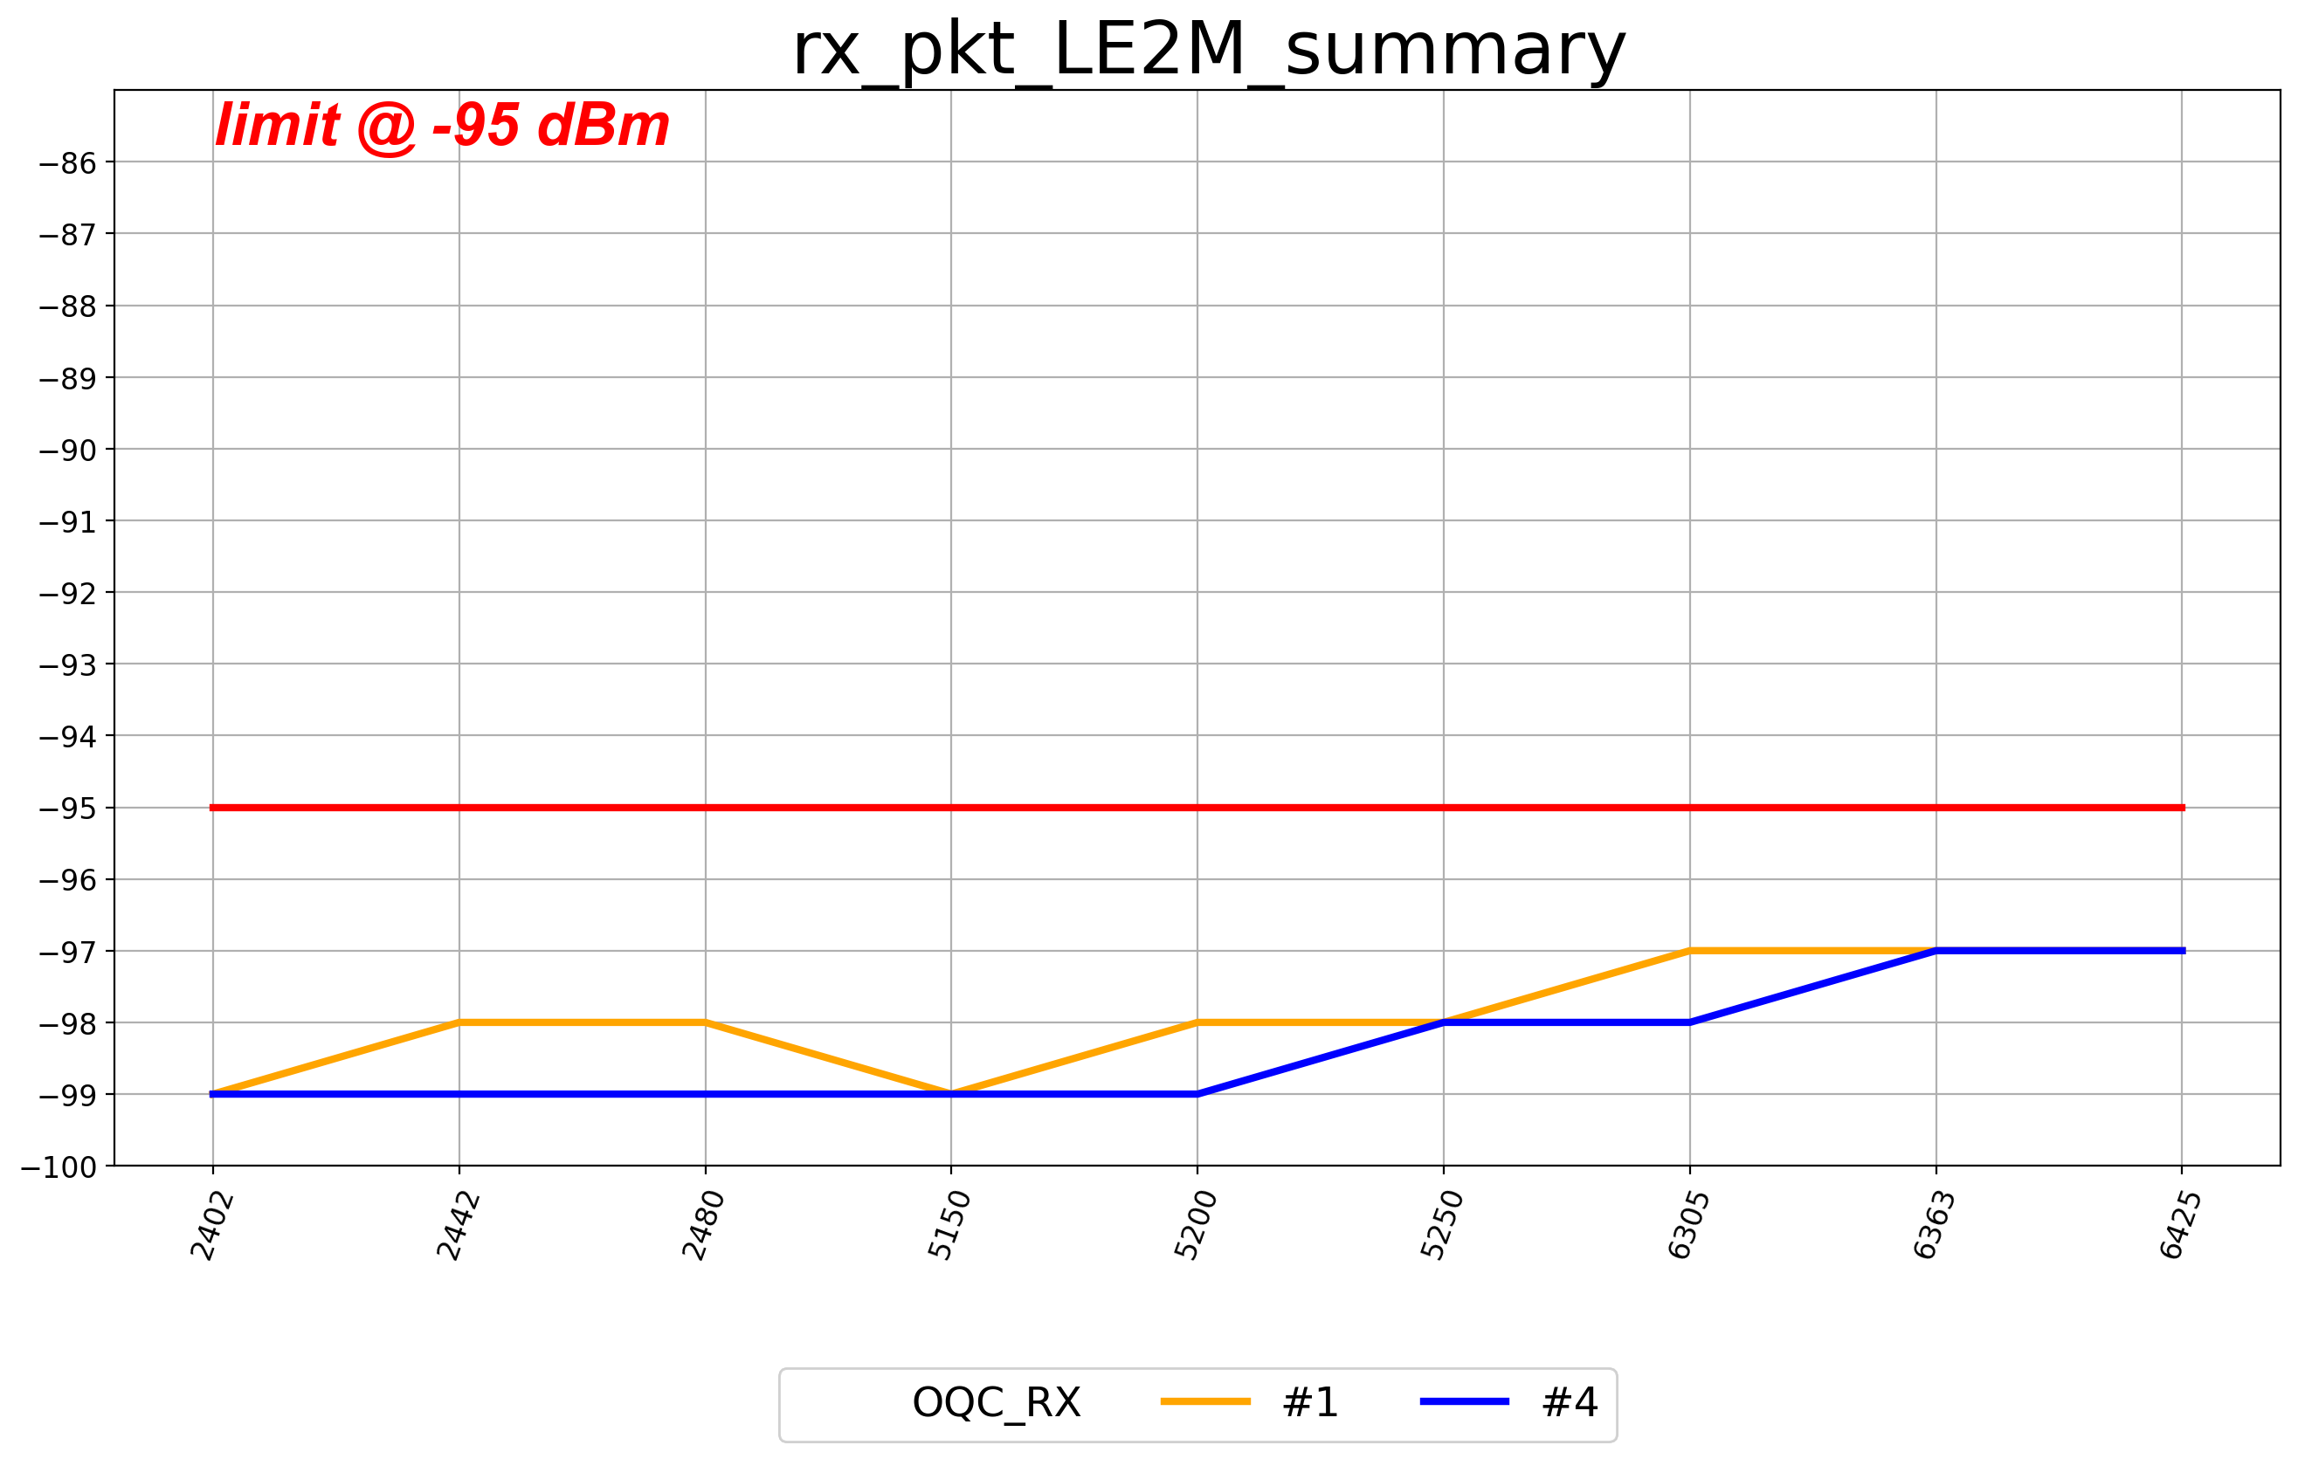
1Sensitivity summary

Slide 4
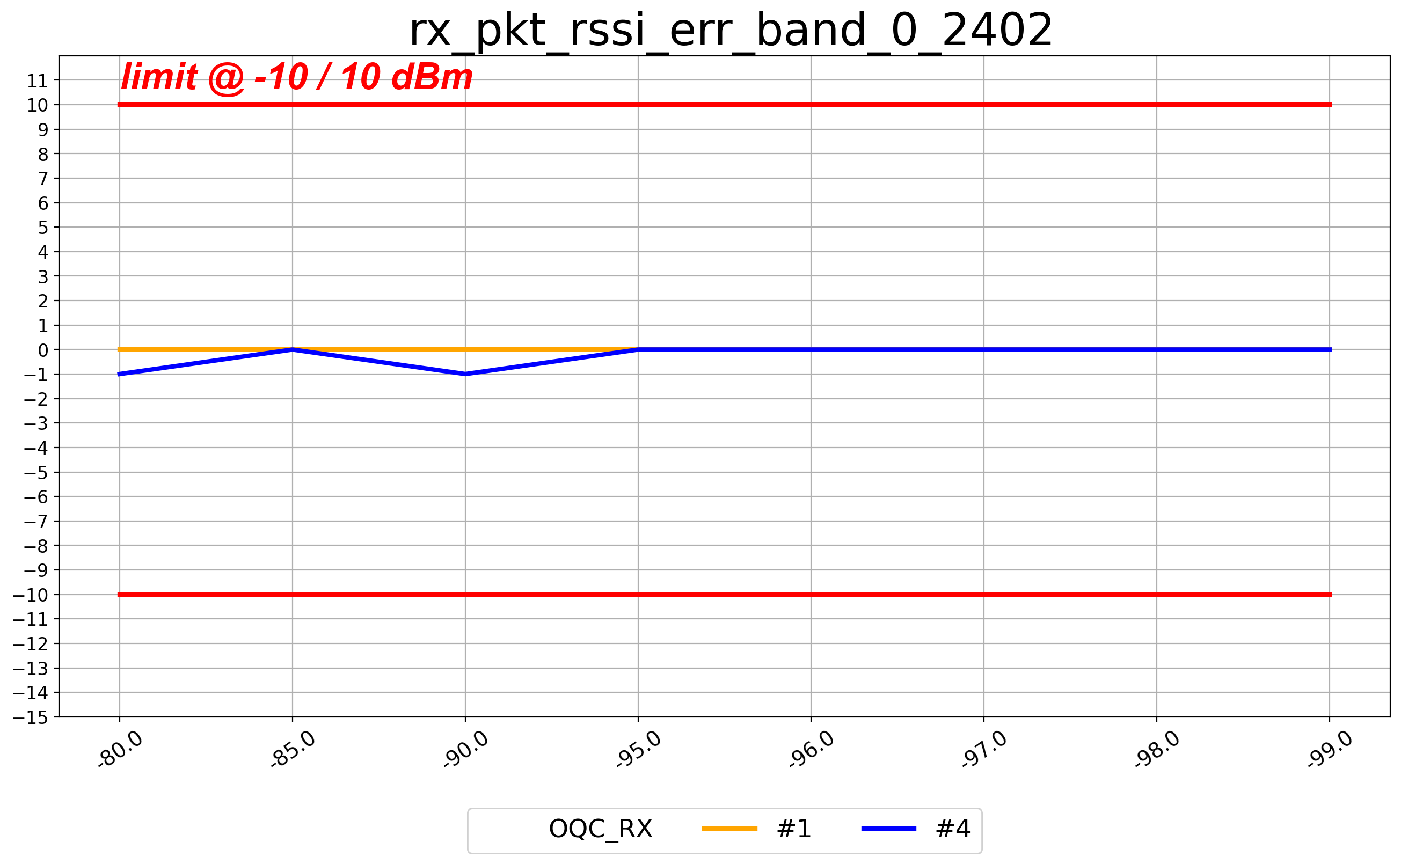
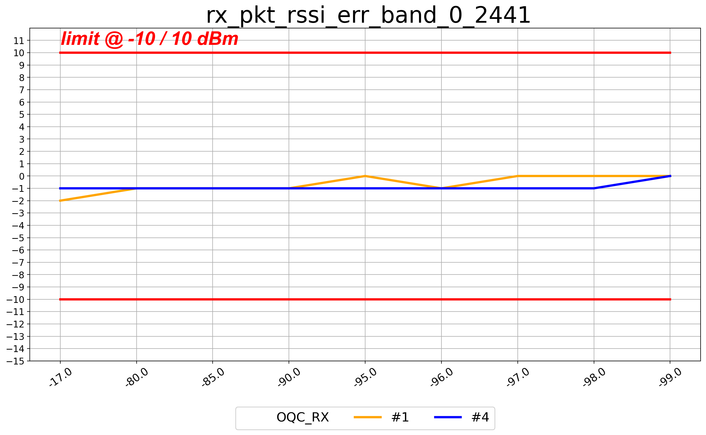
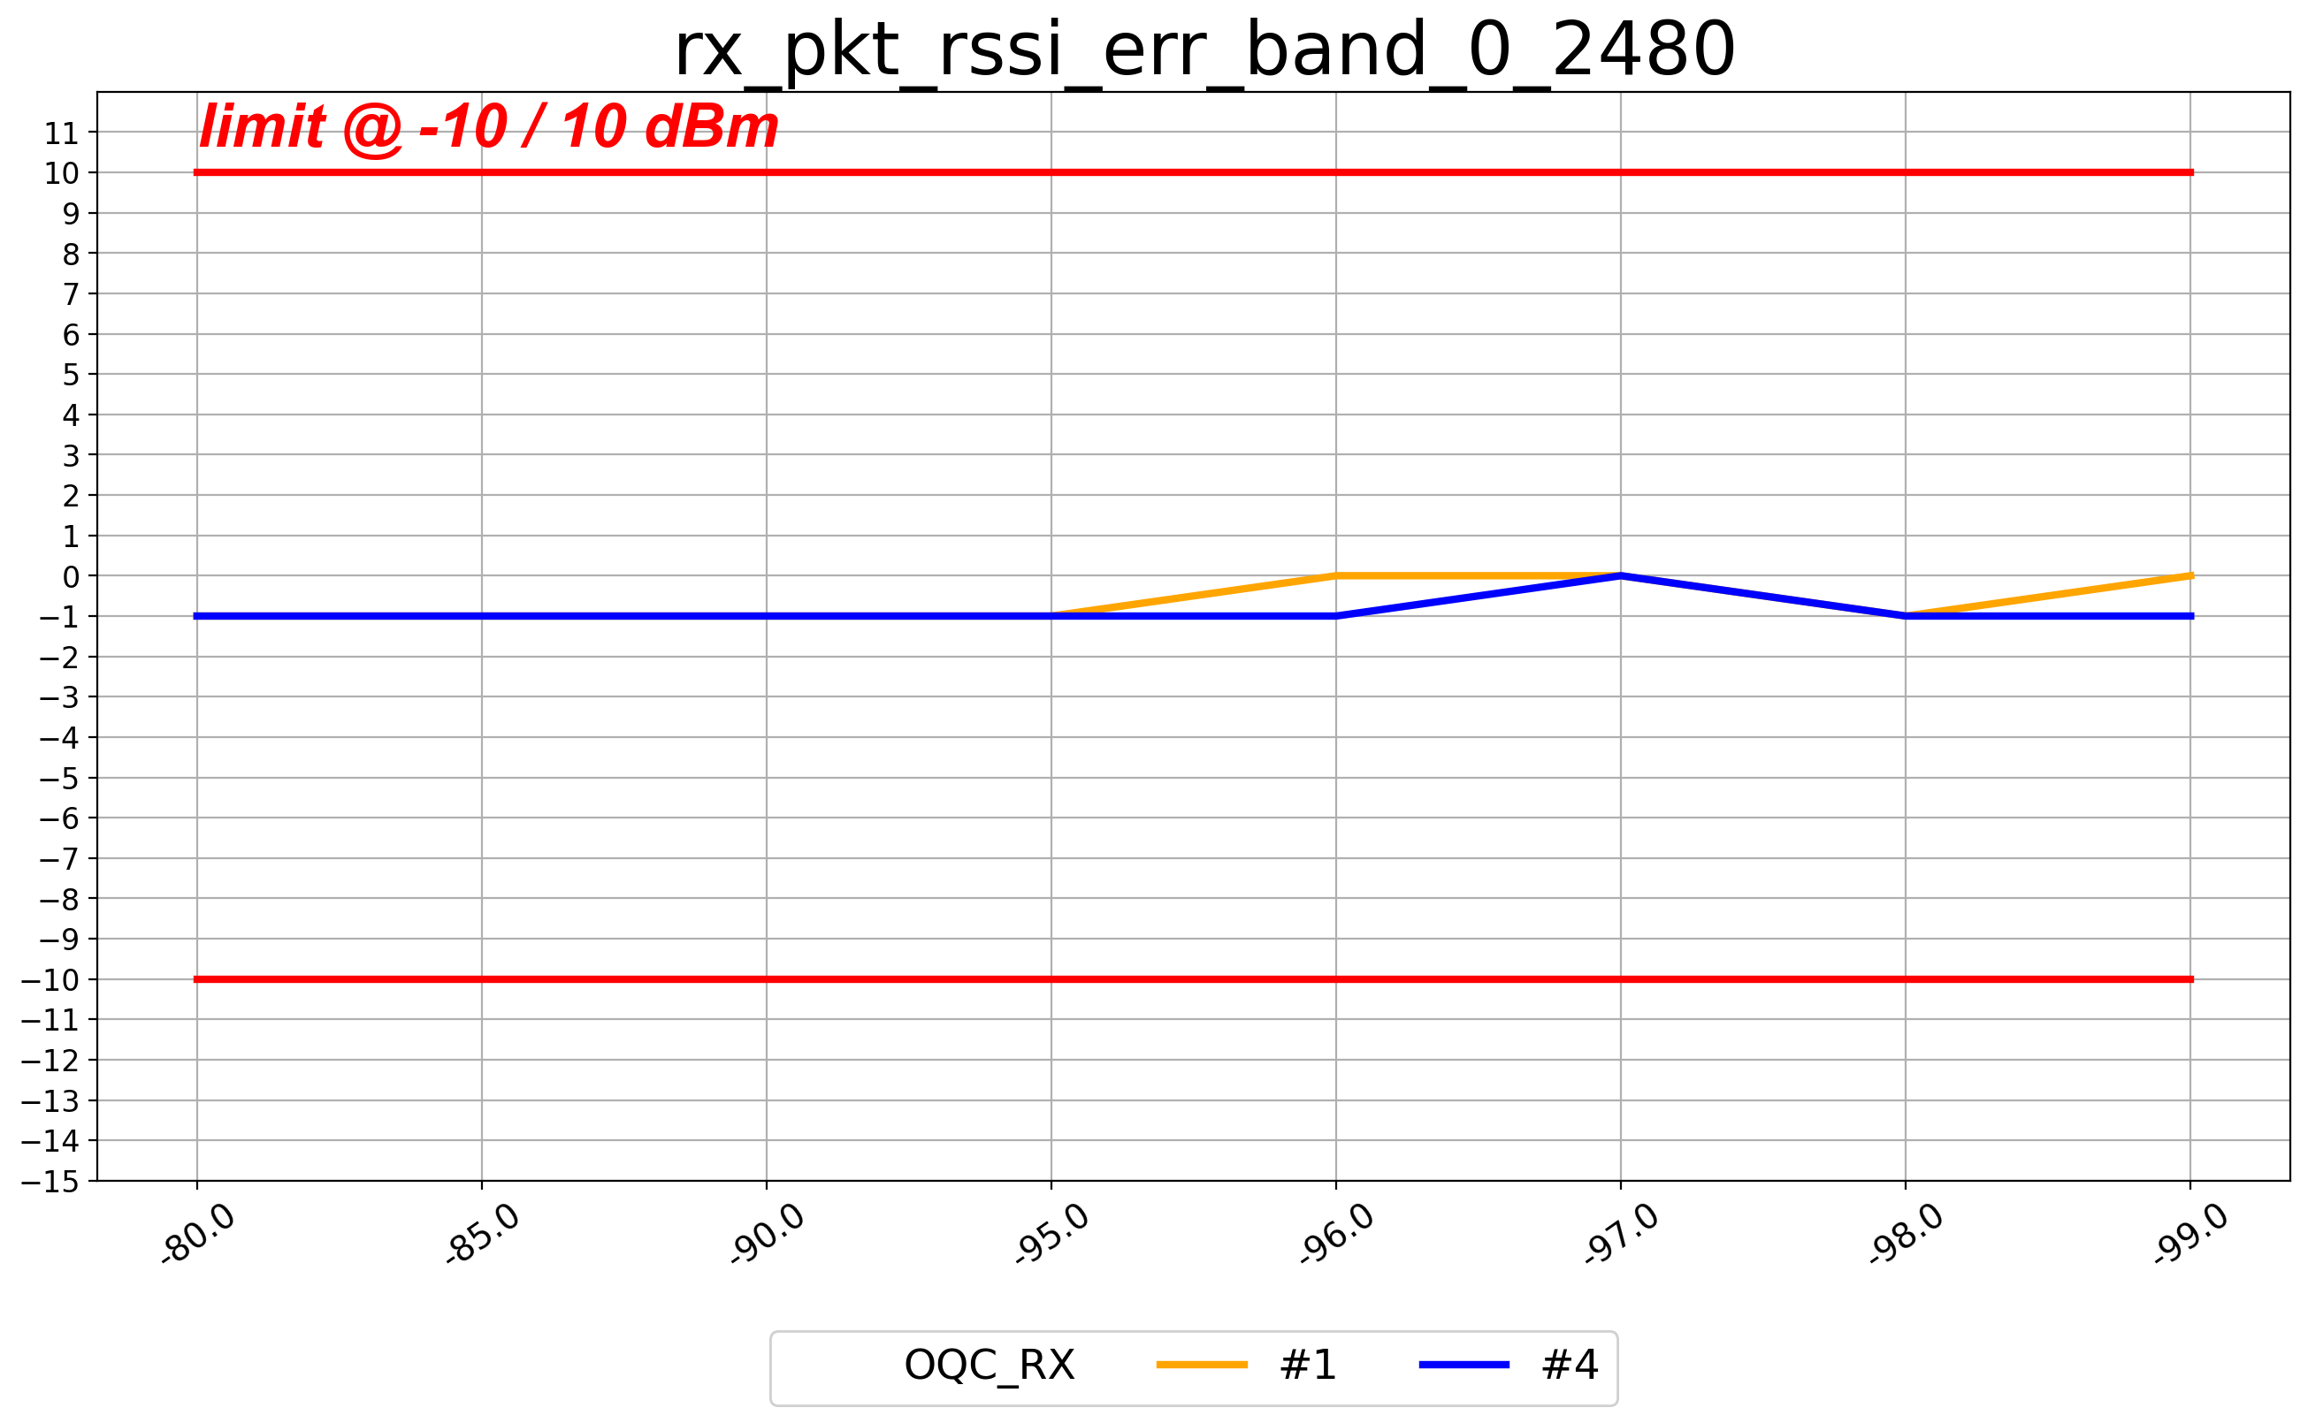
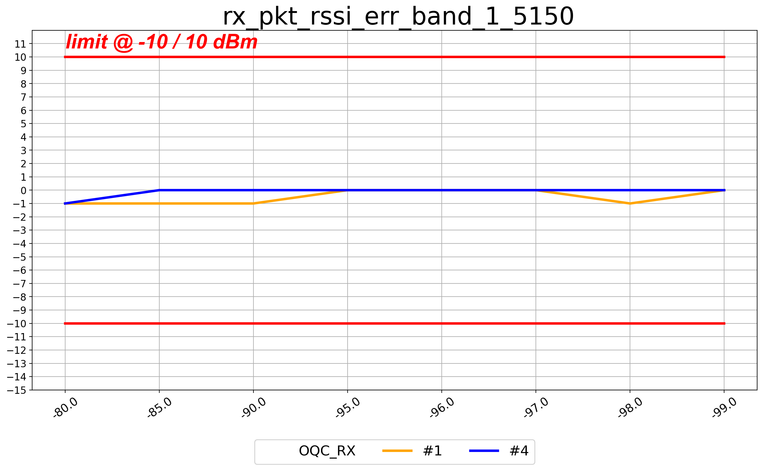
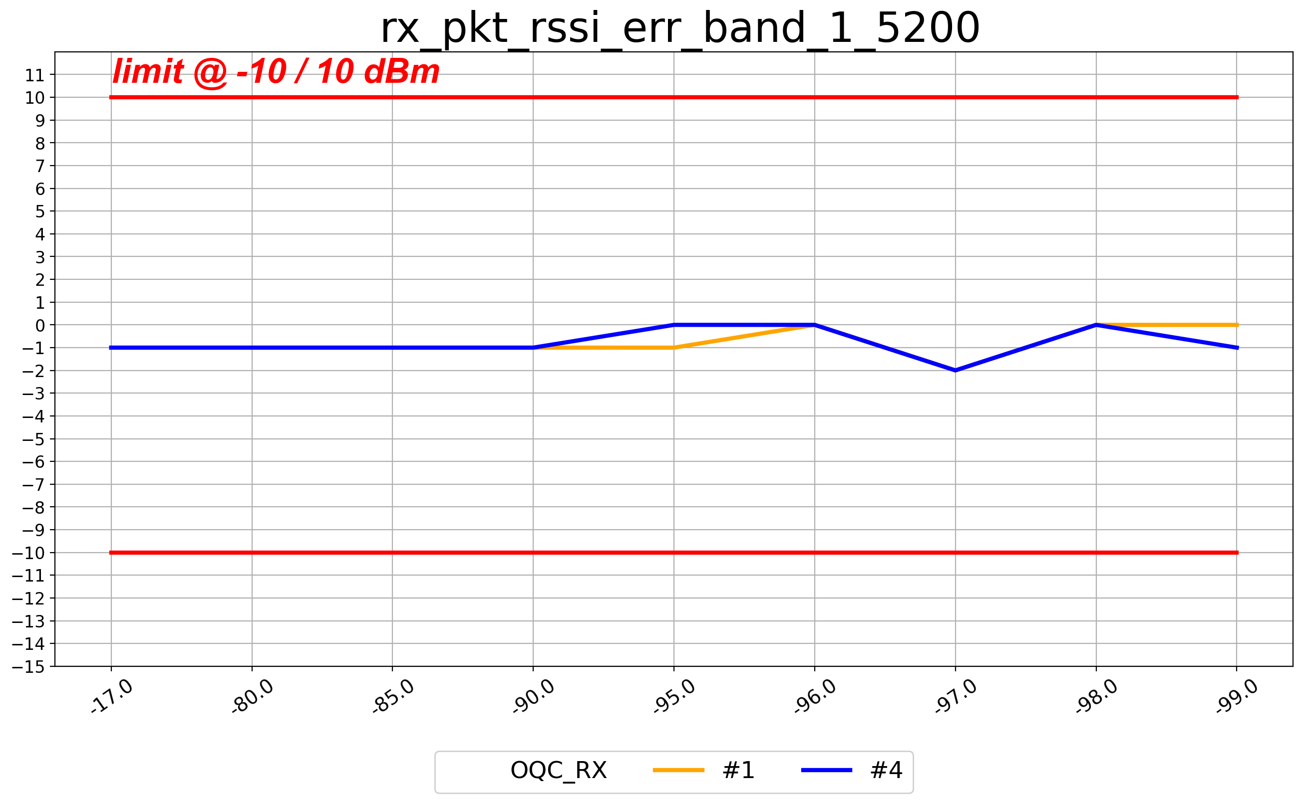
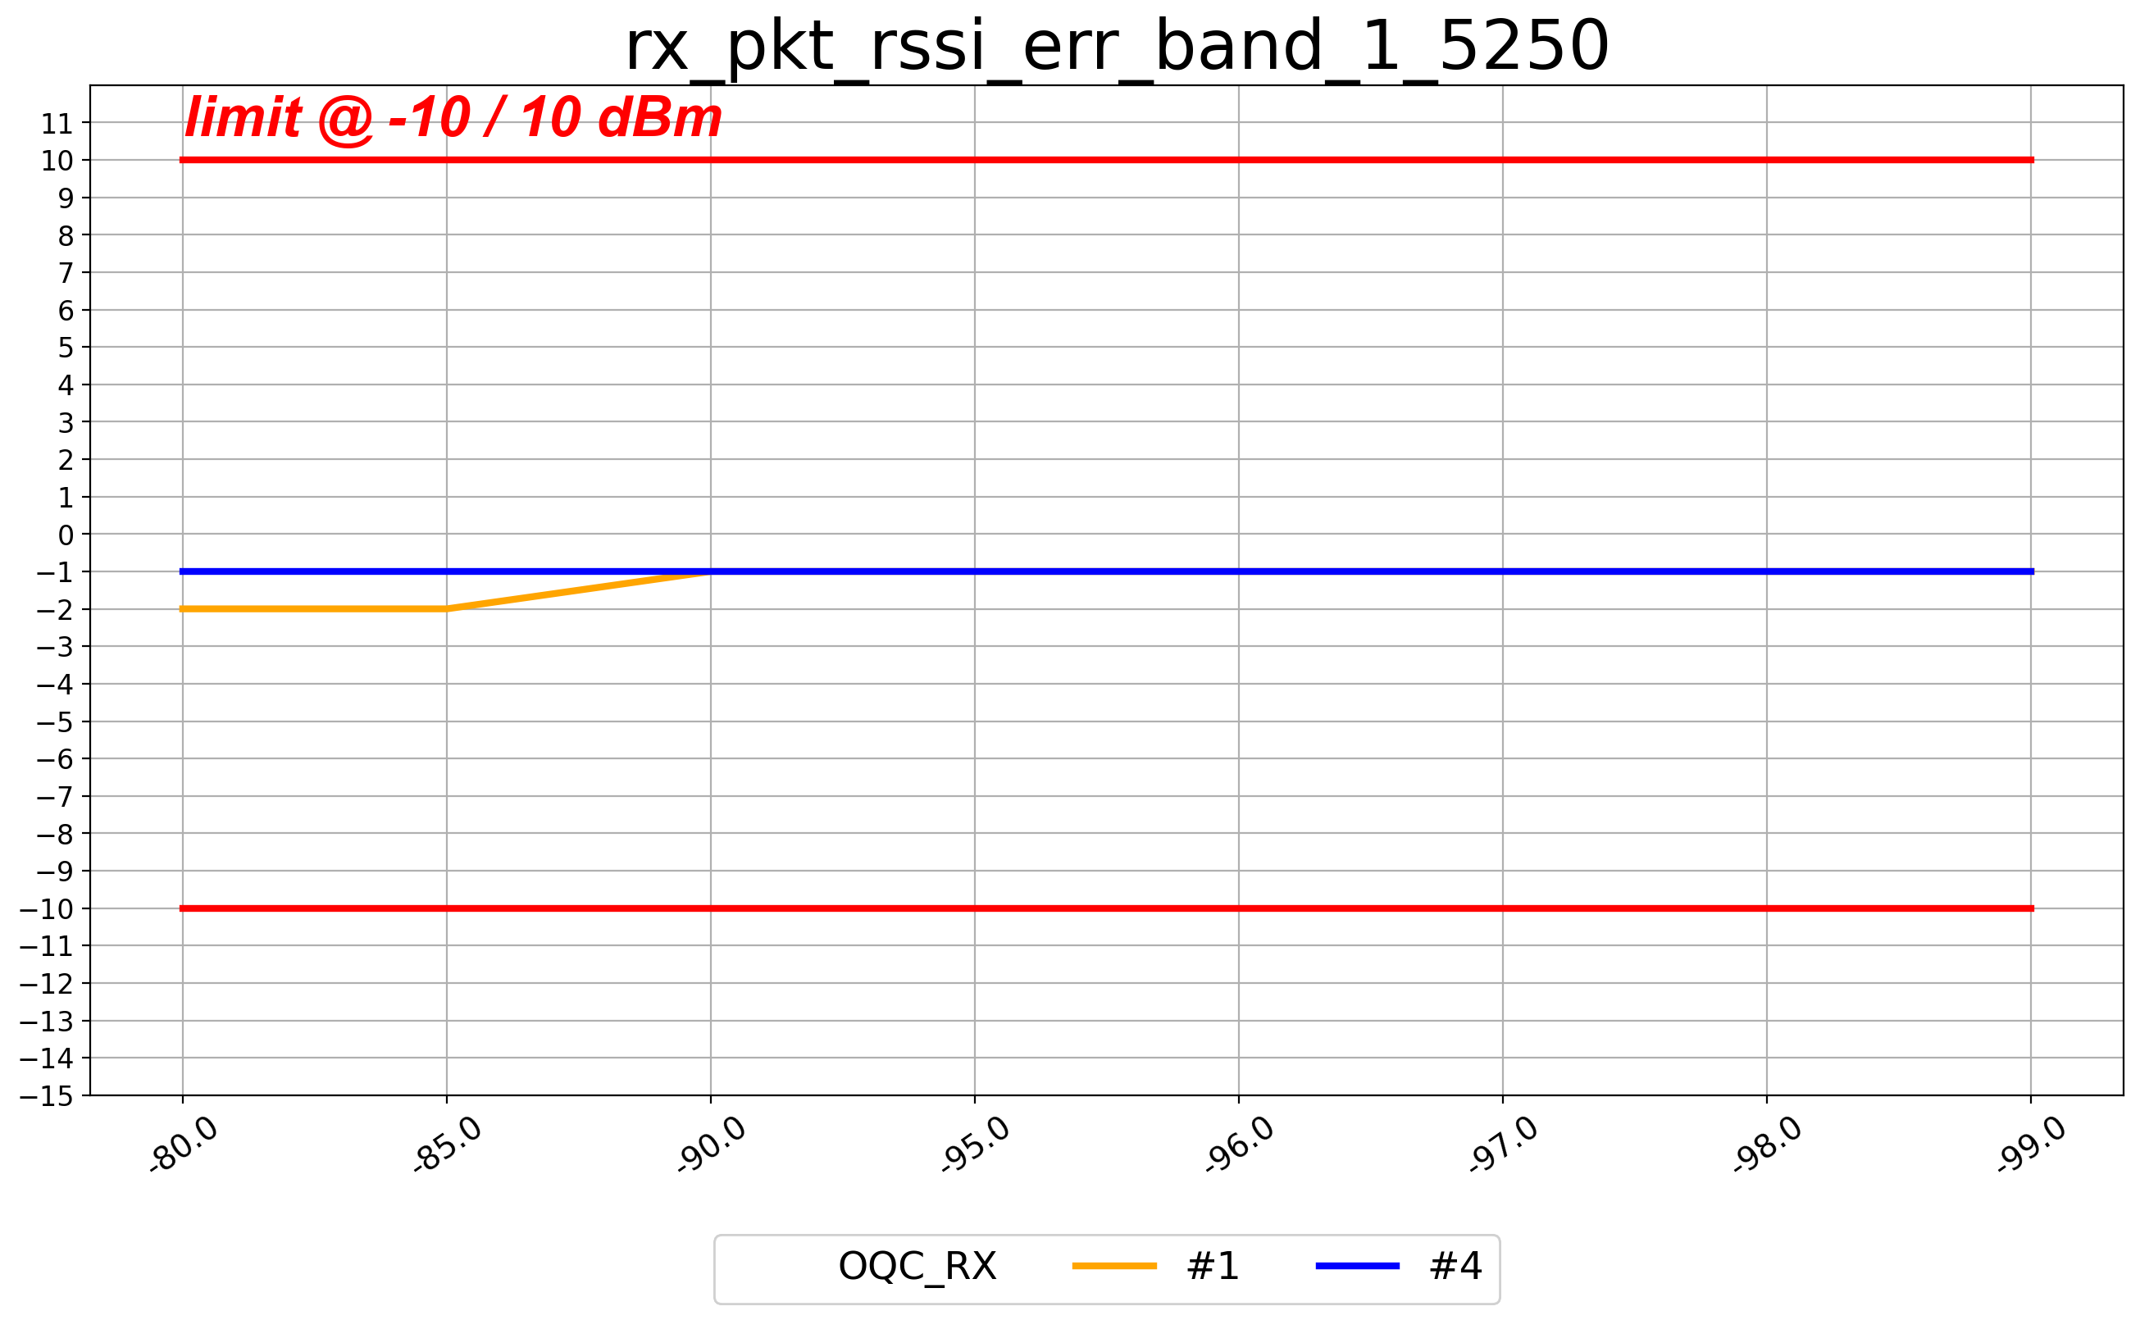
DH5(rssi_err 0.1)_B0

Slide 5
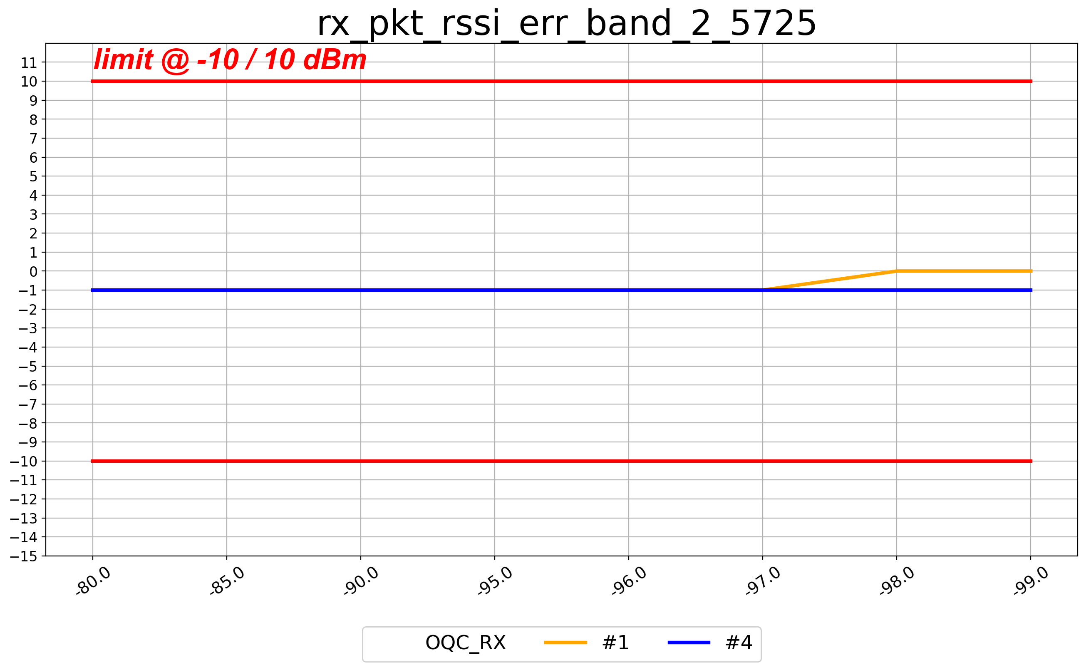
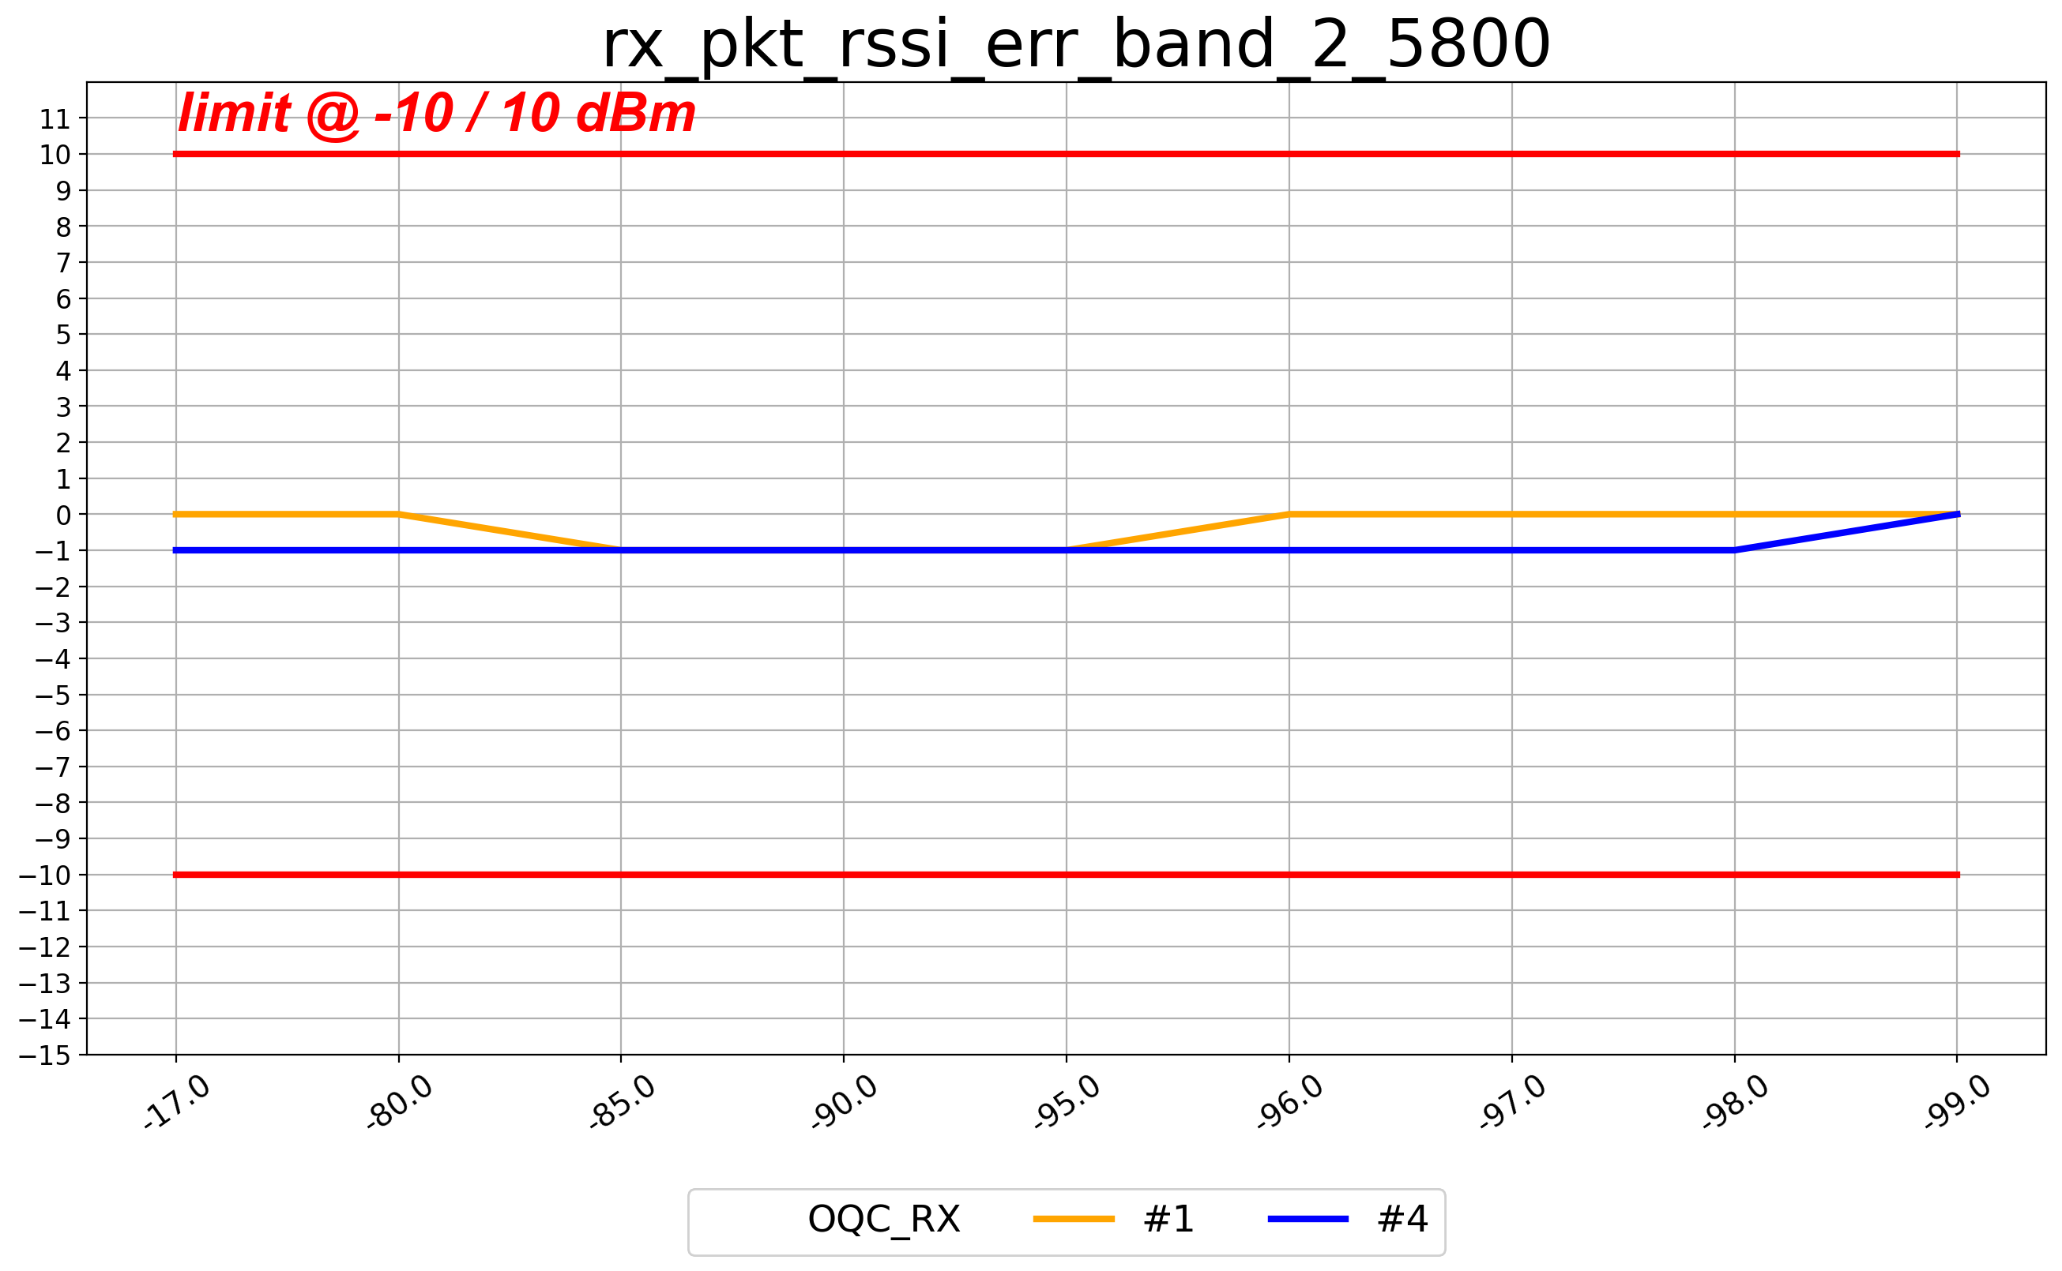
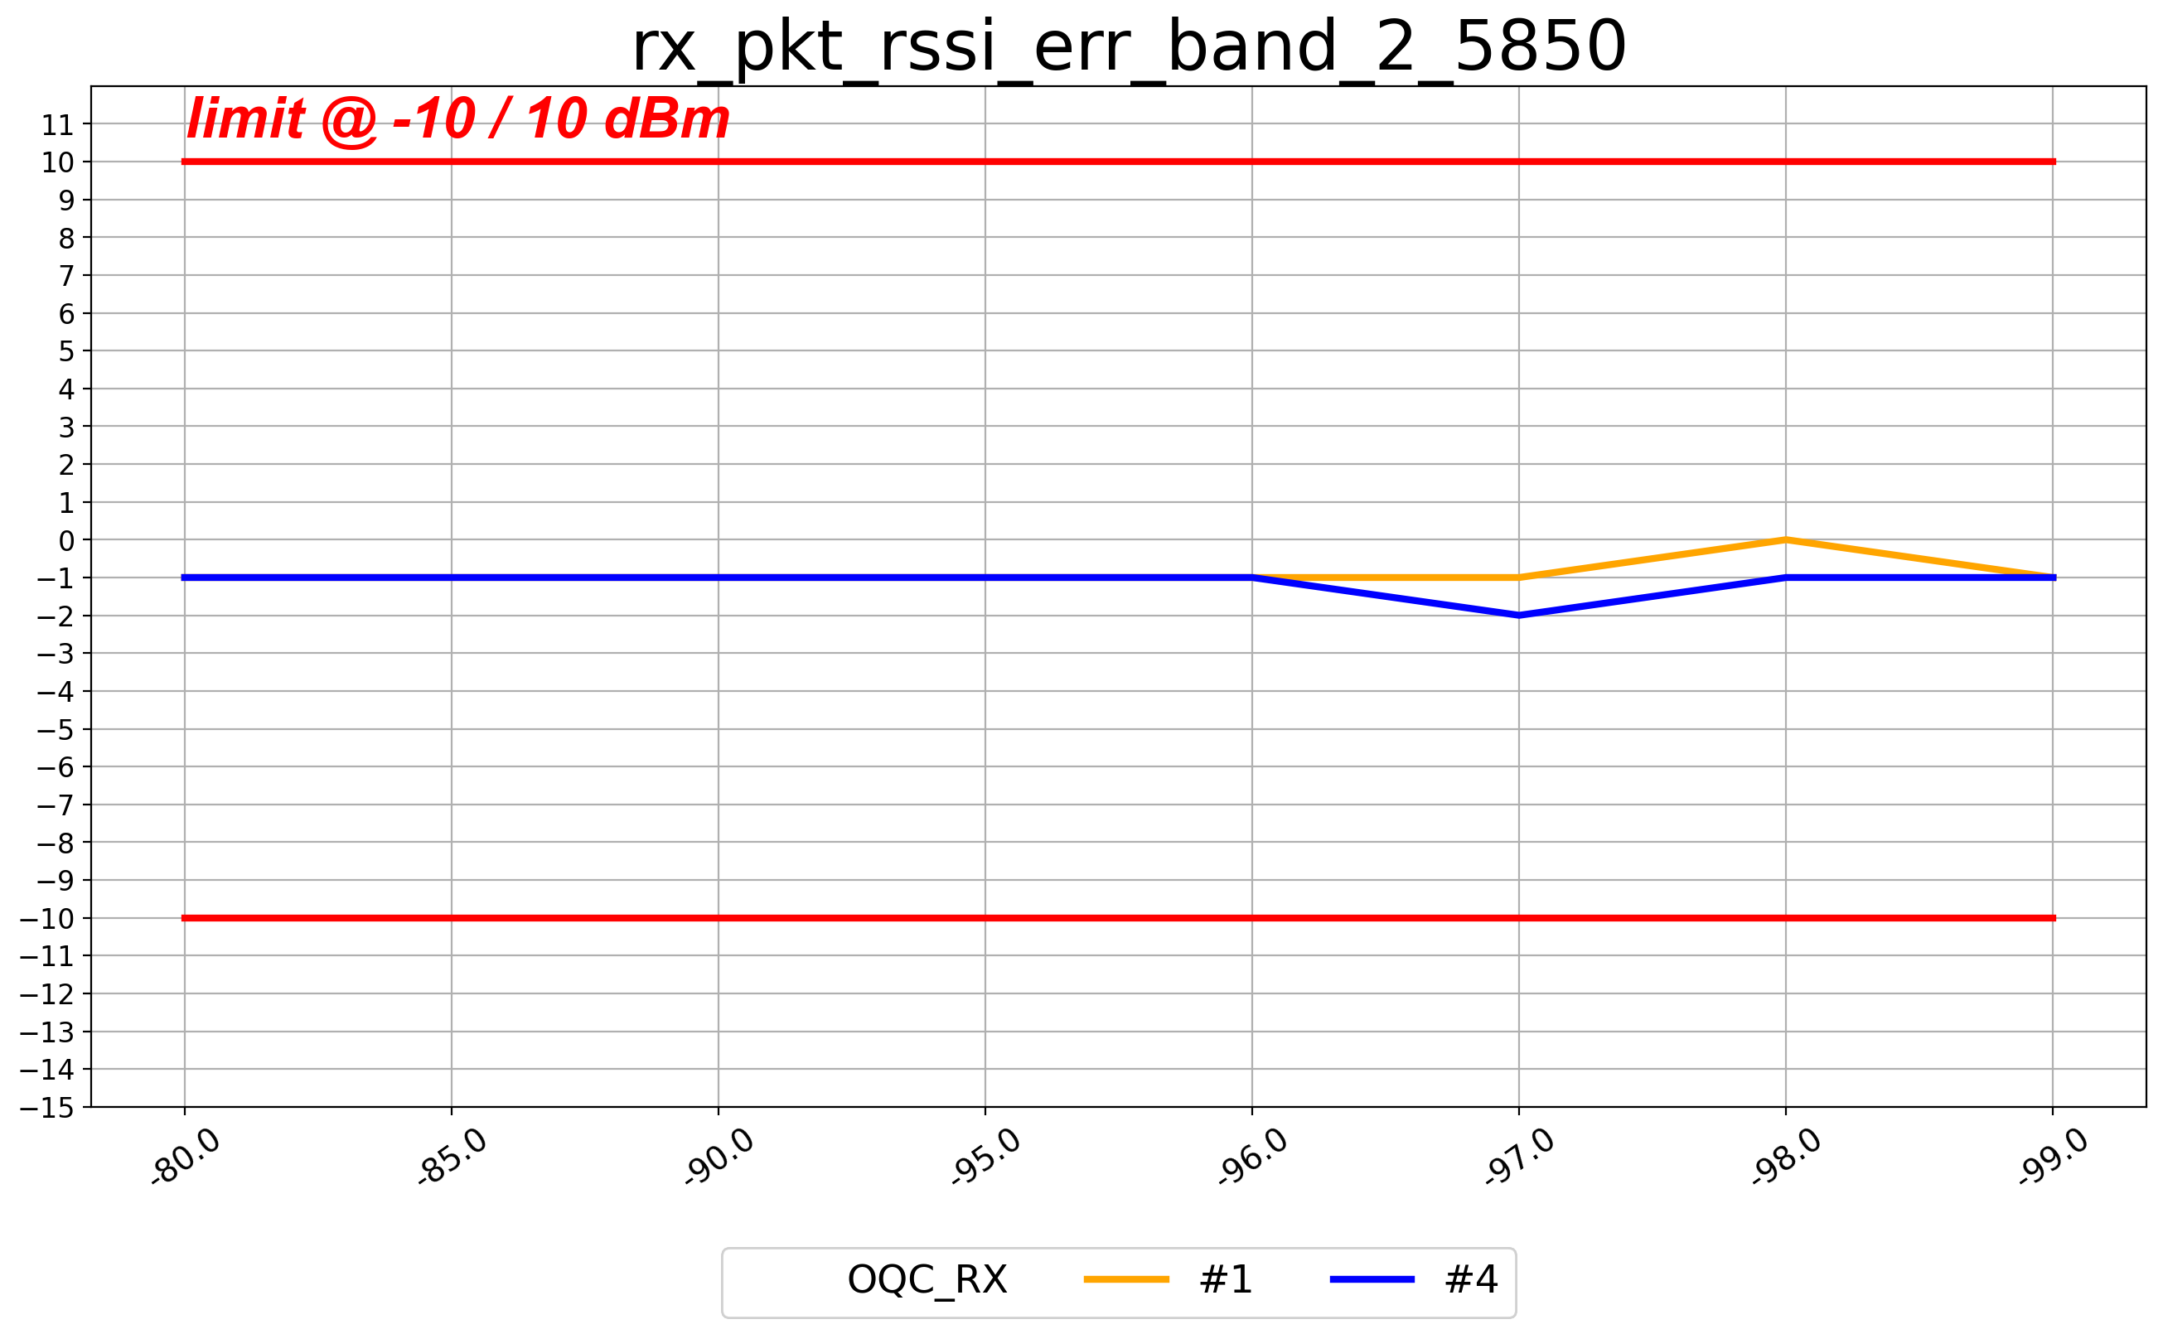
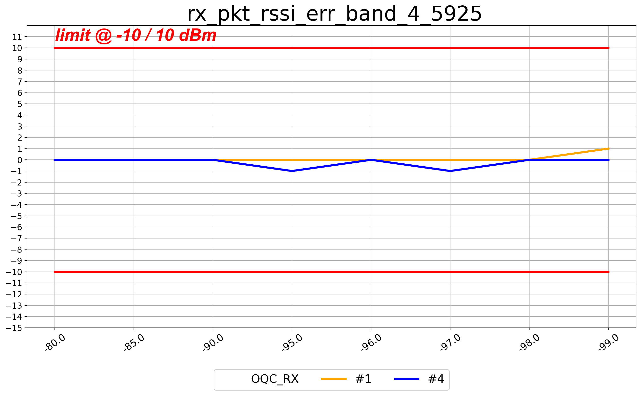
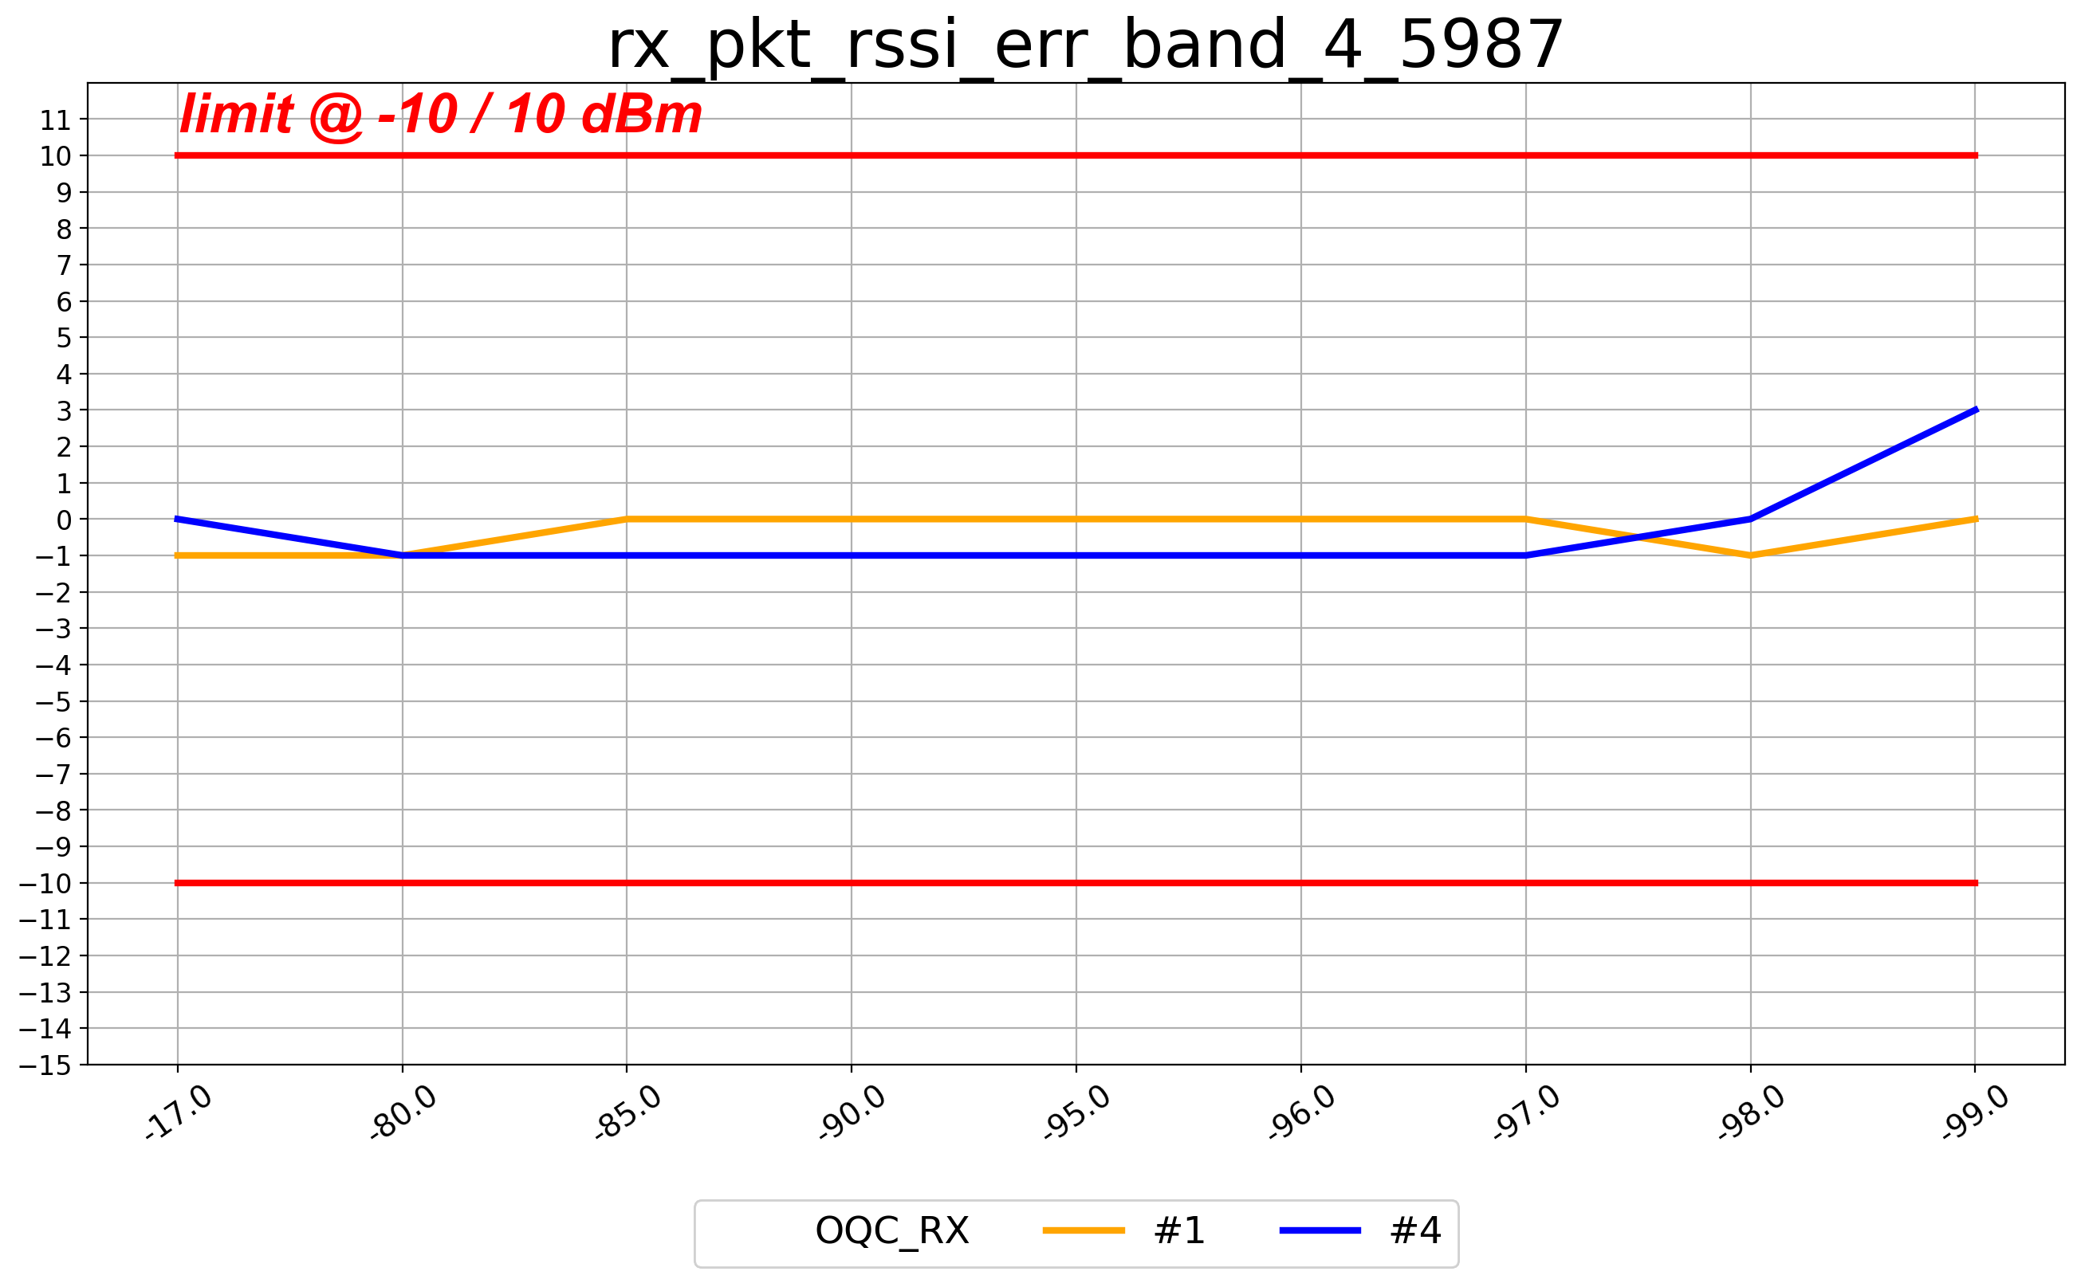

DH5(rssi_err 0.1)_B2

Slide 6
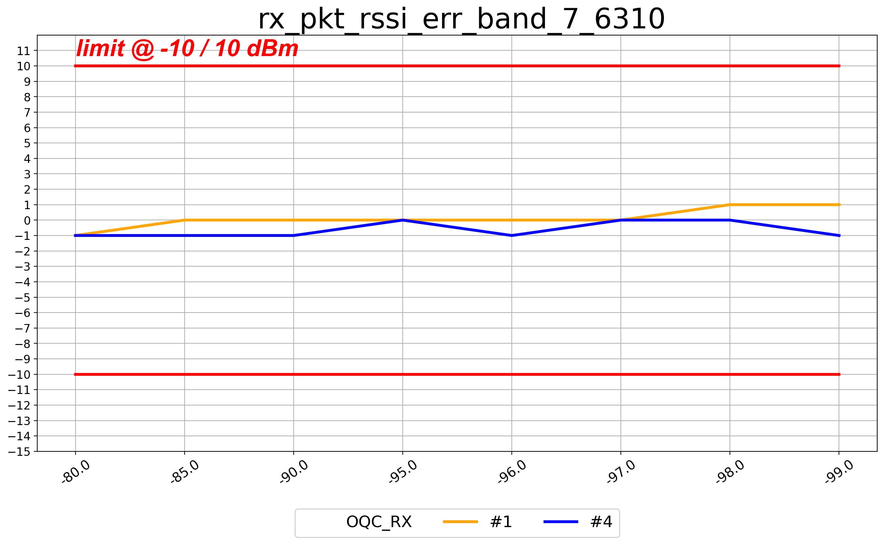
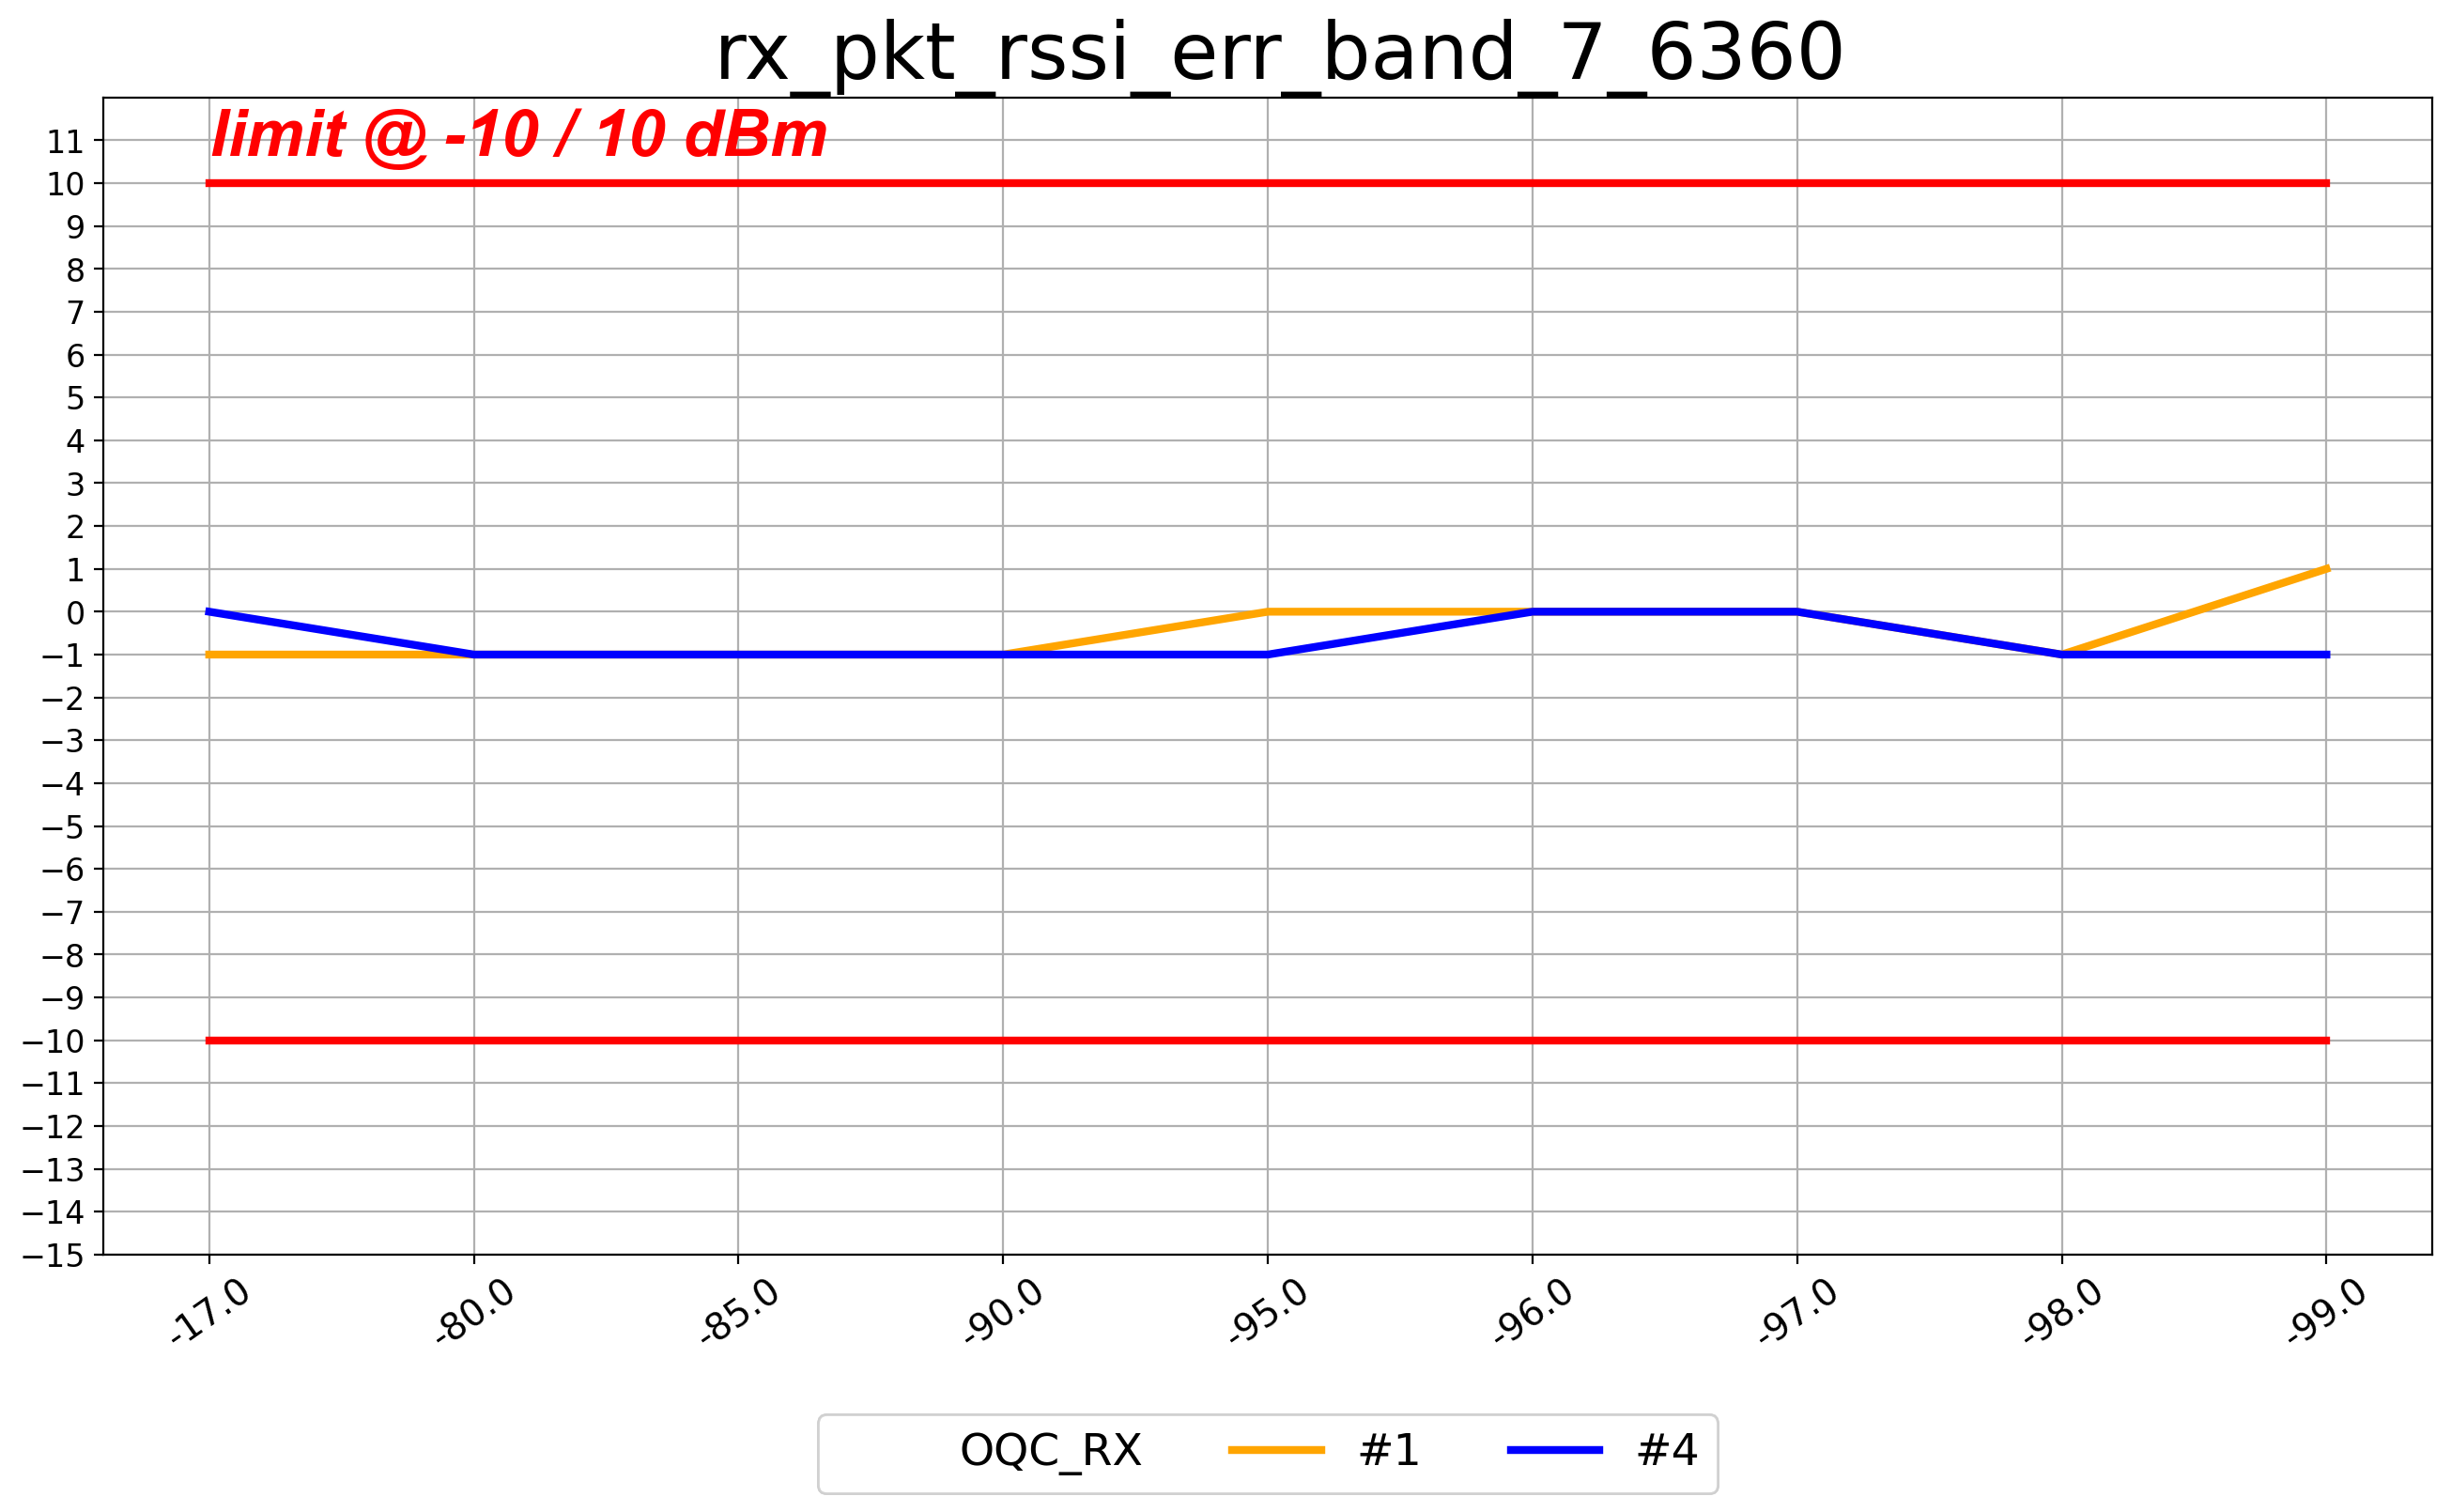
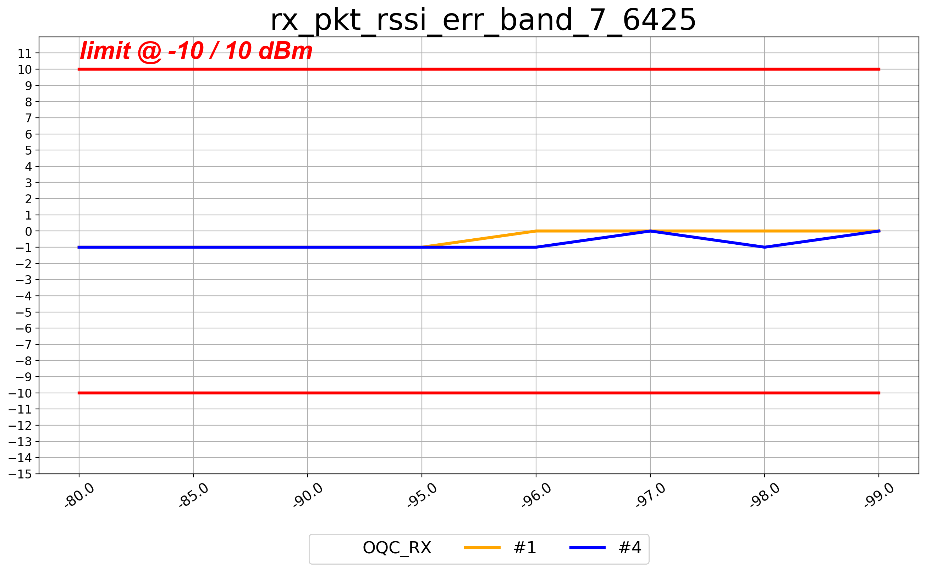
DH5(rssi_err 0.1)_B7

Slide 7
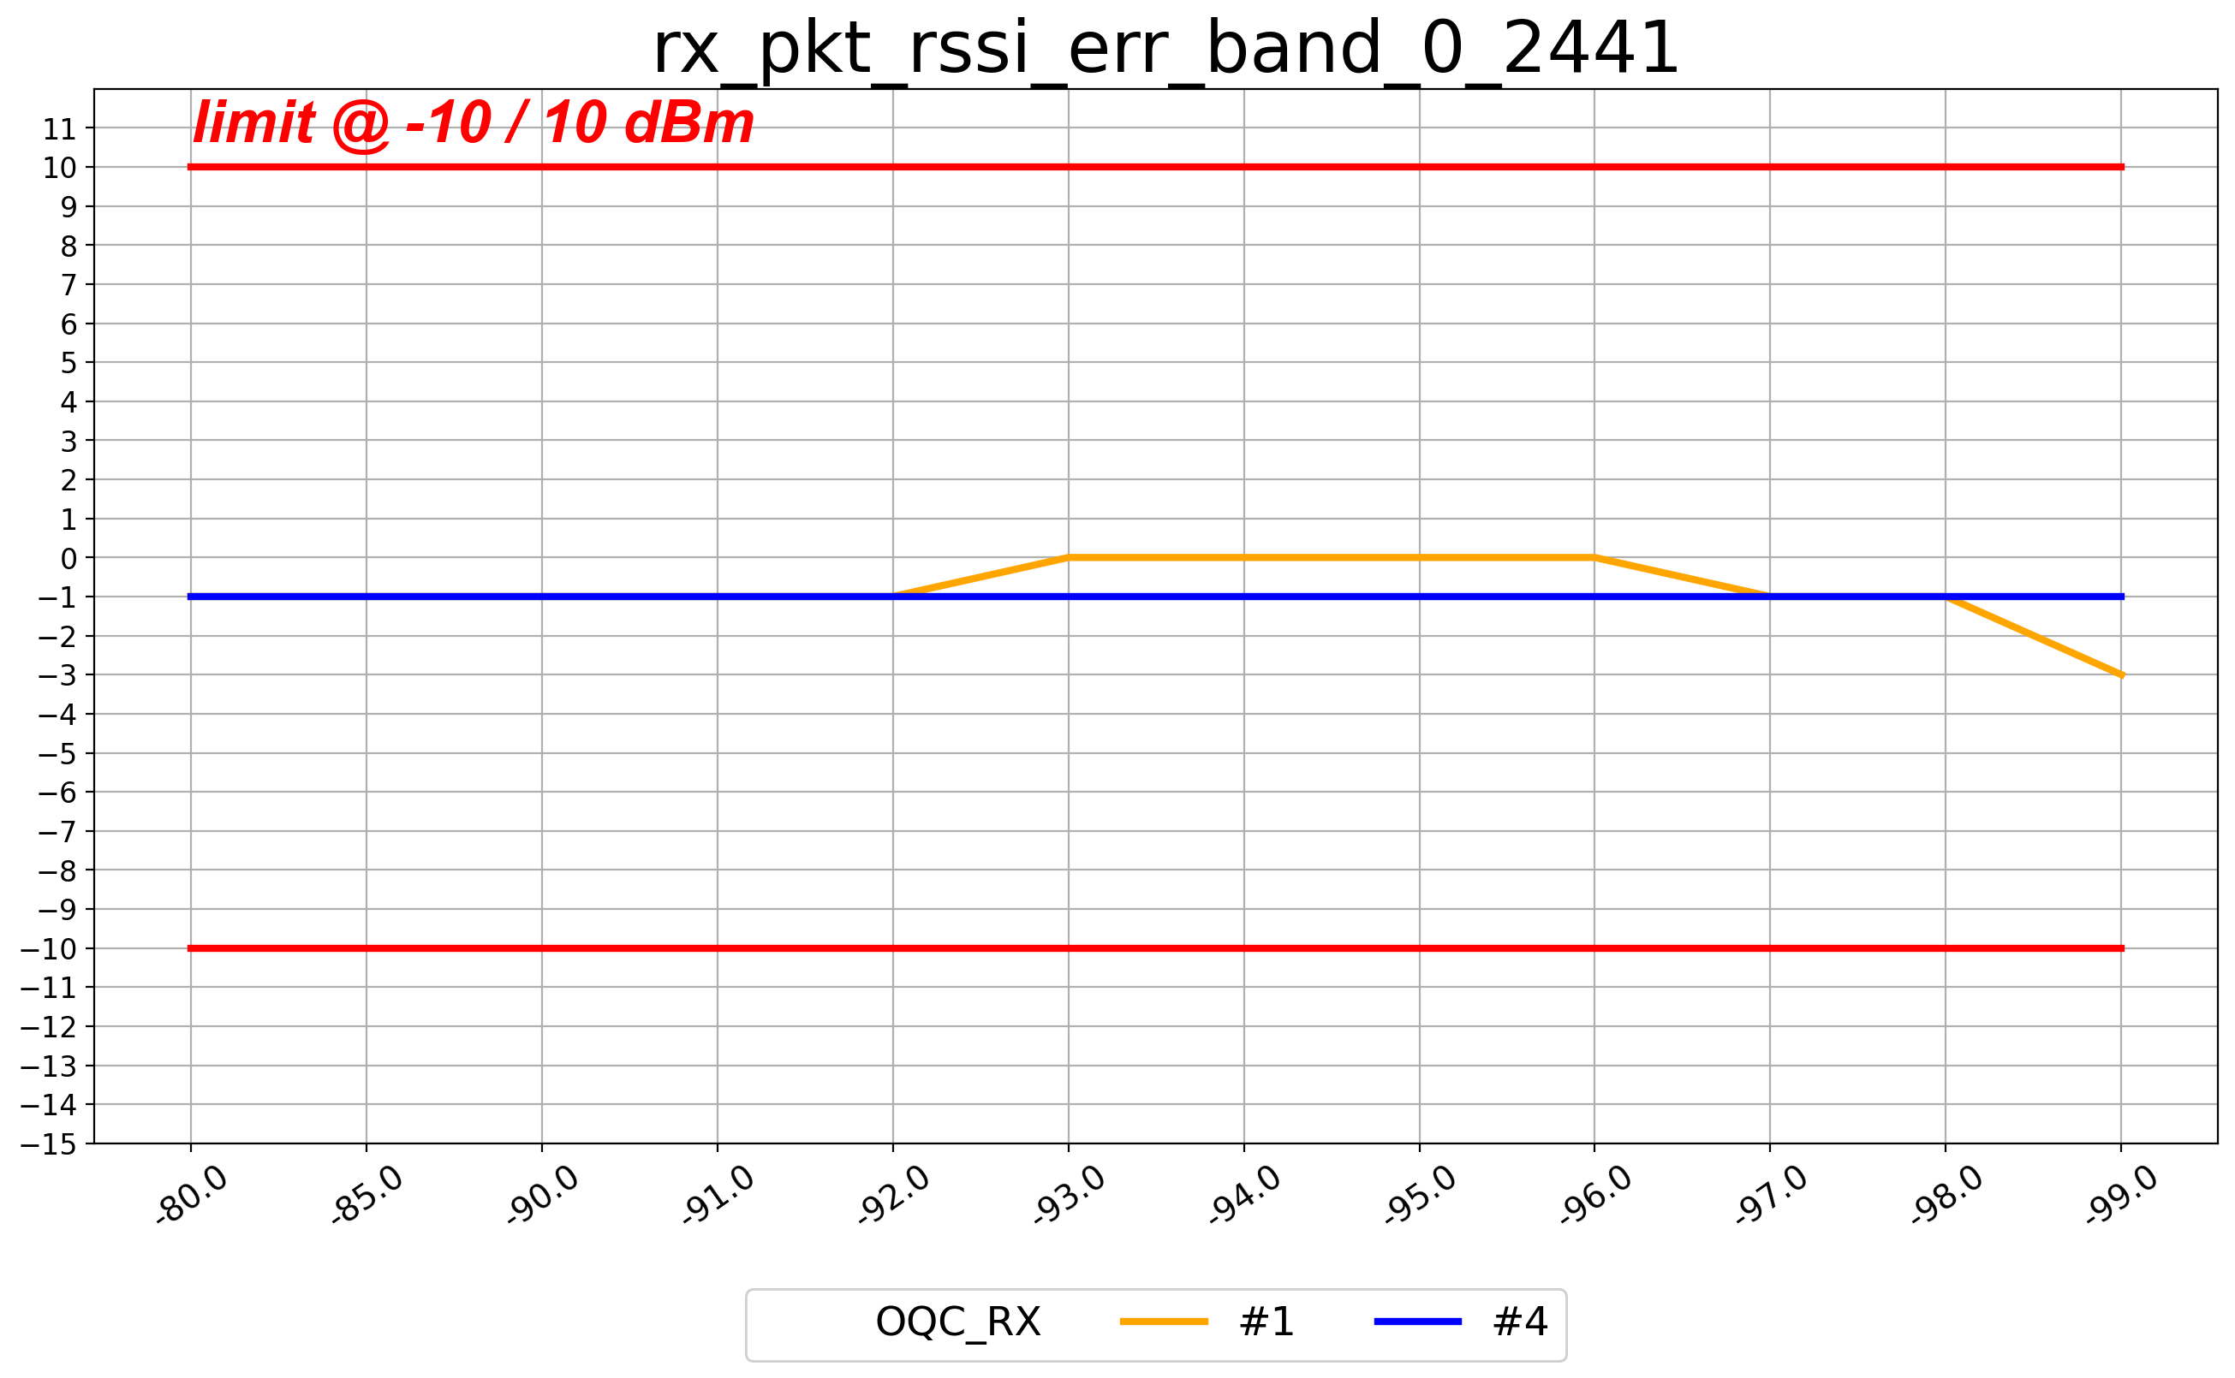
2-DH5(rssi_err 0.01)_B0

Slide 8
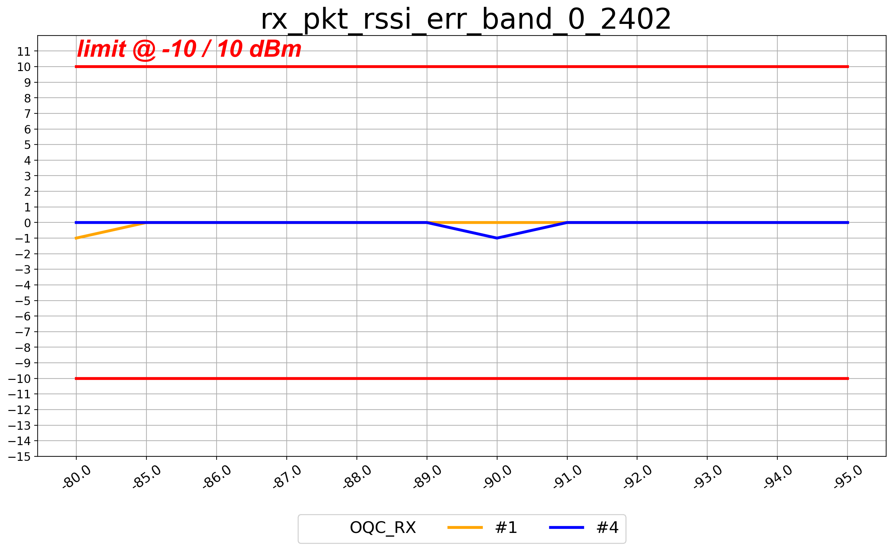
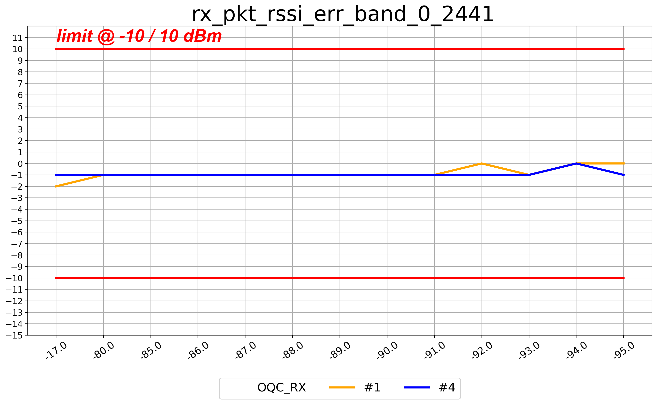
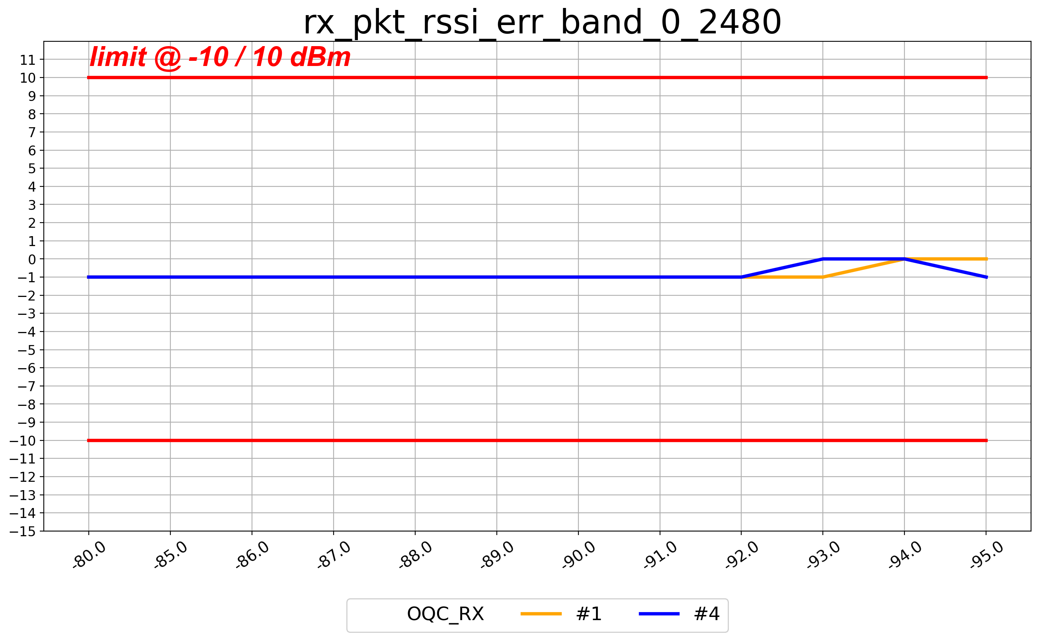
3-DH5(rssi_err 0.01)_B0

Slide 9
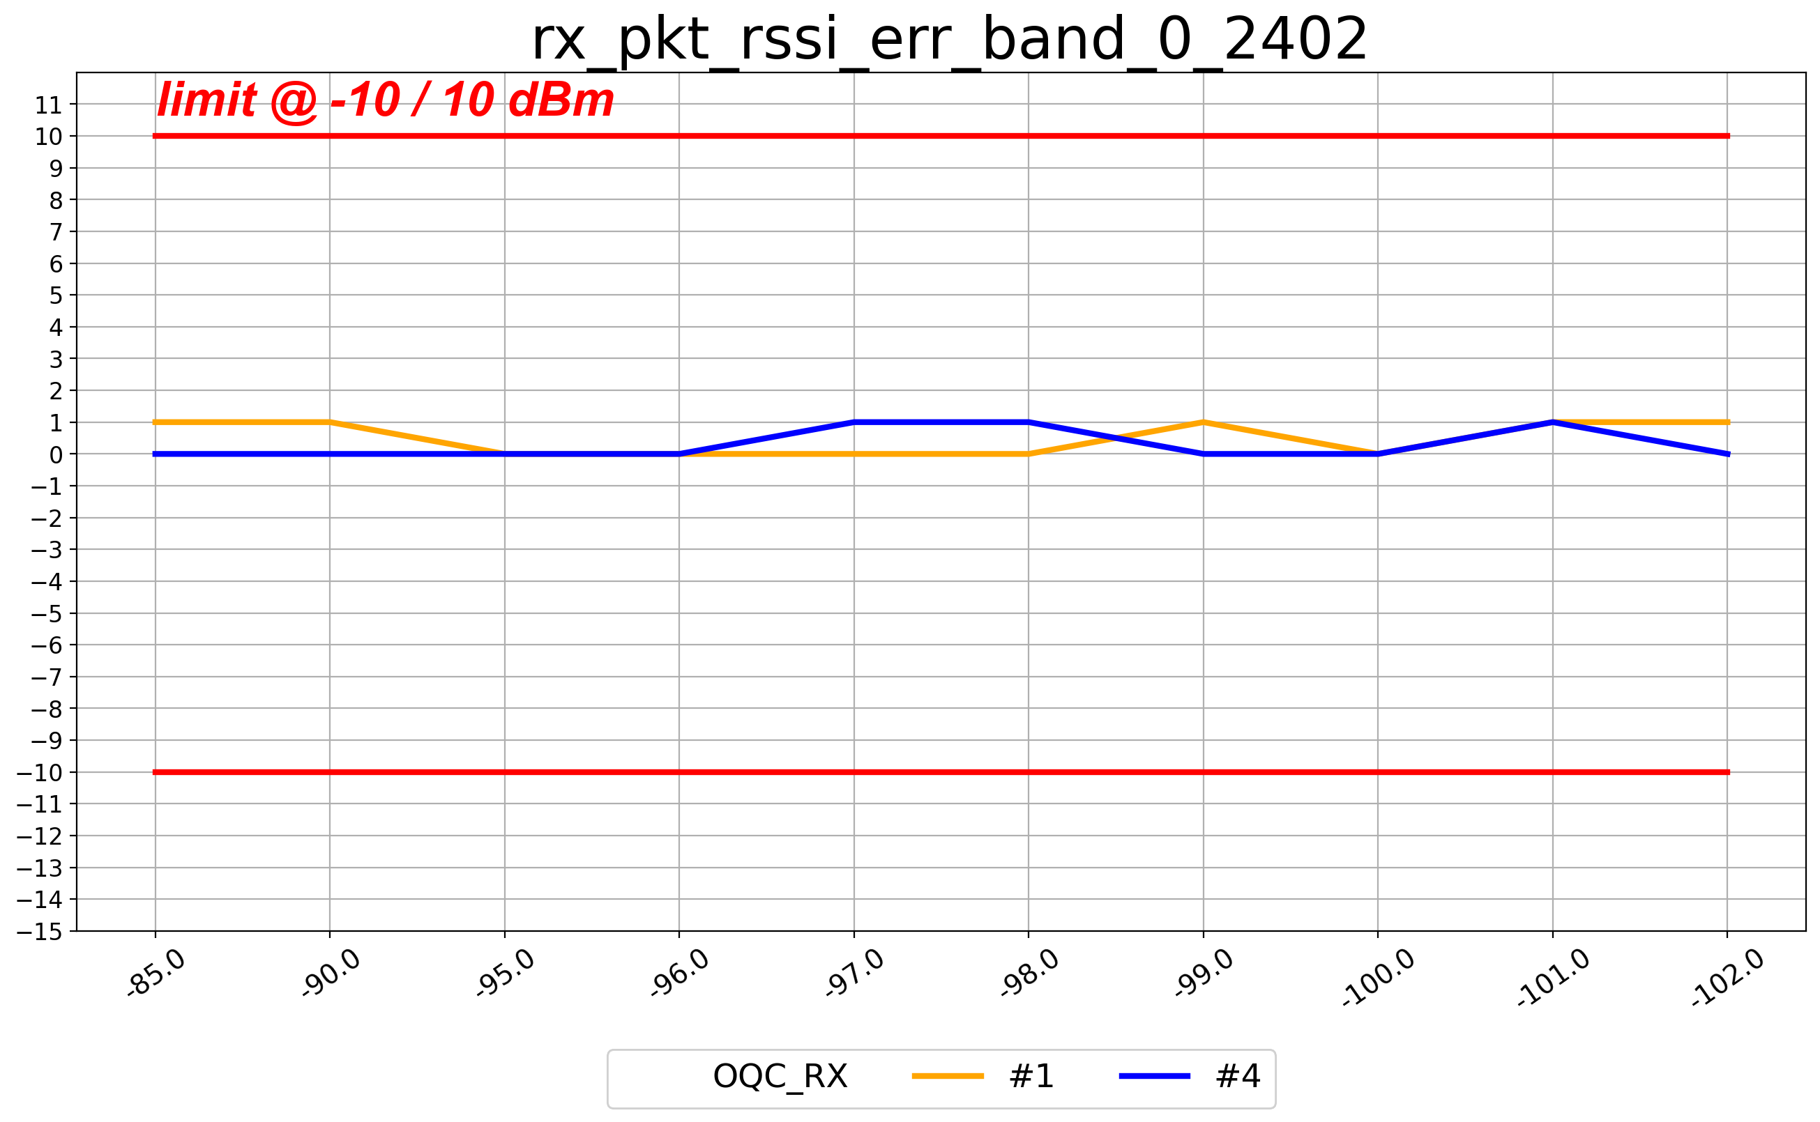

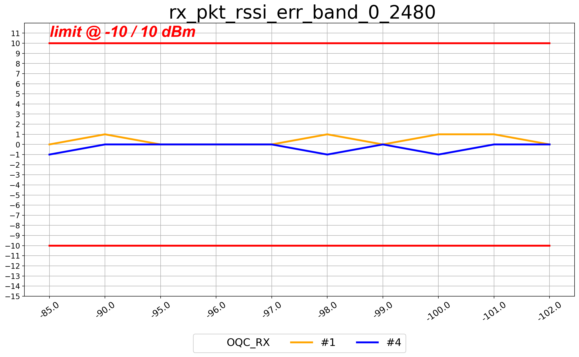
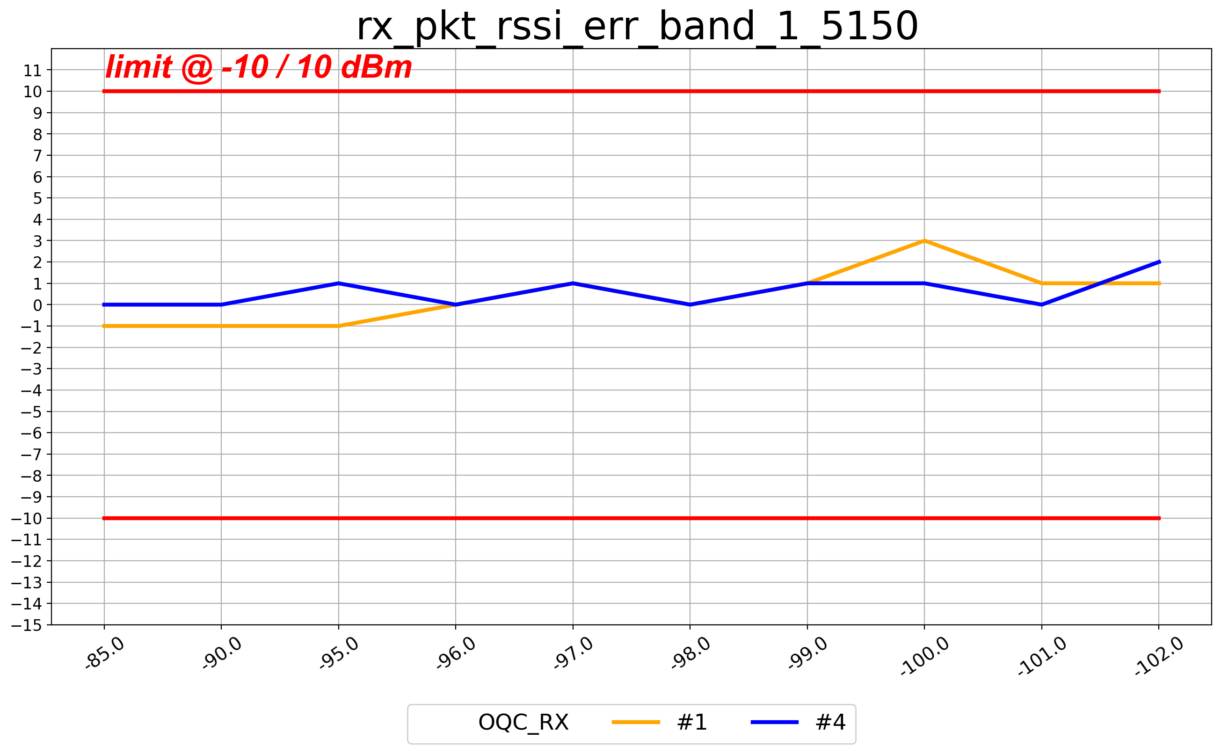
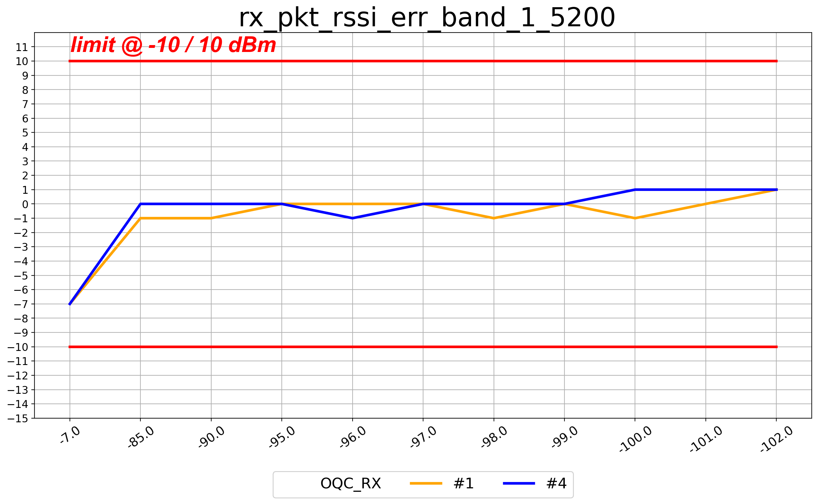
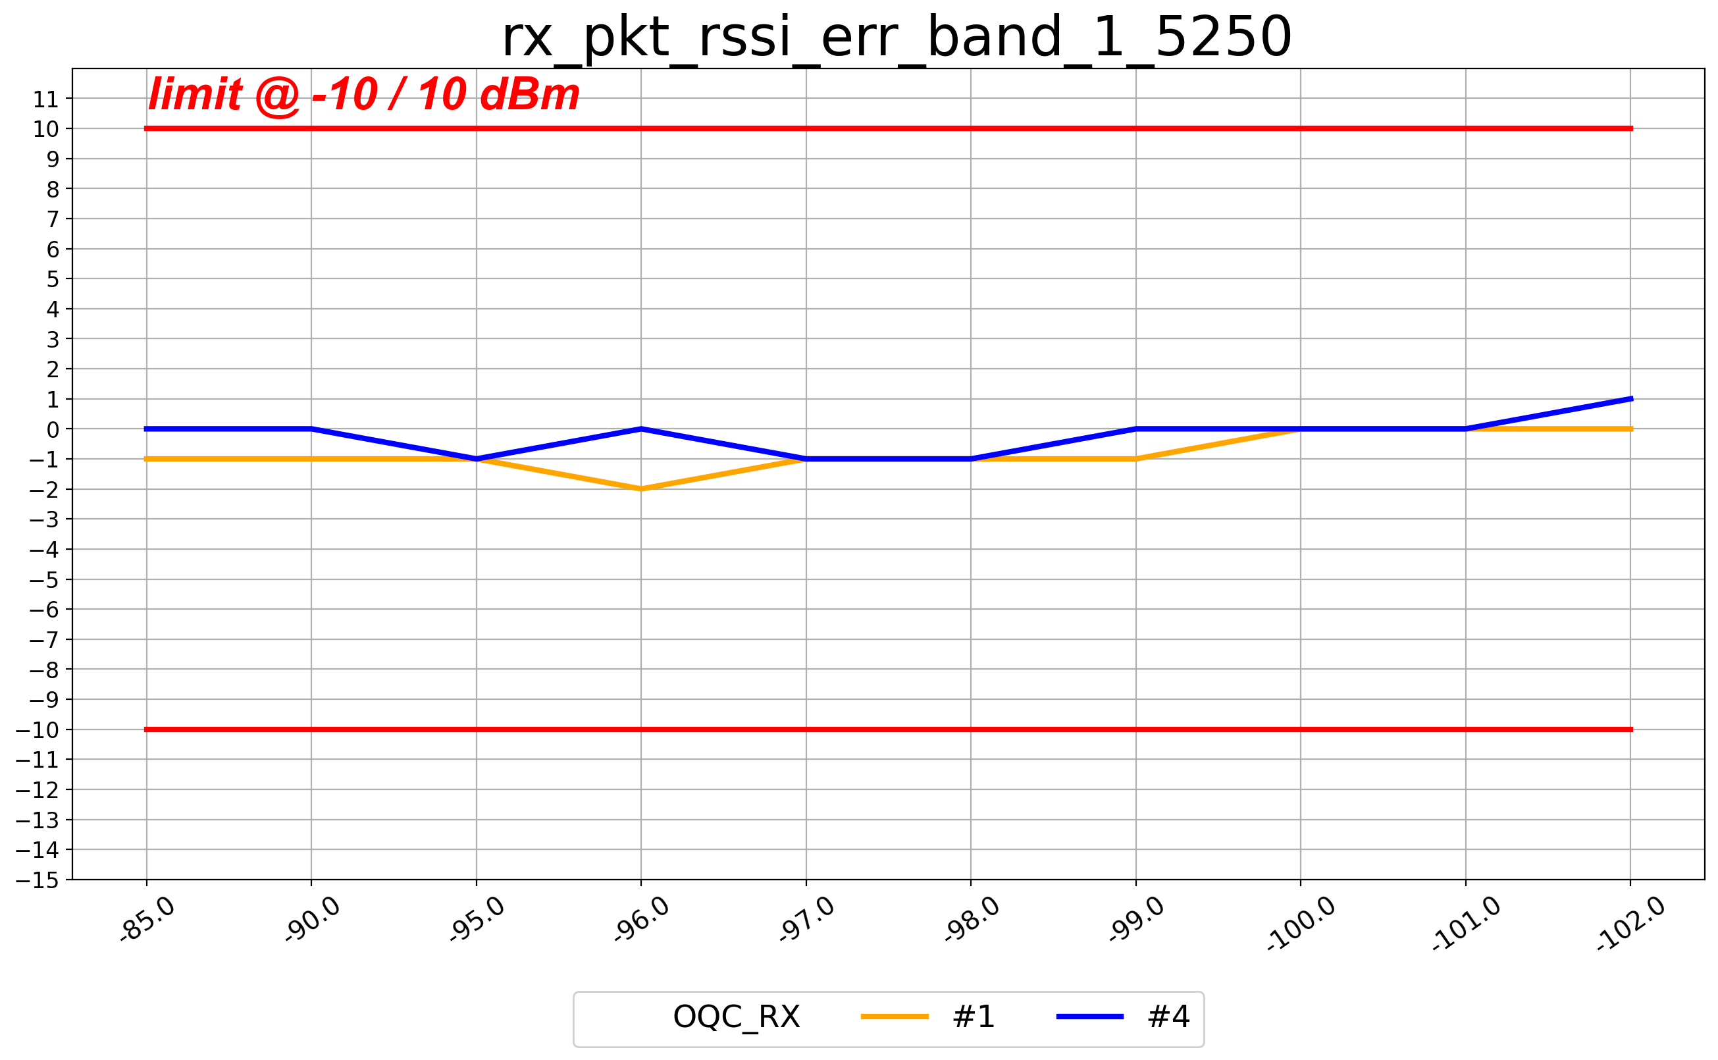
LE1M(rssi_err 30.8)_B0

Slide 10
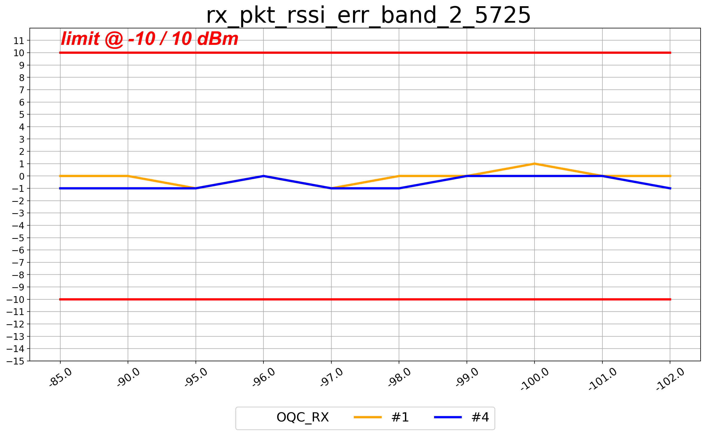
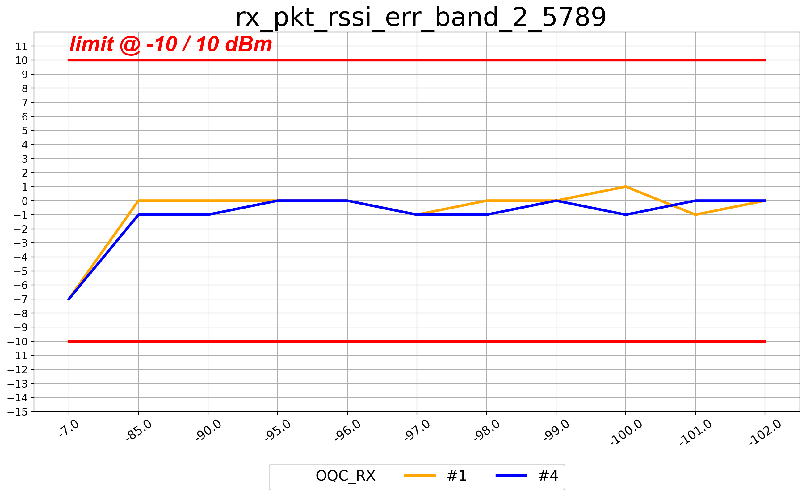
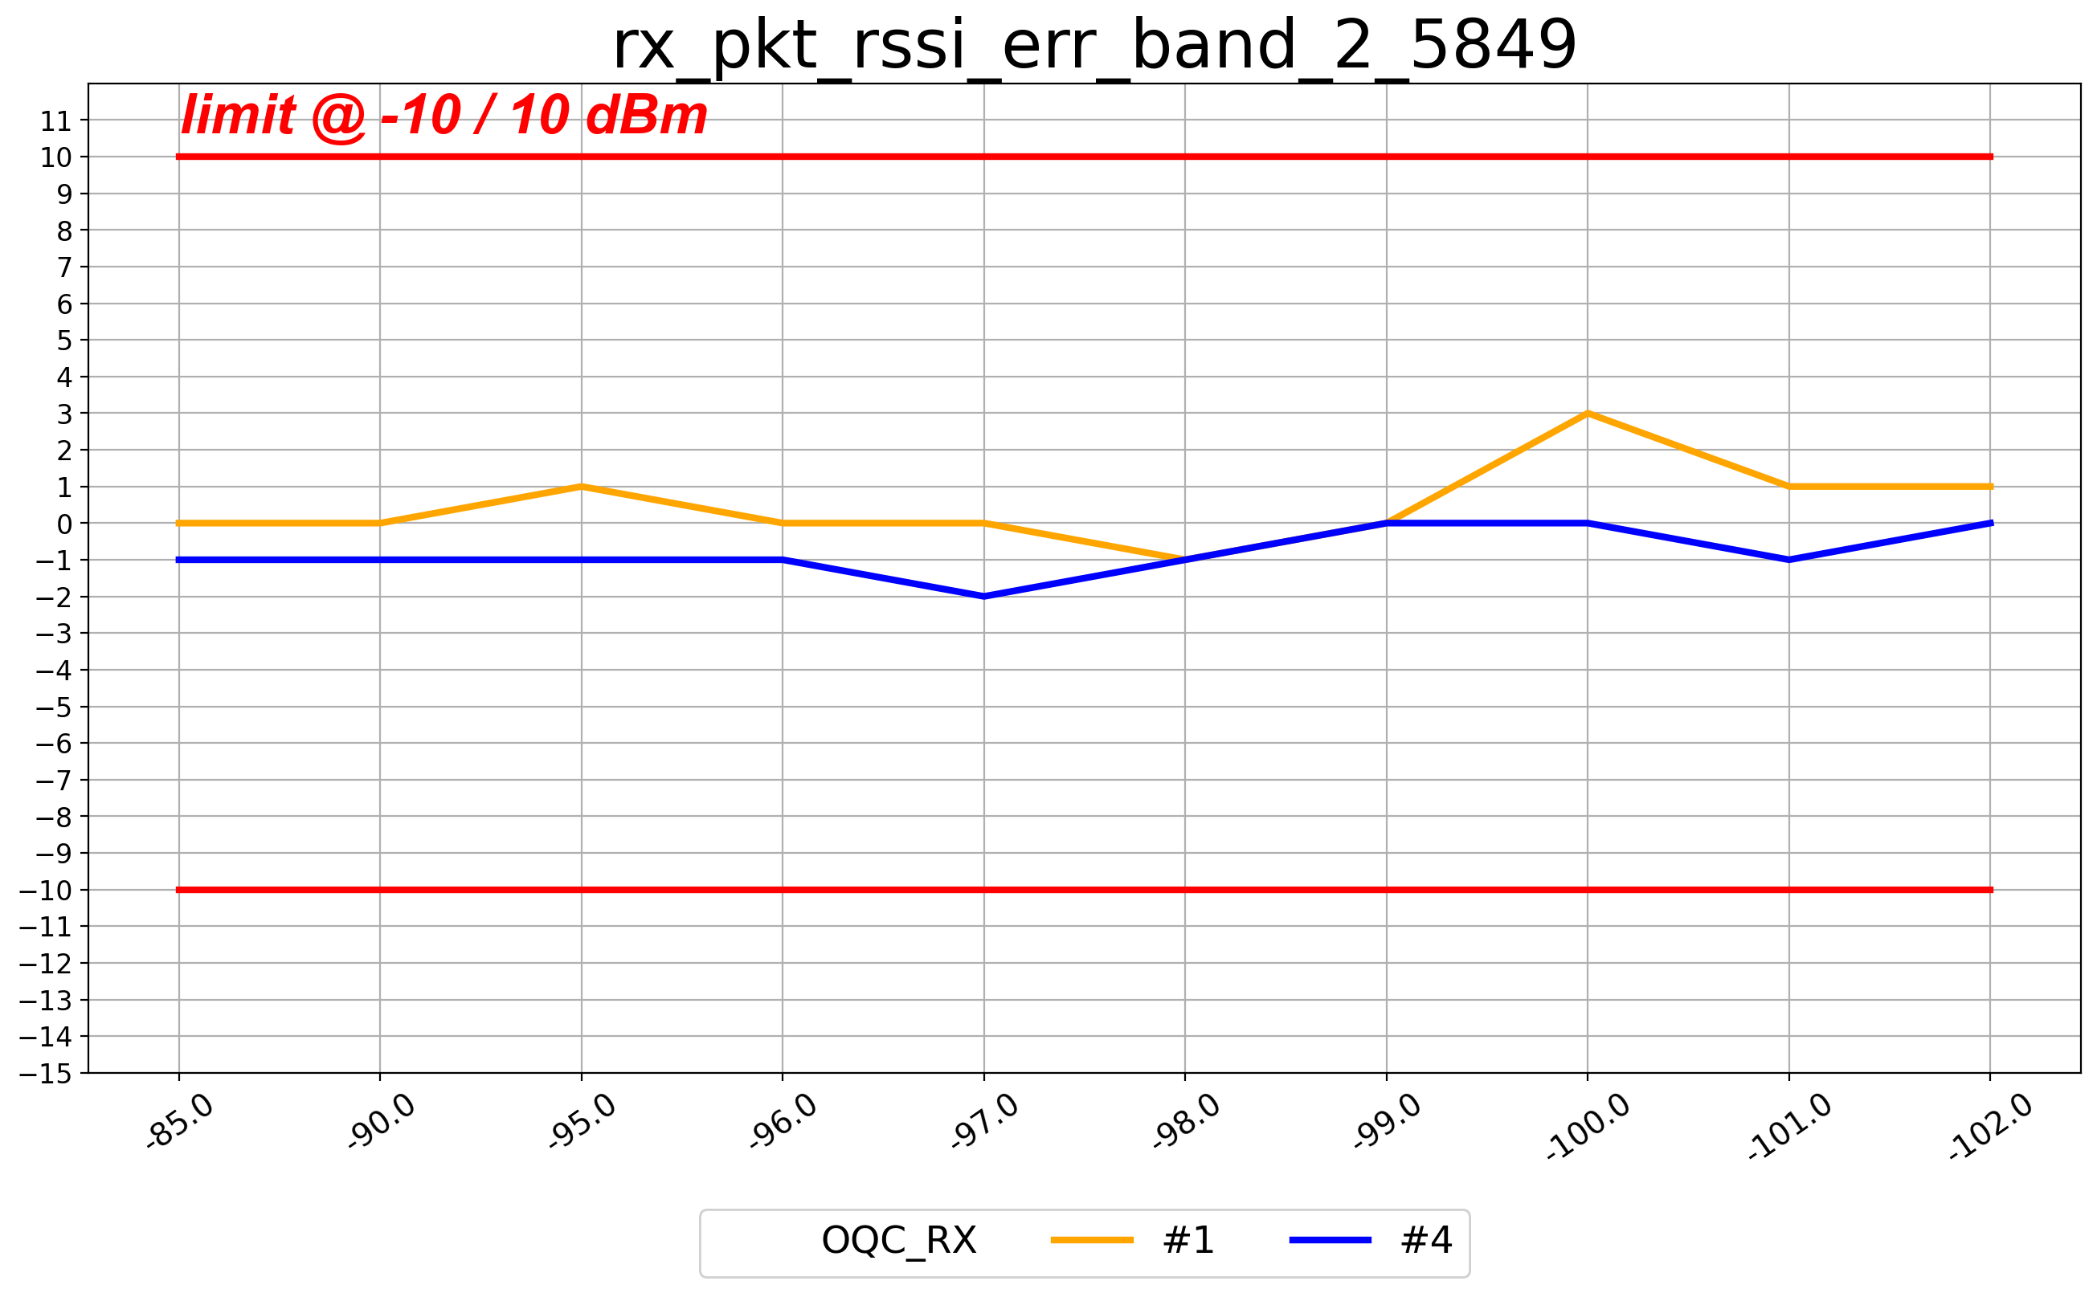
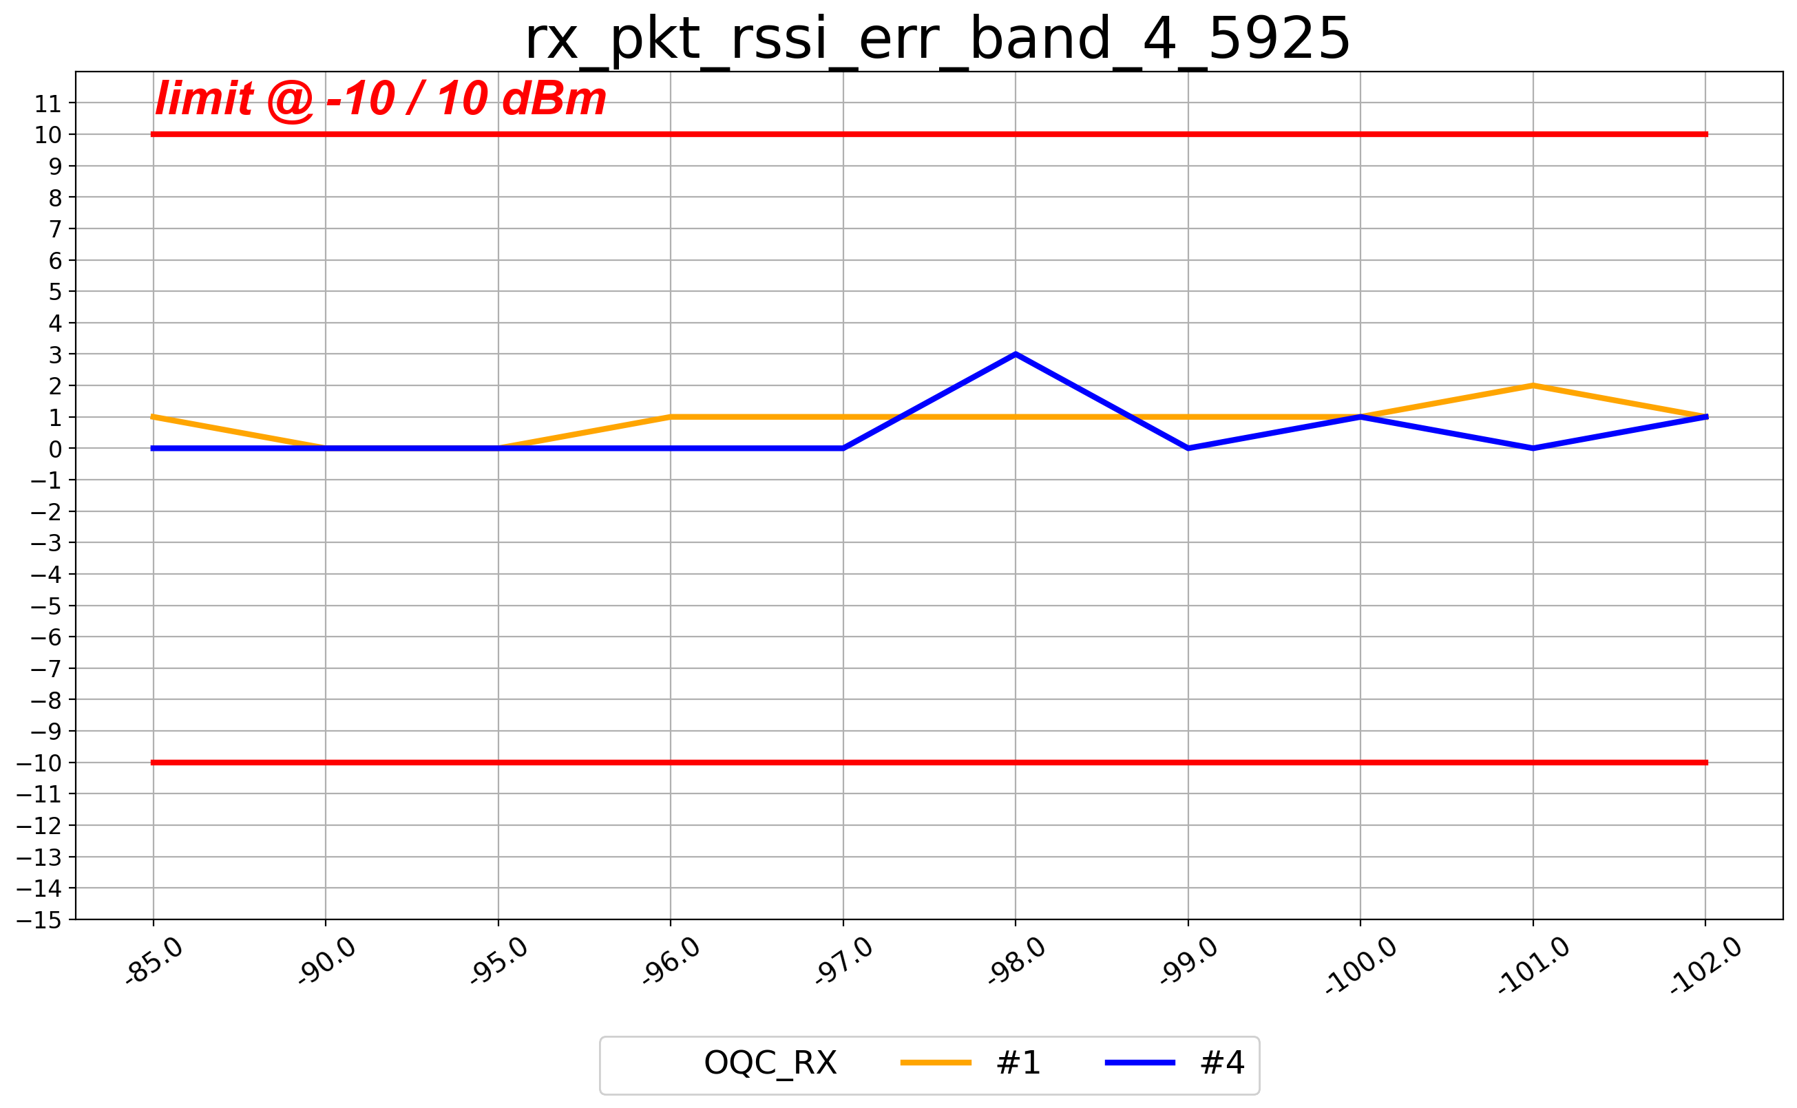
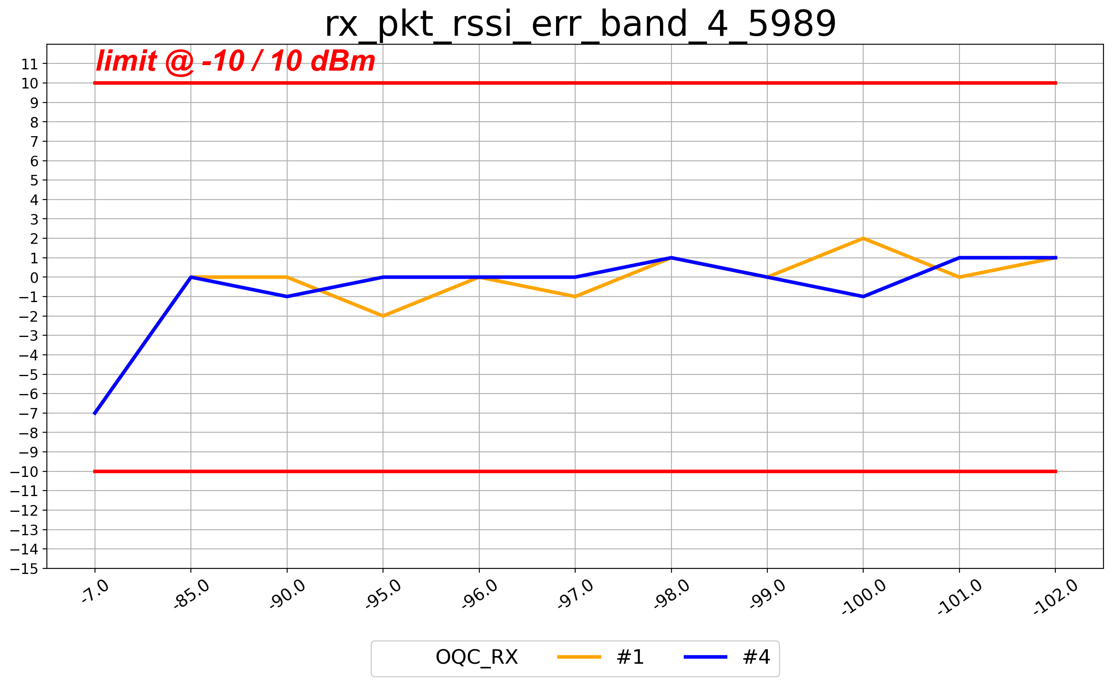
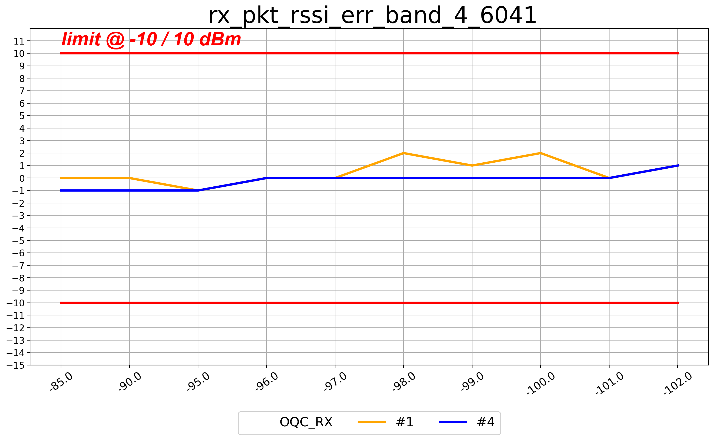
LE1M(rssi_err 30.8)_B2

Slide 11
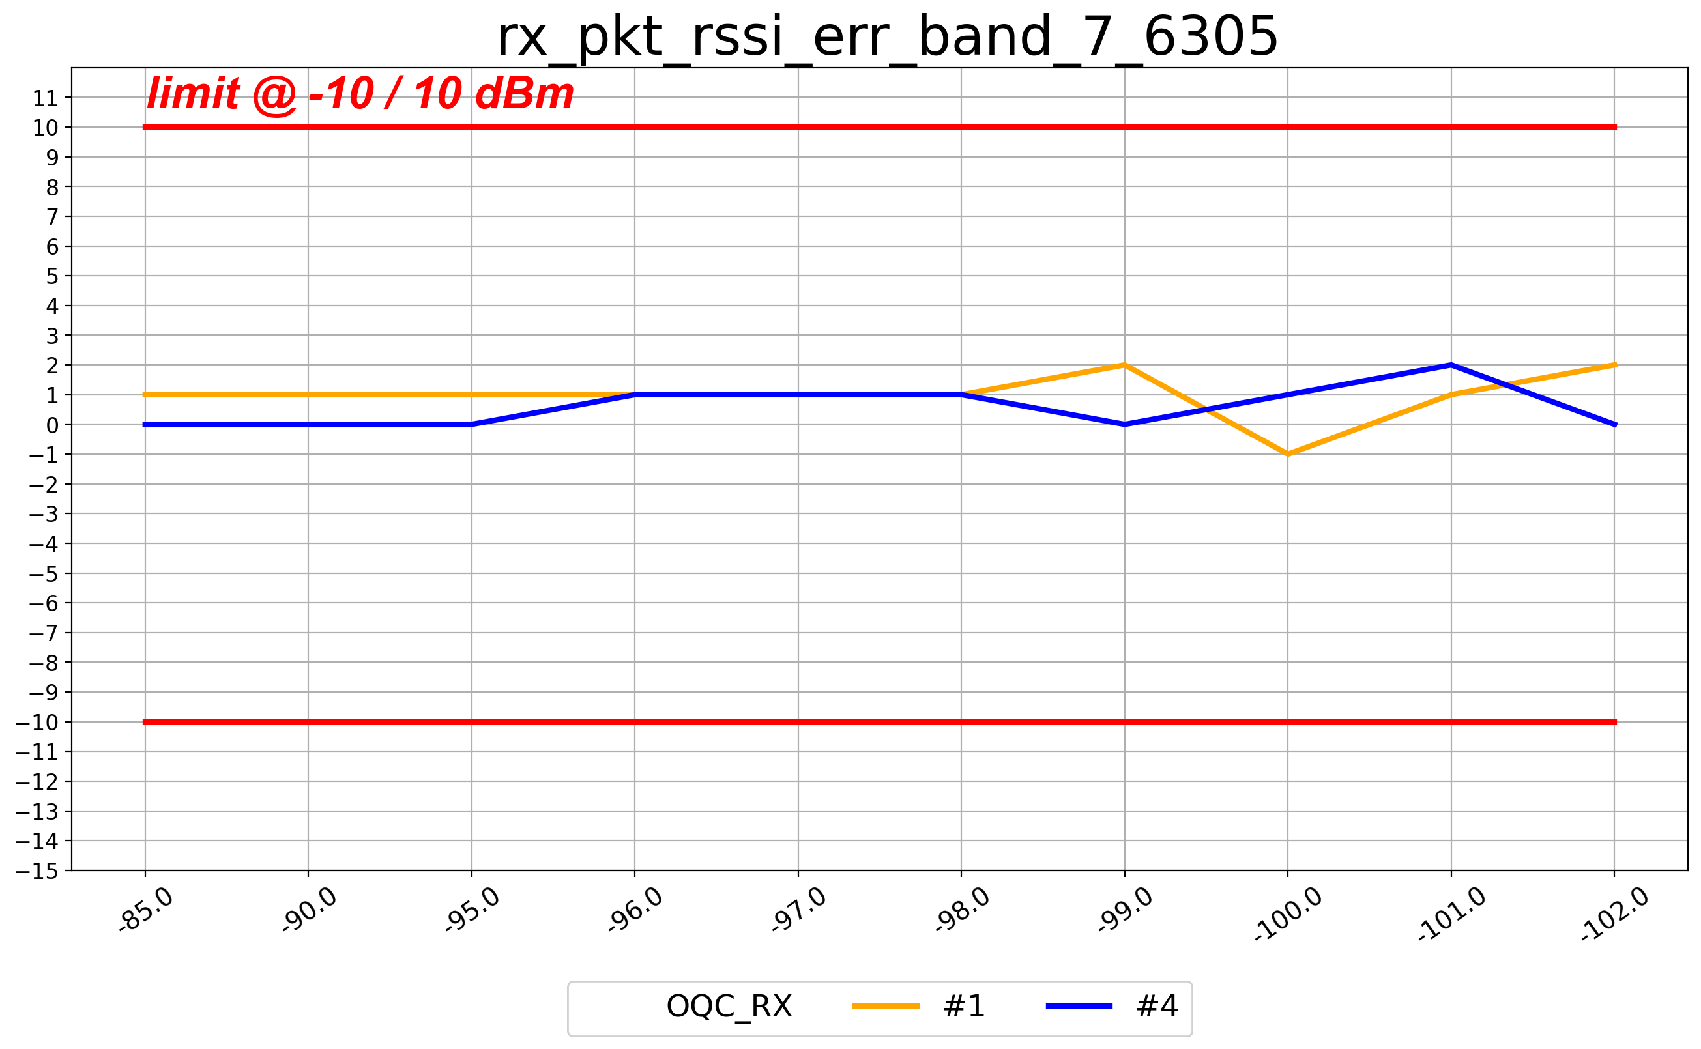
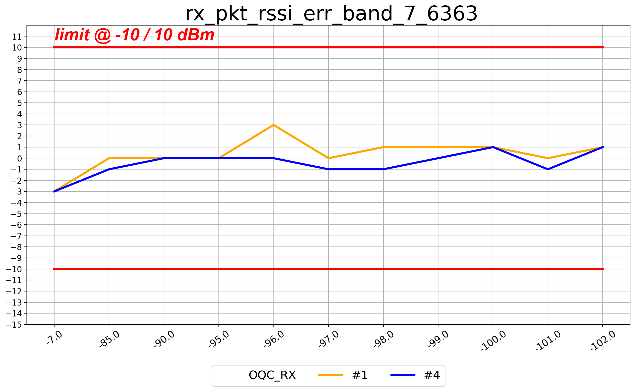
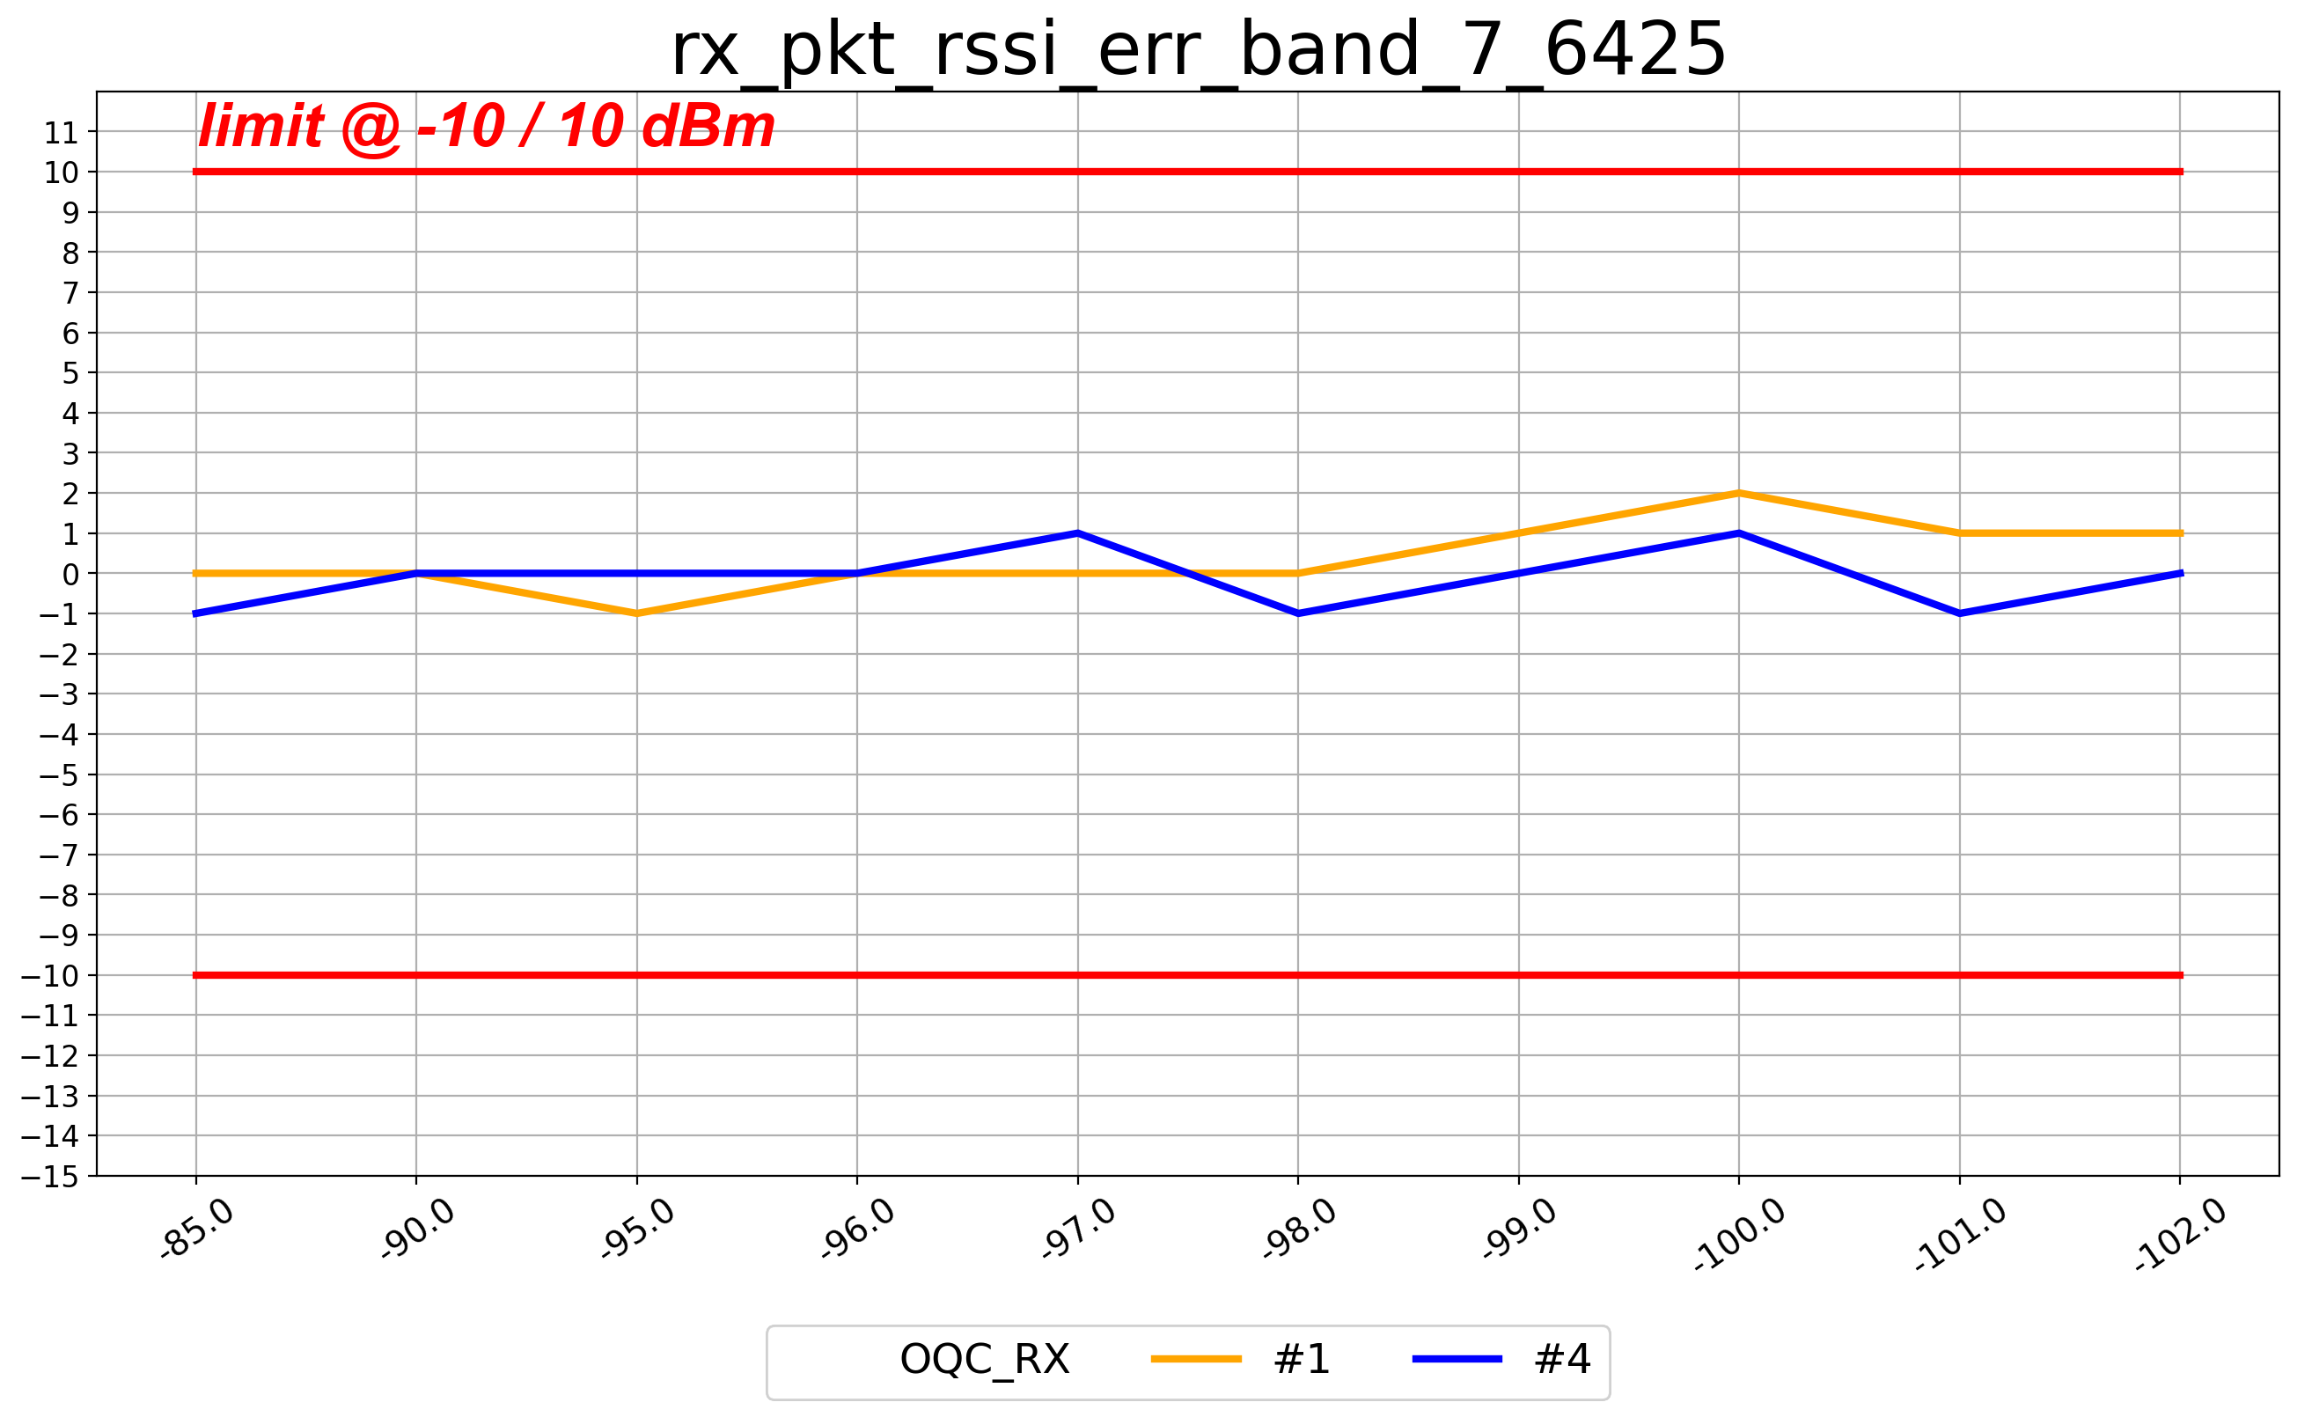
LE1M(rssi_err 30.8)_B7

Slide 12
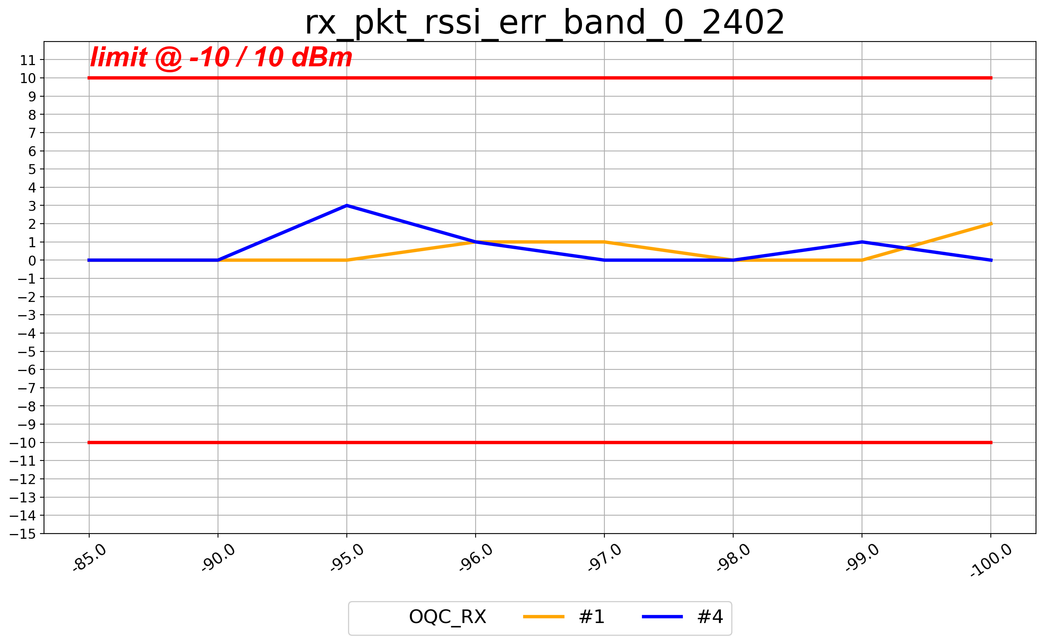
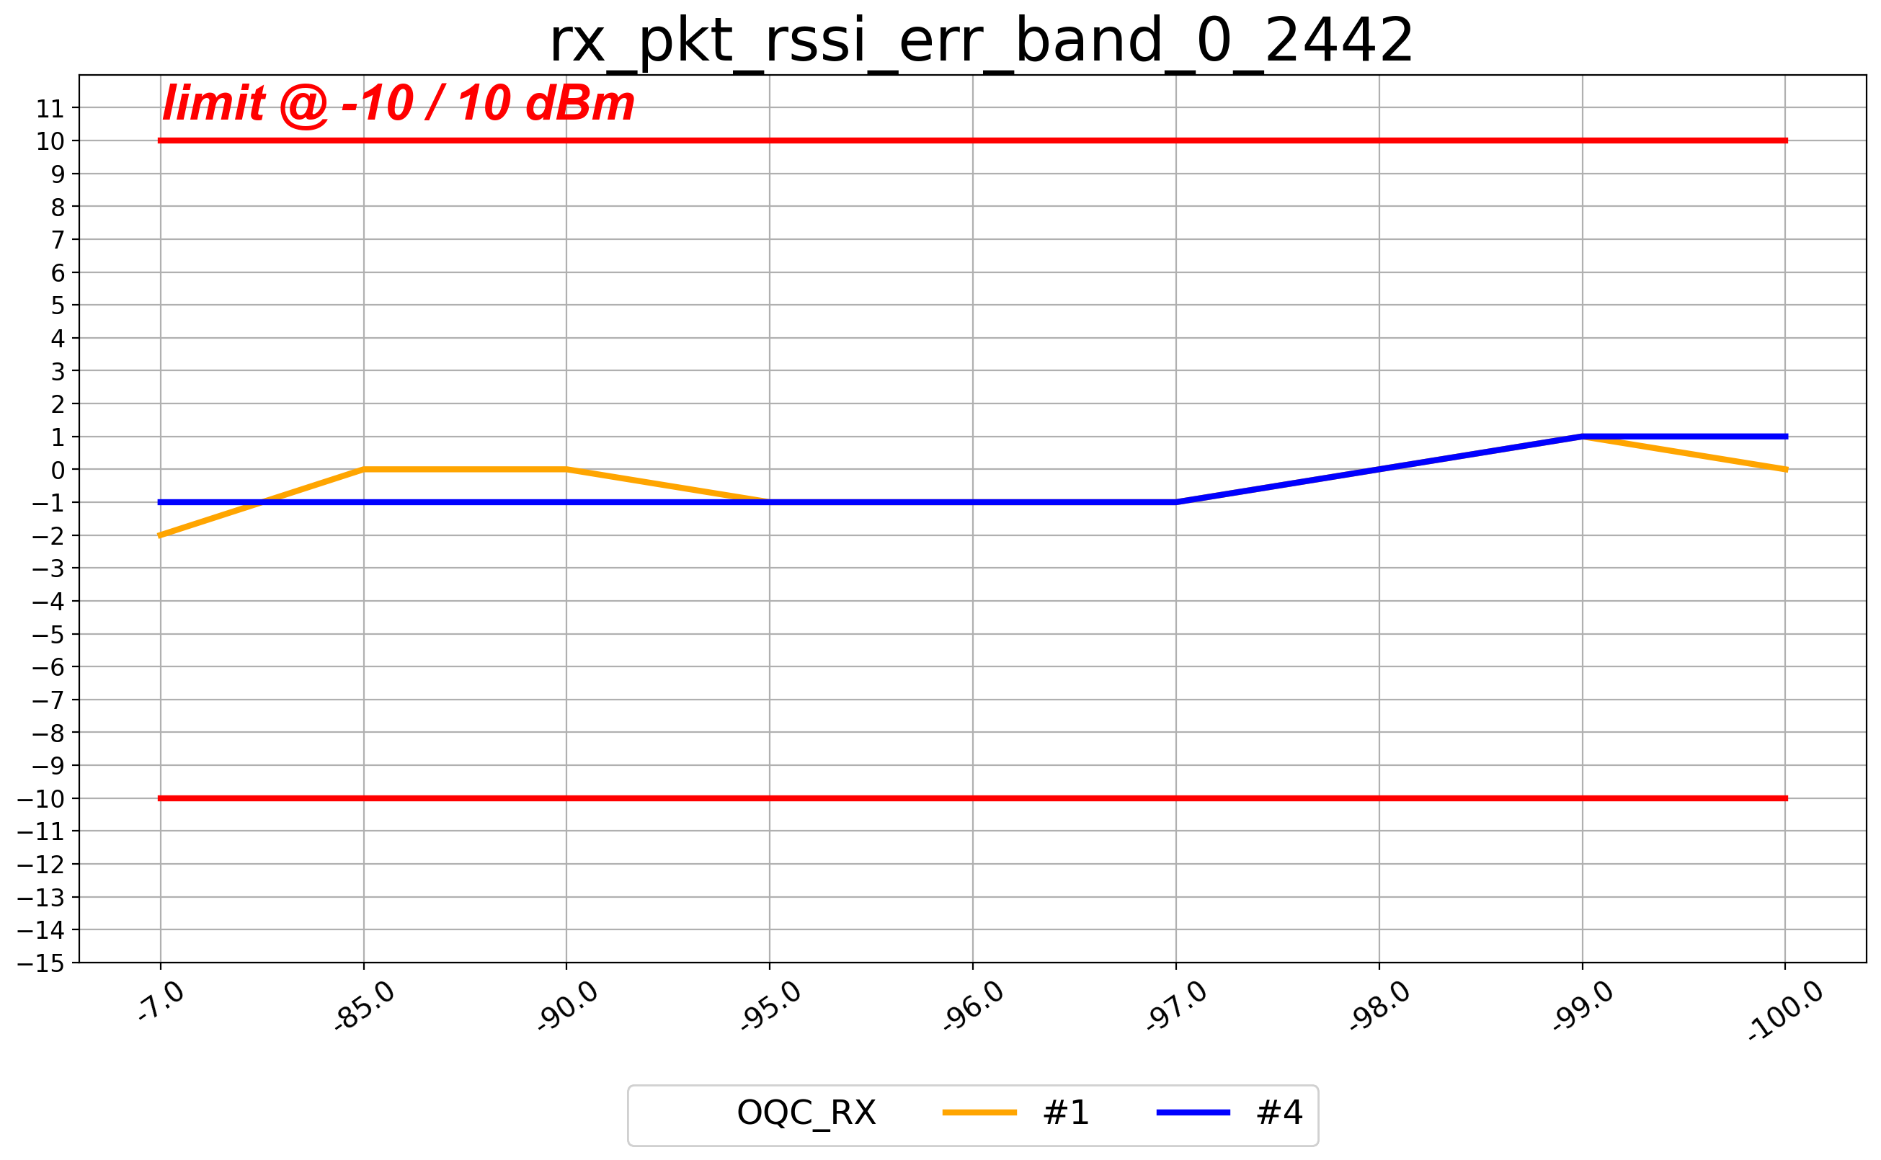
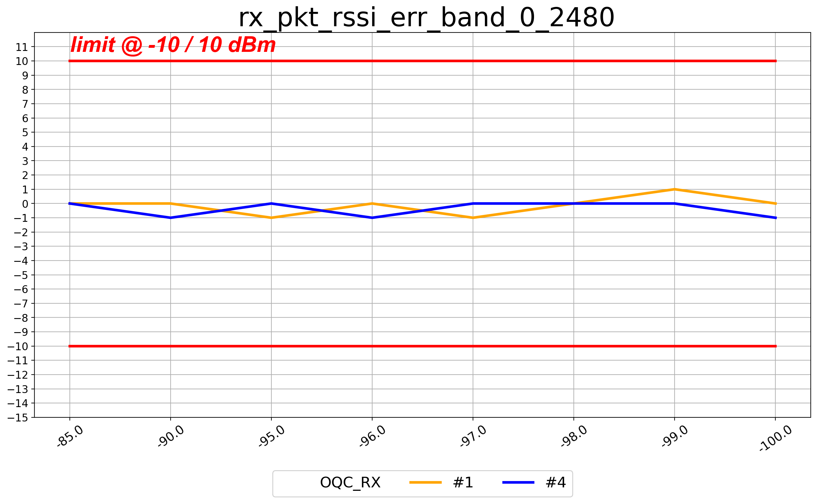
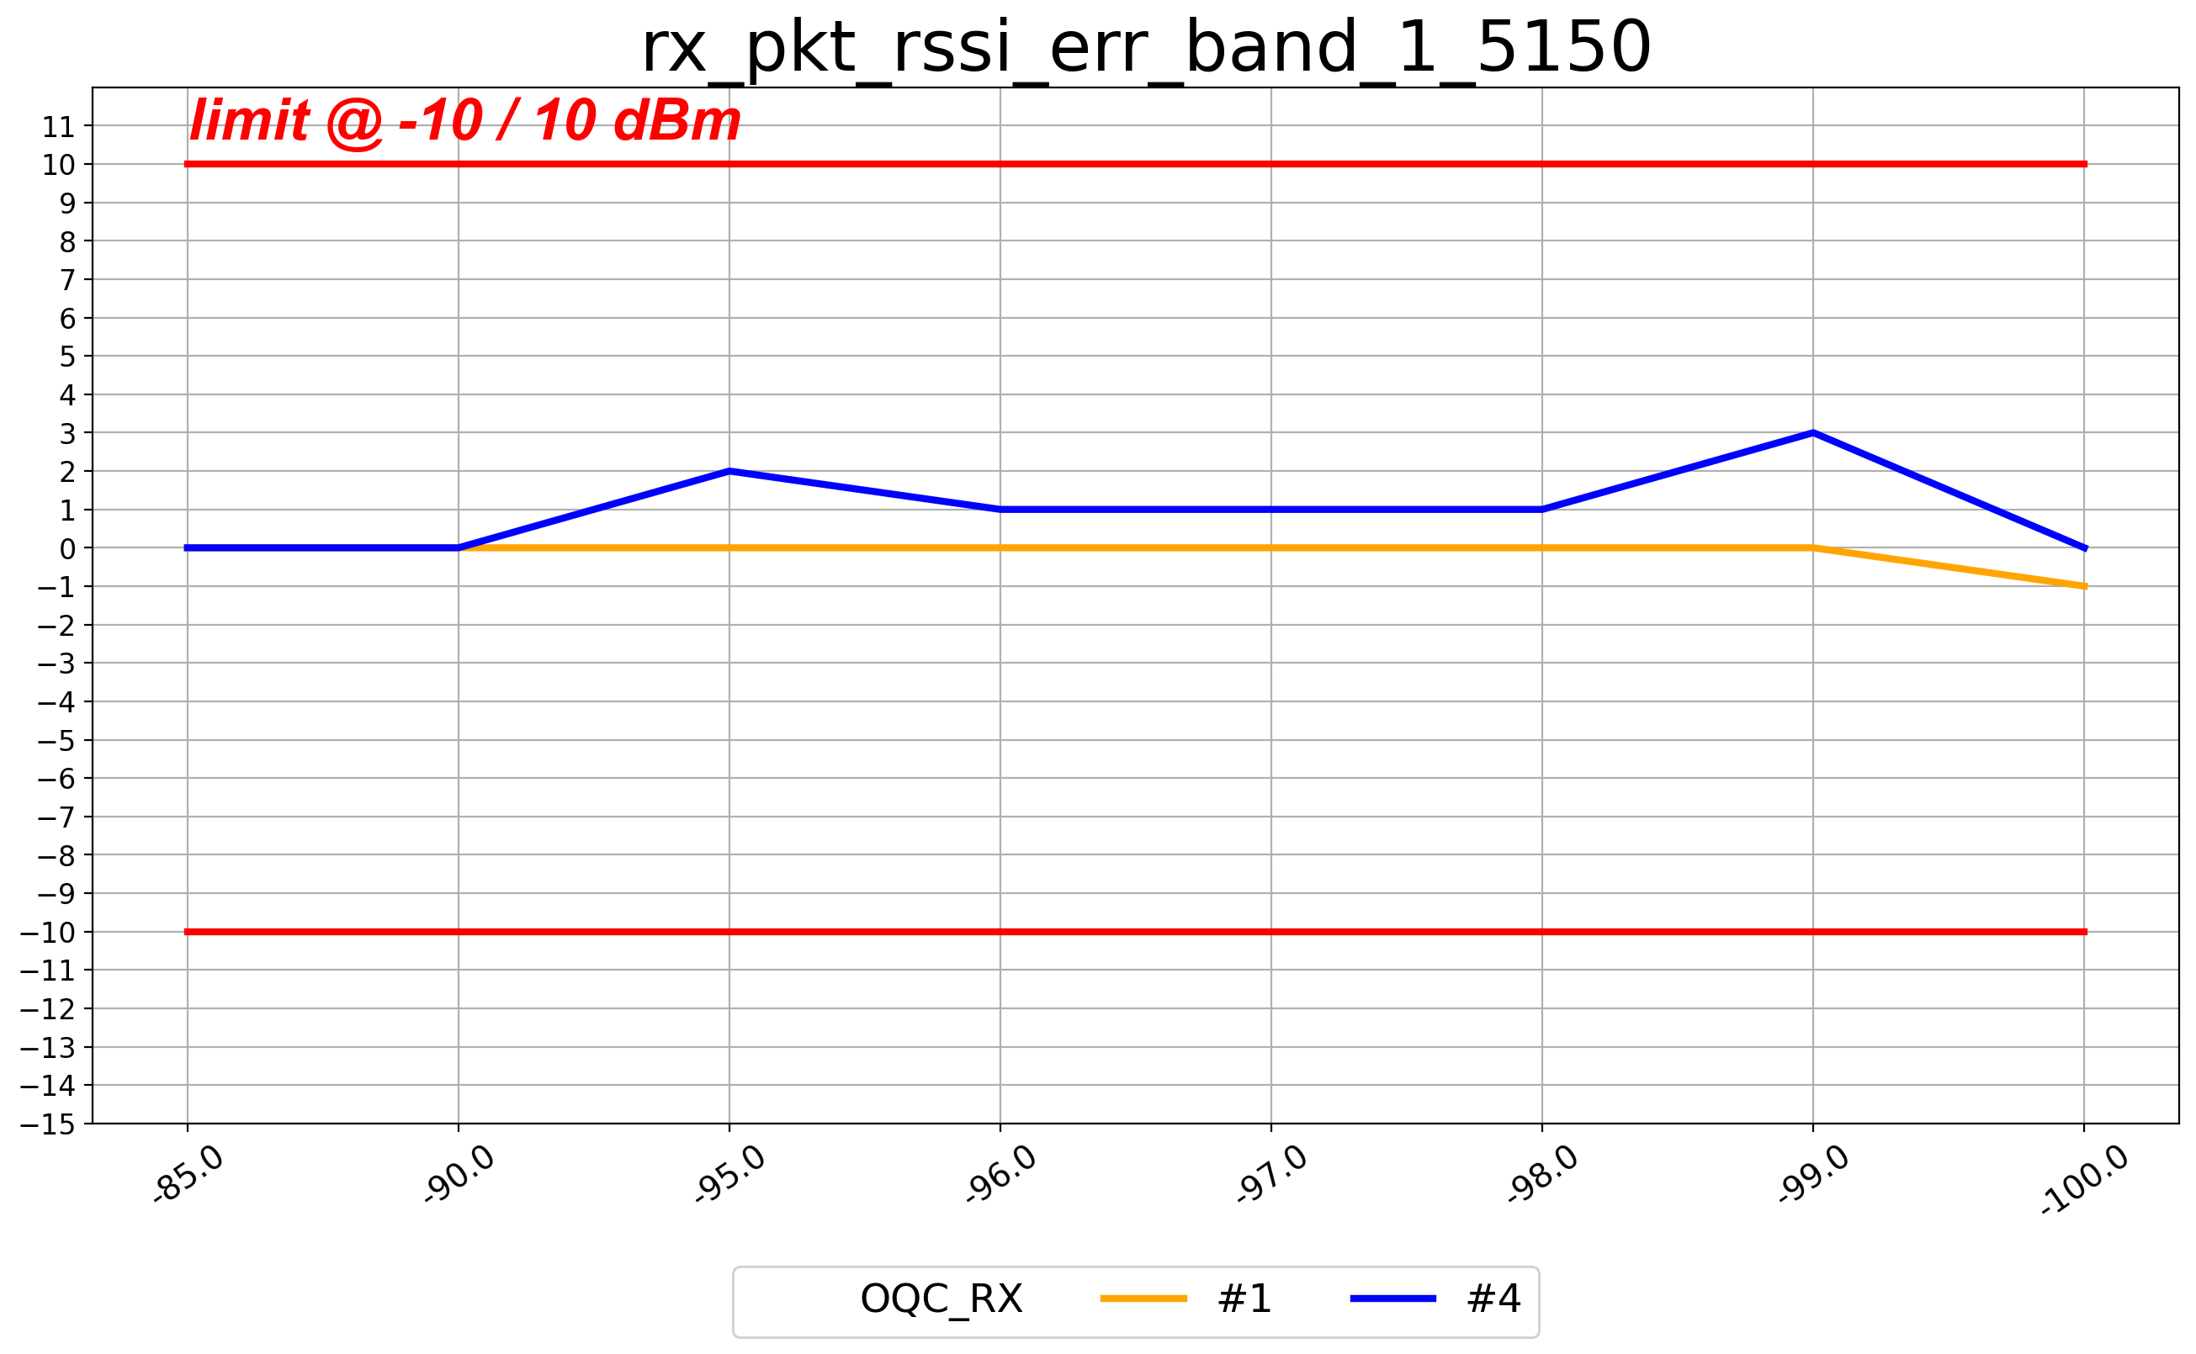
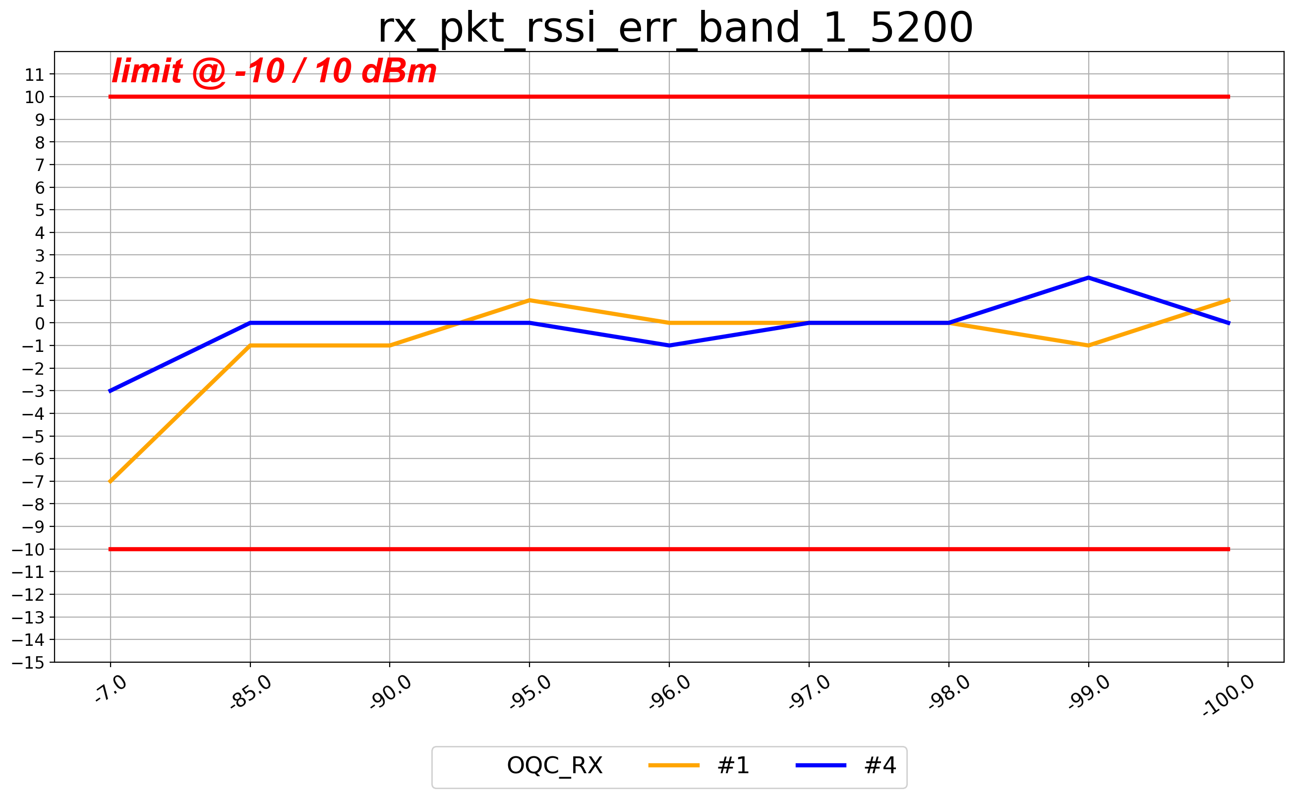
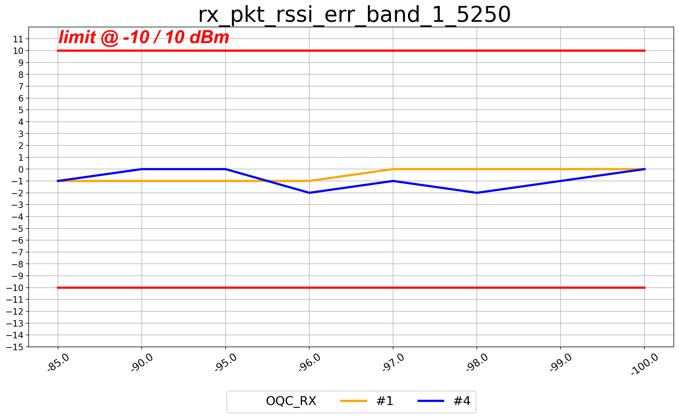
LE2M(rssi_err 30.8)_B0

Slide 13
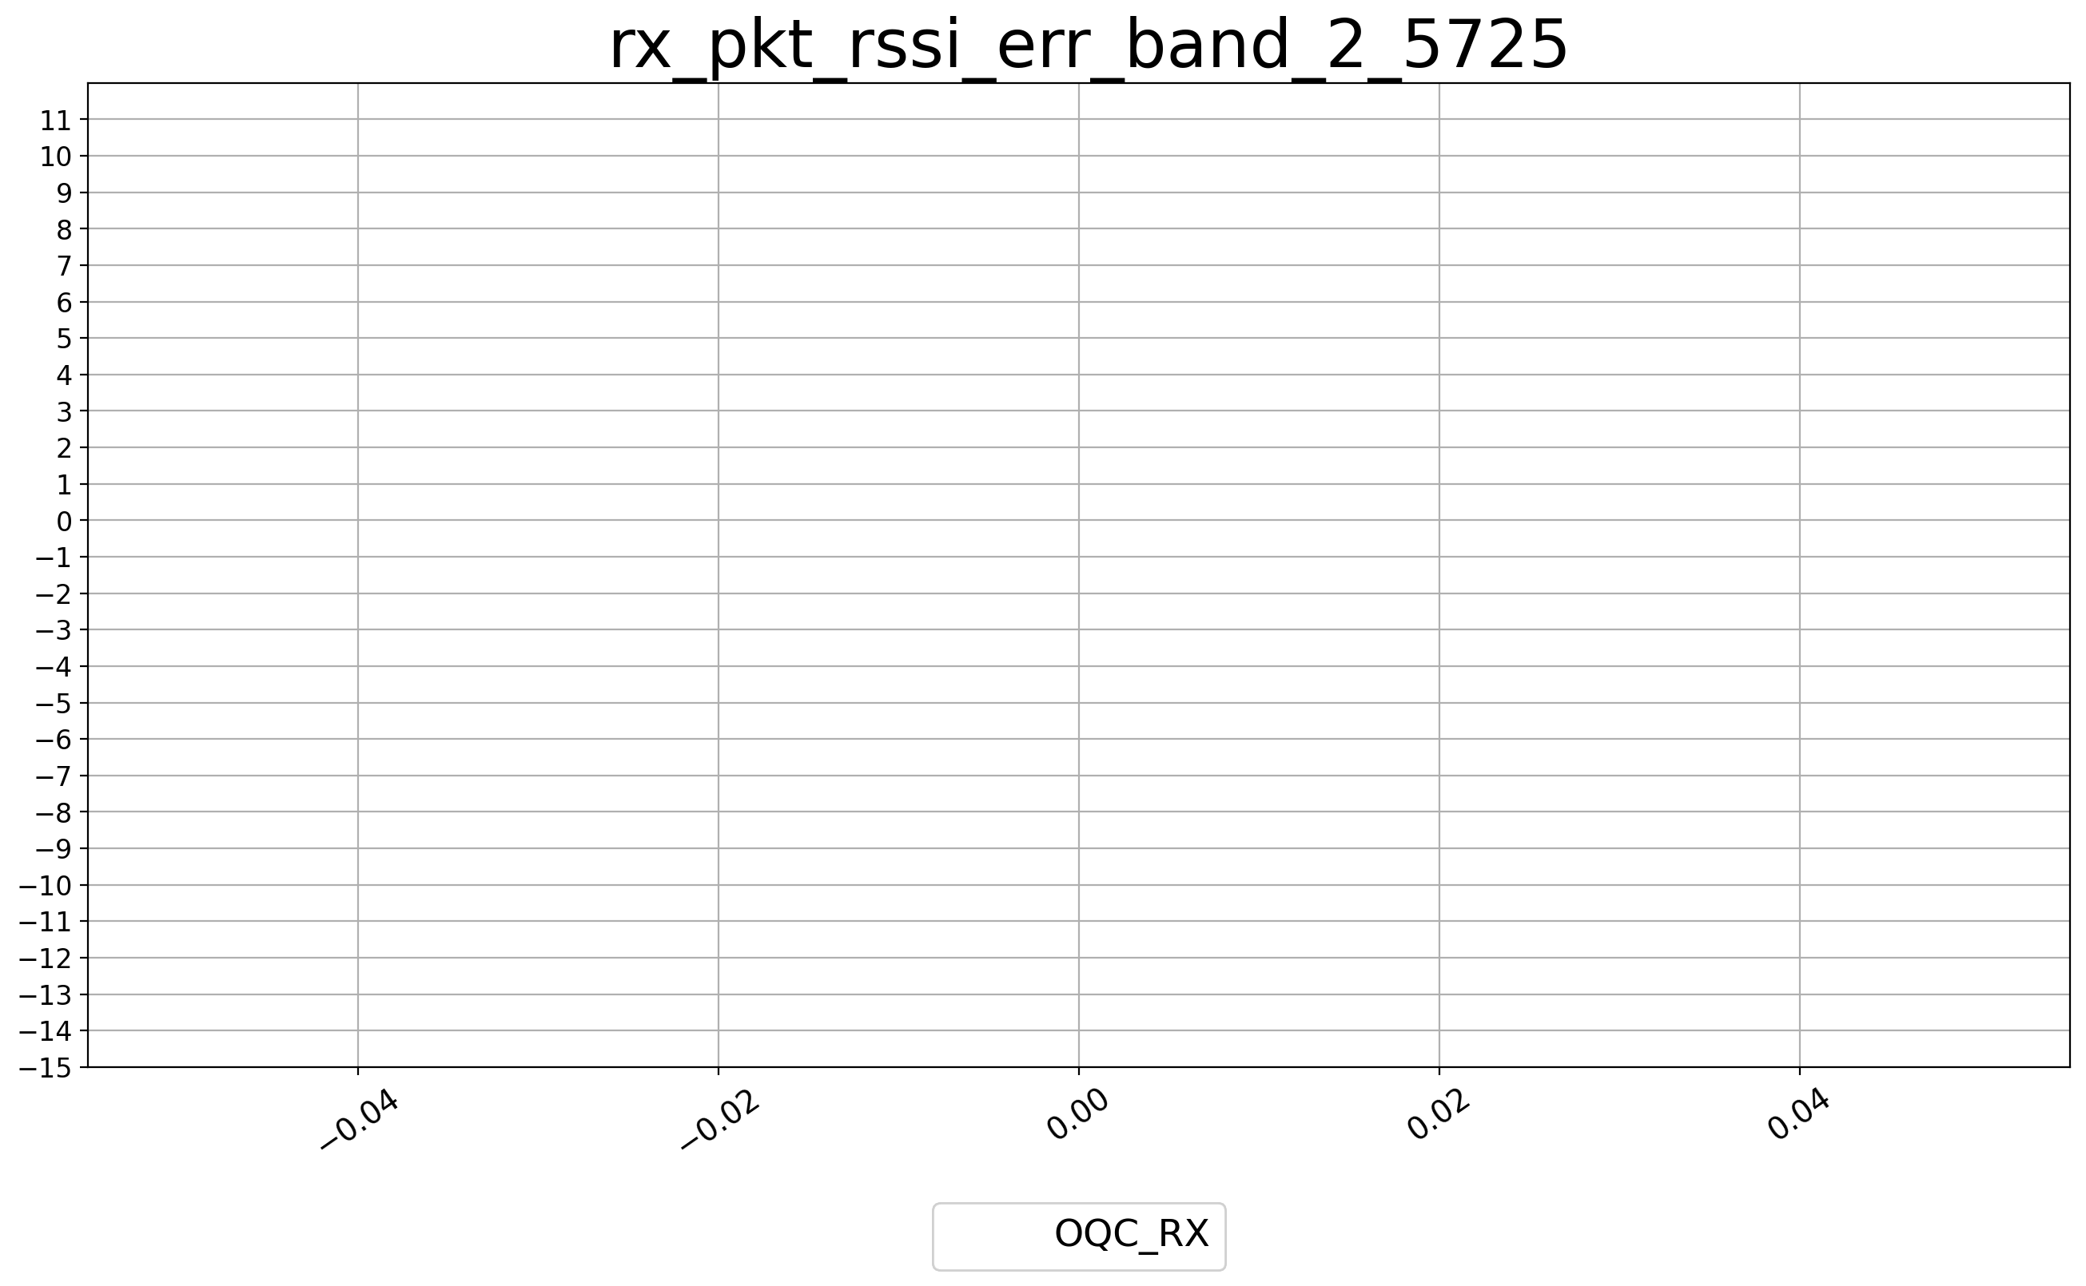
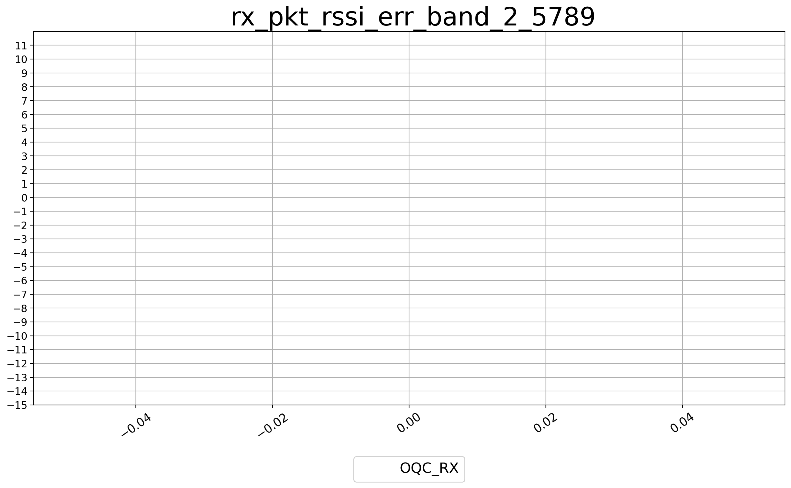
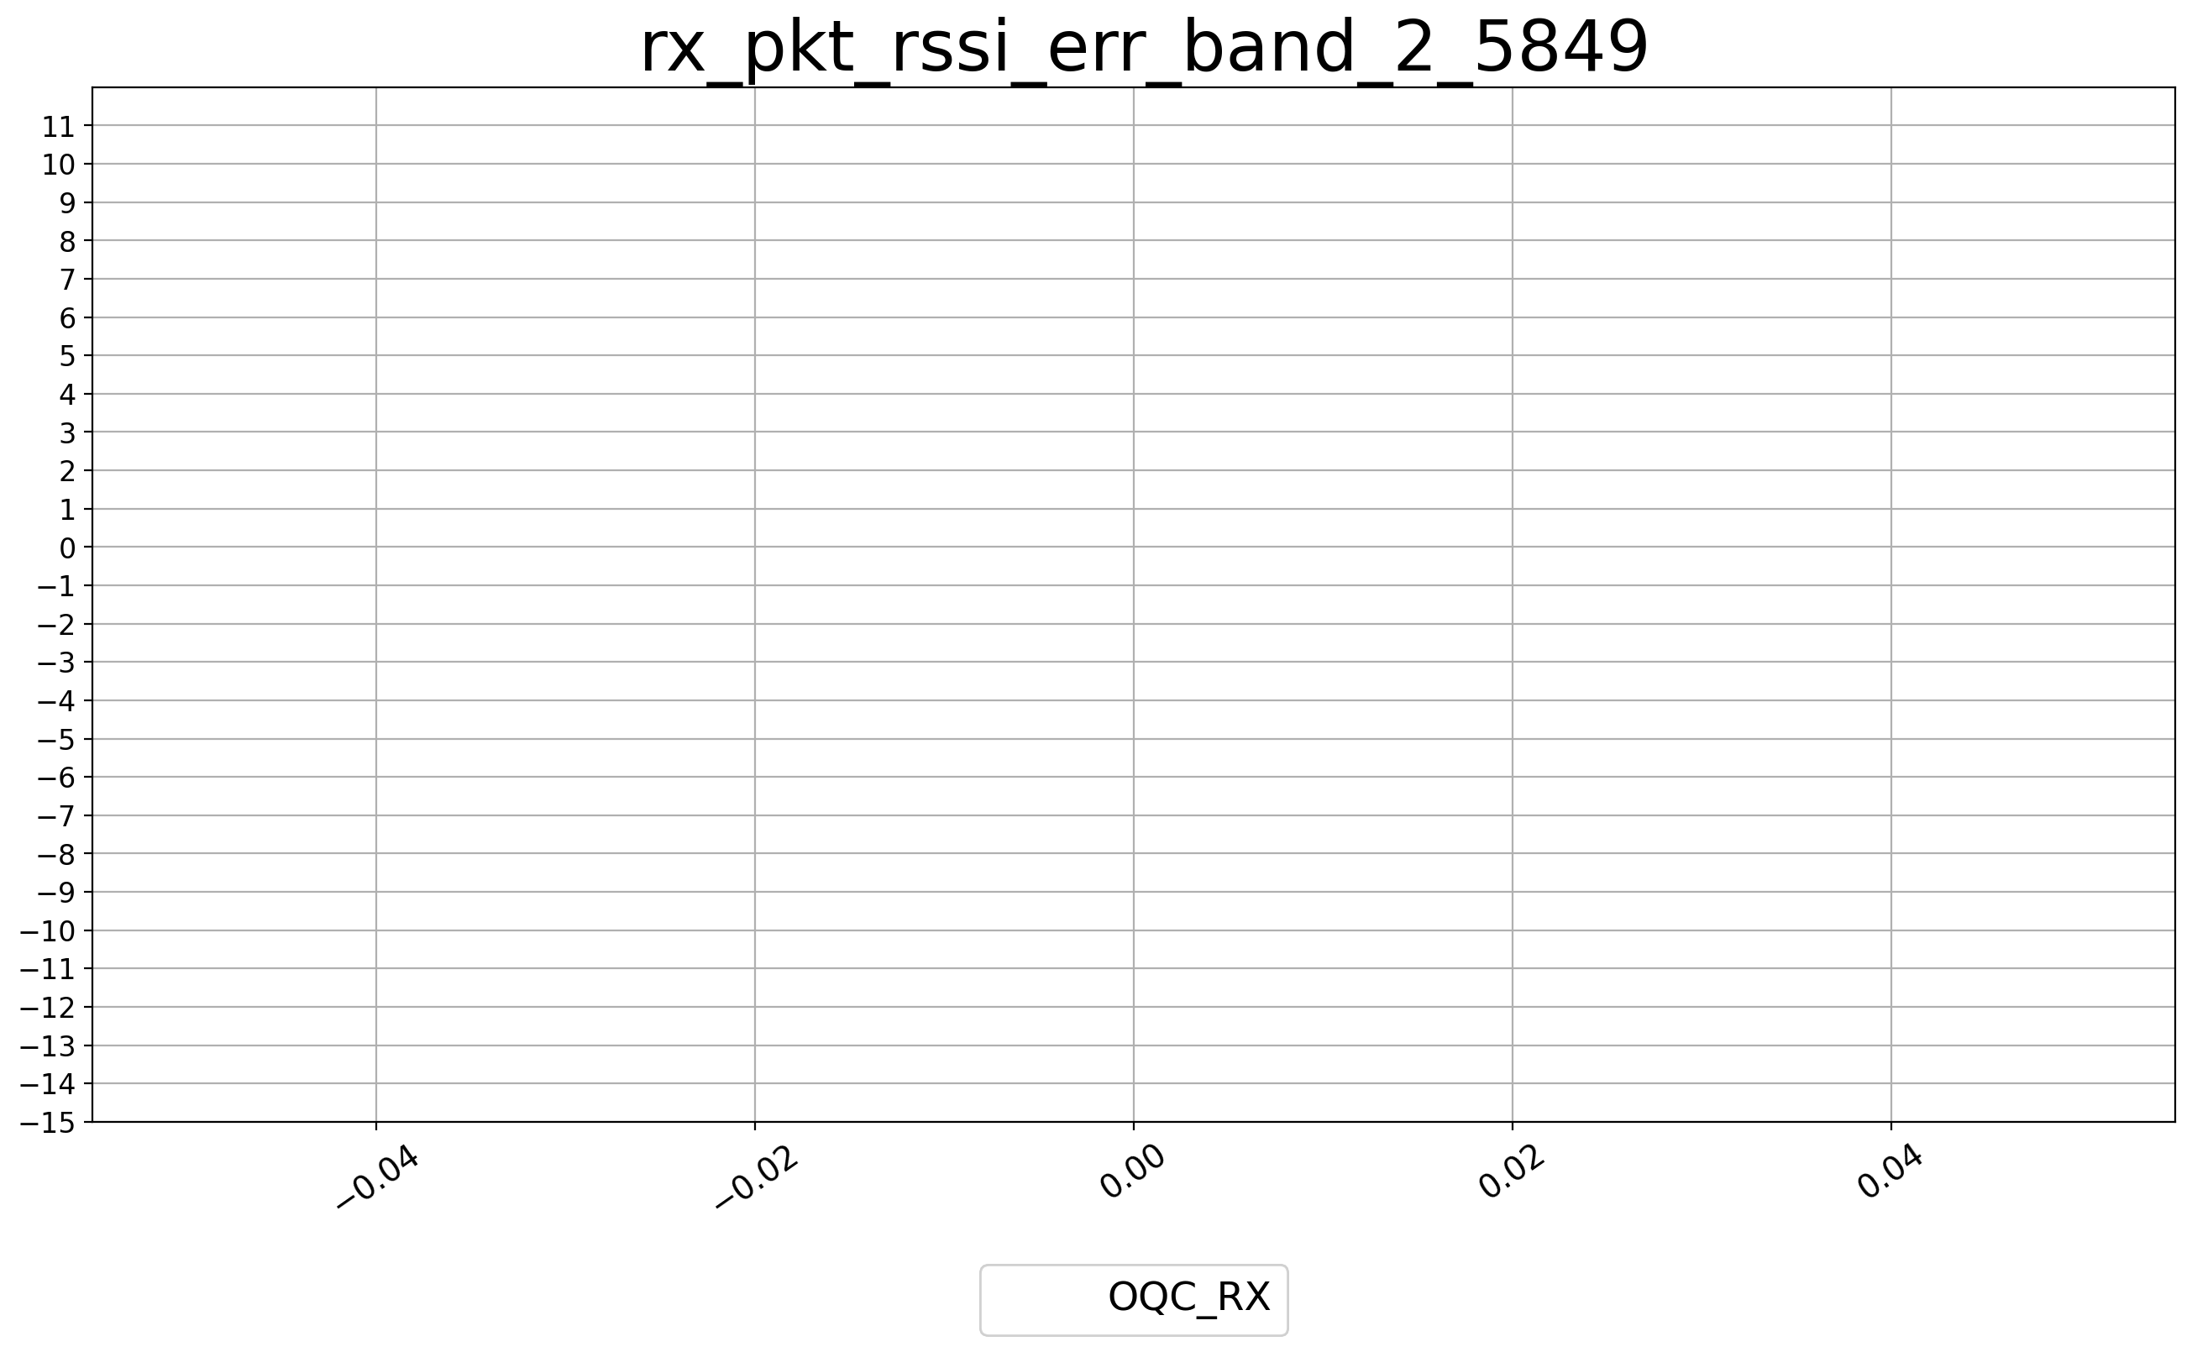



LE2M(rssi_err 30.8)_B2

Slide 14
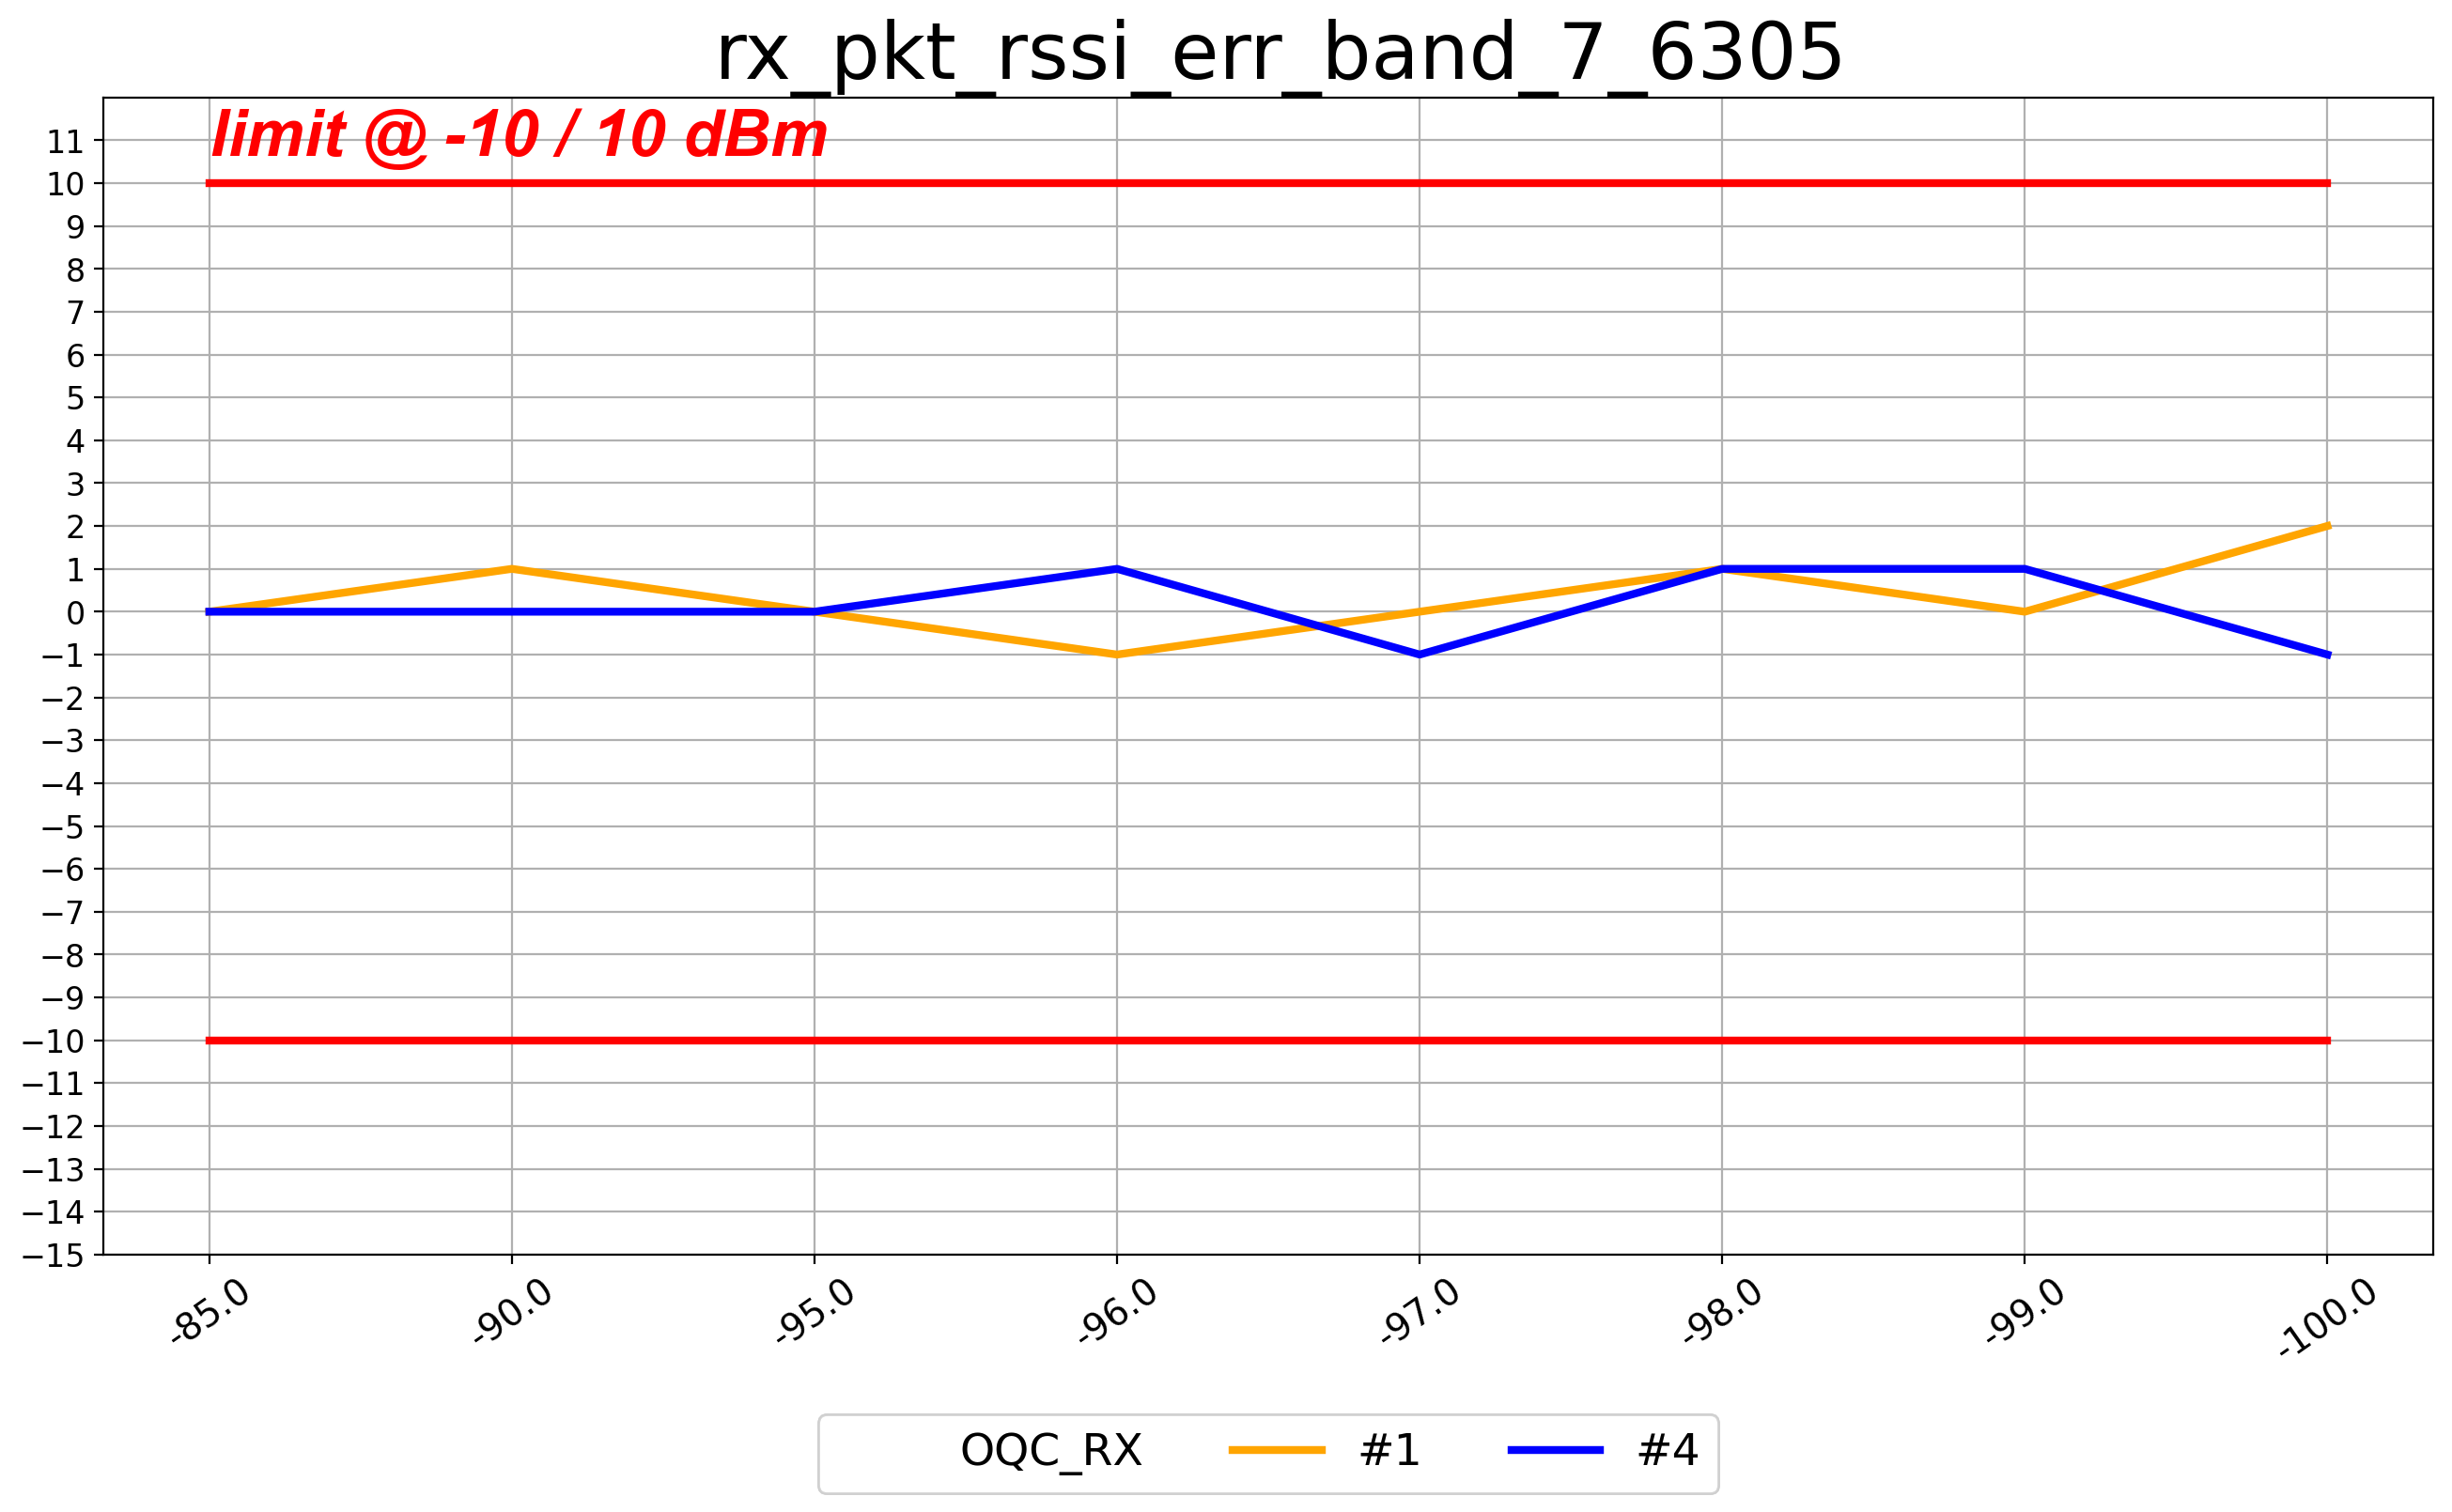


LE2M(rssi_err 30.8)_B7

Slide 15






4-DH5(rssi_err 10)_B0

Slide 16




4-DH5(rssi_err 10)_B2

Slide 17






4-DH5(rssi_err 10)_B5

Slide 18



4-DH5(rssi_err 10)_B7

Slide 19






8-DH5(rssi_err 10)_B0

Slide 20
8-DH5(rssi_err 10)_B2

Slide 21



8-DH5(rssi_err 10)_B7

Slide 22





4-HDRP(rssi_err 10)

Slide 23





8-HDRP(rssi_err 10)

Slide 24






DH5(BER 0.1)_B0

Slide 25






DH5(BER 0.1)_B2

Slide 26



DH5(BER 0.1)_B7

Slide 27

2-DH5(BER 0.01)_B0

Slide 28



3-DH5(BER 0.01)_B0

Slide 29






LE1M(per 30.8)_B0

Slide 30






LE1M(per 30.8)_B2

Slide 31



LE1M(per 30.8)_B7

Slide 32






LE2M(per 30.8)_B0

Slide 33






LE2M(per 30.8)_B2

Slide 34



LE2M(per 30.8)_B7

Slide 35






4-DH5(PER 10)_B0

Slide 36




4-DH5(PER 10)_B2

Slide 37






4-DH5(PER 10)_B5

Slide 38



4-DH5(PER 10)_B7

Slide 39






8-DH5(PER 10)_B0

Slide 40
8-DH5(PER 10)_B2

Slide 41



8-DH5(PER 10)_B7

Slide 42





4-HDRP(PER 10)

Slide 43



8-HDRP(PER 10)

